Slide 1
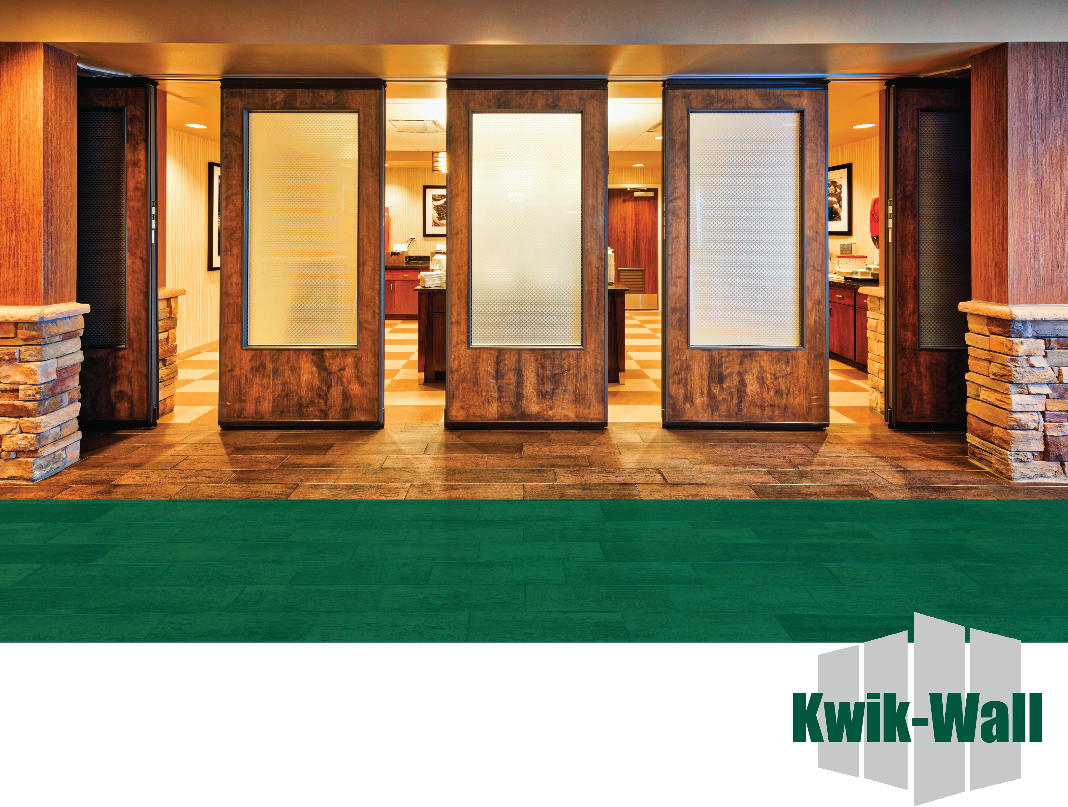
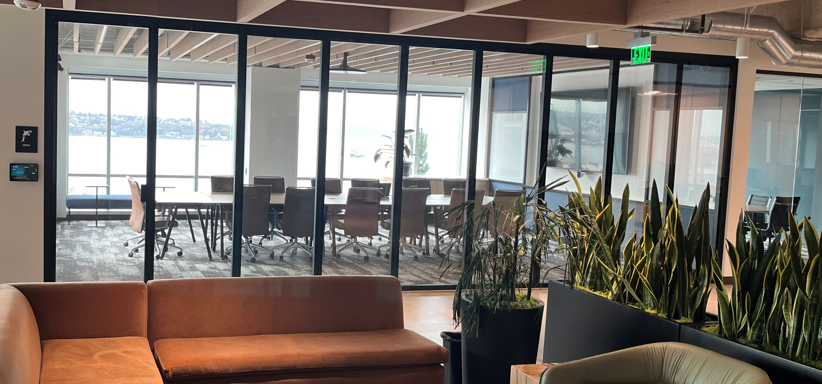

Acoustical Engineering & Applications of Movable Wall Systems
Program J-426

Slide 2


AIA CES Credit
Will be reported to AIA CES
Certificates available upon request
This course is registered with AIA CES for continuing professional education. As such, it does not include content that may be deemed or construed to be an approval or endorsement by the AIA of any material of construction or any method or manner of handling, using, distributing, or dealing in any material or product.
*Questions related to specific materials, methods, and services will be addressed at the conclusion of this presentation.

Slide 3

©Kwik-Wall Co. 2023
Copyright Materials
This presentation is protected by US and International Copyright laws.
Reproduction, distribution, display and use of the presentation without written permission of the speaker is prohibited.
© 2023

Slide 4



Course Objectives
Terminology: Codes and Specifications, such as ADA, ASTM
Acoustics and Applications
Types of Movable Wall Systems –LEED and WELLv2 and how they relate to movable wall systems
Case Studies

Slide 5
Three Key Concepts
Sound Control
Flexible Space Management
Sight Division

Slide 6

Sound Control
How is it measured?
Sound is measured in units known as decibels (db)
The higher the decibel number; the louder the sound.
Fact: Human ear cannot discern a 2 dB variance.

Slide 7

140 dB
130 dB
130 -140 dB Aircraft taking off
120 dB
120 -130 dB Rivet Hammer
Highly hazardous
110 dB
110 -120 dB Angle grinding
100 dB
100 -120 dB Chain Saw
90 dB
90 -100 dB Power Tools
Hazardous
80 - 90 dB Busy Restaurant
80 dB
70 - 80 dB City Street
70 dB
70 - 75 dB Loud Radio
Annoying, irritating,
speech masking
60 dB
50 - 60 dB Normal Conversation
50 dB
40 - 45 dB Quiet Office
40 dB
30 - 40 dB Quiet Bedroom
30 dB
Typical
noise
levels
20 dB
*Source: iosh
10 dB
0 dB
0 dB Threshold of hearing

Slide 8
ASTM STANDARDS
ASTM E-90 | “Standard Test Method for Laboratory Measurement of Airborne - Sound Transmission Loss of Building Partitions”
ASTM E-413 | NIC is Noise Isolation Class. NIC is a single number noise reduction rating of a partition or room where sound pressure level differentials are measured in 1/3 octave bands and compared with standard contours per ASTM E-413.
ASTM E-1414 | Standard Test Method for Airborne Sound Attenuation Between Rooms Sharing a Common Ceiling Plenum
ASTM E-336 | Standard Test Method for Measurement of Airborne Sound Attenuation between Rooms in Buildings. This is called an NIC test conducted per ASTM E 336. NIC is Noise Isolation Class.
ASTM C-522 | Standard Test Method for Airflow Resistance of Acoustical Materials
ASTM E-557 | “Architectural Application and Installation of Operable Partitions”
ASTM E-84 | Standard Test Method for surface burning characteristics of building materials
ASTM C 423 | “Standard Test Method for Sound Absorption and Sound Absorption Coefficients by the Reverberation Room Method”.)

Slide 9
Sound Control
How are Operable Walls acoustically rated?
Sound Transmission Class (STC).
The Sound Transmission Class (STC) is a single number rating system which measures the sound insulation value of a partition, door or window. The STC rating ranks the sound transmission loss or noise reduction performance of wall systems: i.e., the higher the STC rating the more effective the sound insulation.

Slide 10
Sound Control
How are Operable Walls acoustically rated?
ASTM is the American Society of Testing and Materials. The American Society of Testing and Materials is a technical organization which publishes acoustical consensus standards. The ASTM committee on environmental acoustics has established specific laboratory and field tests for evaluating the noise reduction or sound transmission loss of barriers such as partitions.

Slide 11
Sound Control
How are Operable Walls acoustically rated?
Question - What is ASTM E-90?
Answer - ASTM E-90 is the “Standard Test Method for Laboratory Measurement of Airborne - Sound Transmission Loss of Building Partitions” this ASTM testing procedure covers the laboratory measurements of airborne-sound transmission loss of building partitions such as walls, windows and other space dividing elements.

Slide 12
Sound Control
How are Operable Walls acoustically rated?
Question - What is ASTM E-413
Answer - The “Classification for Rating Sound Insulation” provides a method for calculating single number acoustical ratings using data from laboratory measurements of the sound transmission loss of partitions such as ASTM E-90. The single number rating, called the Sound Transmission Class (STC), permits specifiers to rank the sound transmission loss or noise reduction performance of wall systems.

Slide 13
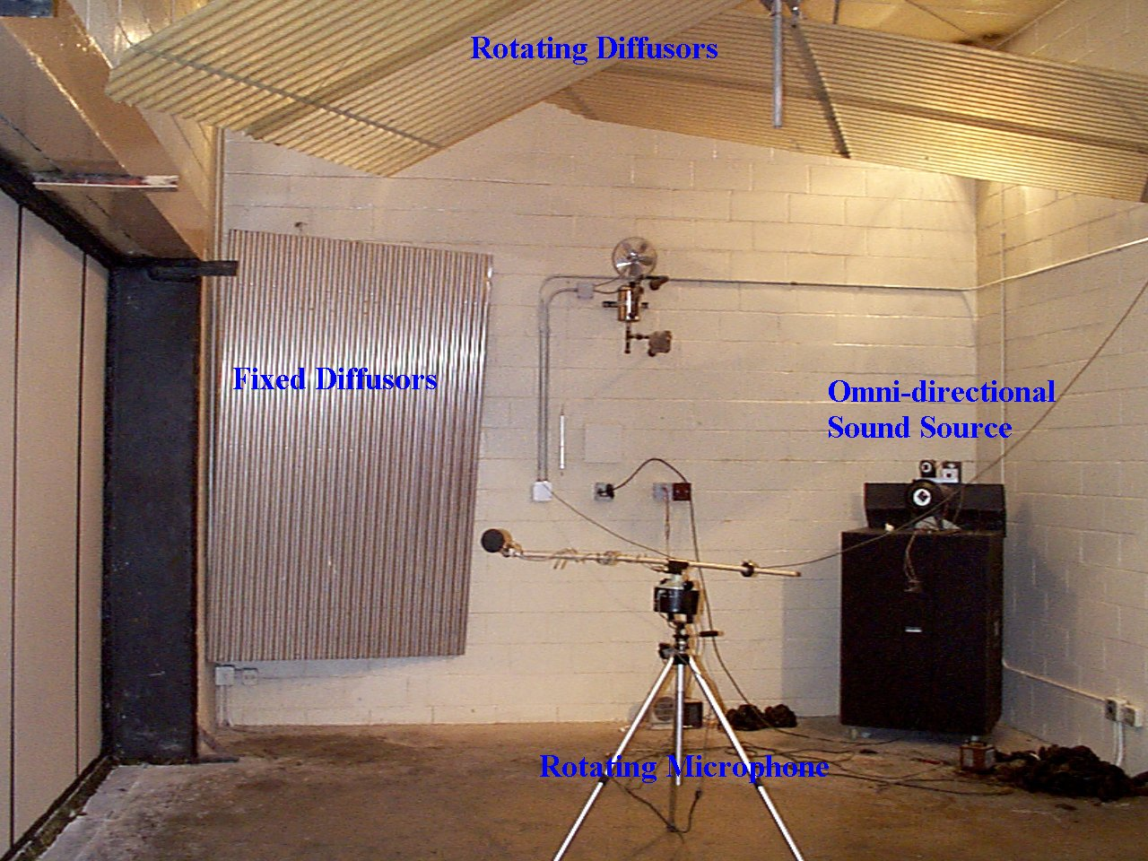
Sound Control
How are Operable Walls acoustically rated?

Slide 14
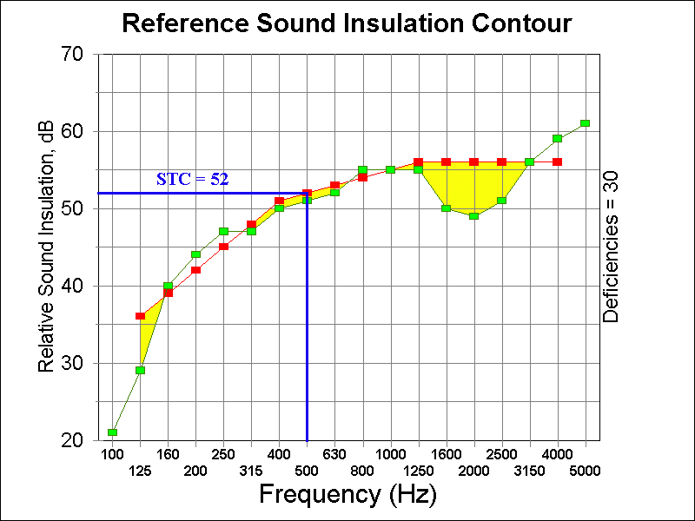
Sound Control
SOUND CONTOUR GRAPH

Slide 15
Comparison Chart
Now that we know what an STC rating is and how it is determined, how does it relate to other building materials and our own senses about sound?
Sound Control
A percentage is transmitted
A sound is emitted
A percentage is absorbed
Source Room
Sound Pressure Level 80 dB
Receiving Room
Sound Pressure Level 41 dB
A percentage is reflected
STC 39 Door

Slide 16
Sound Control
Question – What are the effects in the change of decibels?
Answer – The following chart give us an understanding of how the change in decibels is perceived by the human ear.
Note: Loudness is measured in “decibels” (db). The dynamic range of human hearing is from 0 to 120 decibels.

Slide 17
Sound Control
Decibel Change in Apparent Loudness
1 dB Not discernable by the human ear
3 db Just perceptible.
5 db Clearly noticeable.
10 db Twice as loud (or 1/2).
15 db Three times as loud
20 db Four times as loud (or 1/4).
Source: Architectural Graphic Standards

Slide 18
Sound Control
Question – What types of materials and construction methods stop sound?
Answer - As you could see from the previous slides, weight mass and space separation help to stop sound waves from being transferred. The heavier the material and the thicker the wall the better the sound reduction.

Slide 19
Sound Control
Question - Are field sound tests sometimes required?
Answer - Yes. This is called an NIC test conducted per ASTM E 336. NIC is Noise Isolation Class. NIC is a single number noise reduction rating of a partition or room where sound pressure level differentials are measured in 1/3 octave bands and compared with standard contours per ASTM E-413.

Slide 20
Sound Control
Question - Is the NIC test the field measurement of the movable wall system or the room the movable wall system is installed in?
Answer - Both. Because of this, movable wall systems must be installed per ASTM E-557.

Slide 21
Sound Control
Question - What is ASTM E-557?
Answer - The “Architectural Application and Installation of Operable Partitions” defines how to prepare, and to some extent design, the perimeter opening of the movable wall system. This standard covers sound leaks, flanking paths and overhead structural support and floor level conditions.

Slide 22
Flanking Paths
Question – What do you mean by flanking paths?
Answer – Leaks in the surrounding construction of a movable wall thru which sound will travel.

Slide 23
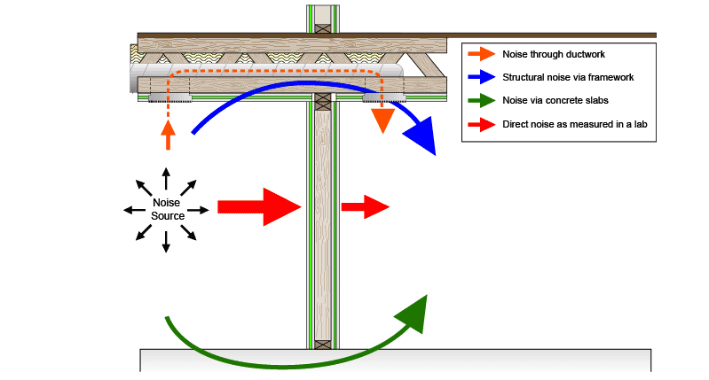
Flanking Paths

Slide 24




Which STC to use?
VOLUME OF
BODIES
TYPE OF
EVENTS
LEVEL OF
NOISE
TYPE OF
FURNITURE

Slide 25
Types of Movable Walls
Operable Wall
A suspended wall from an overhead track system which allows for easy movement of the panels from their storage location(s) to installed position(s).
Movable Glass Wall
For uninterrupted visual continuity across your interior space. A suspended glass wall from an overhead track system which allows for easy movement of the panels from their storage location(s) to installed position(s). Can be floor supported as well as top supported.
Accordion Partition
A suspended wall from an overhead track system, featuring a pantograph hinge design.

Slide 26
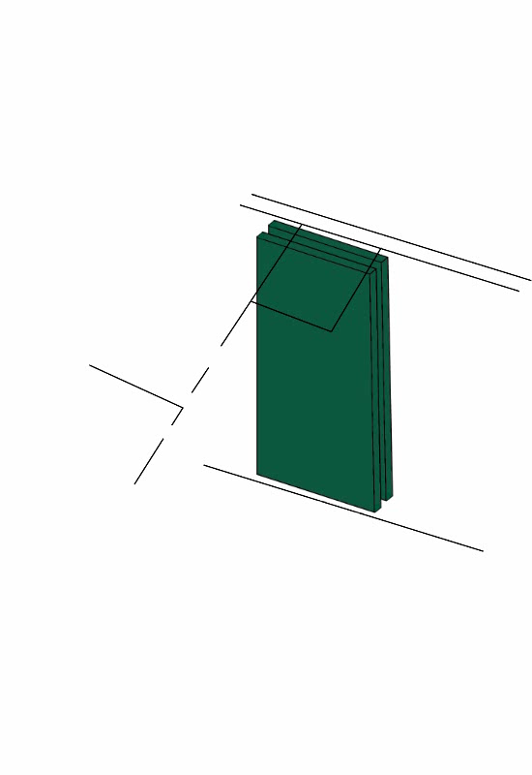
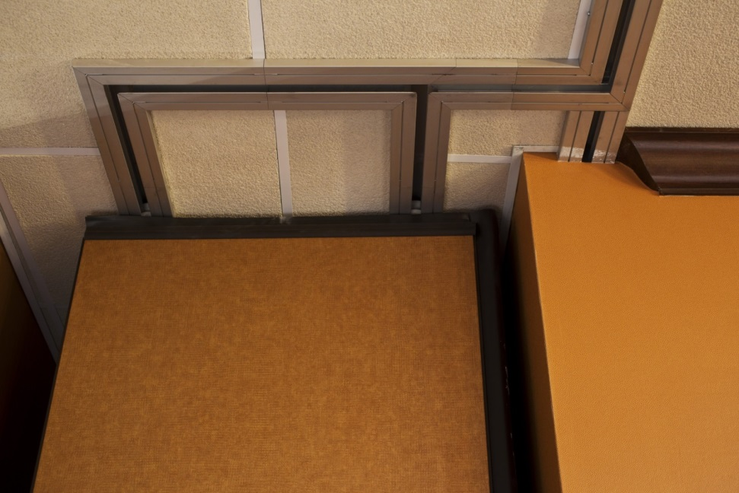
Operable Partition Systems
MULTI-DIRECTIONAL TRACK SYSTEM
TRACK SYSTEM: Multi-Directional Featuring 90⁰ Square Corner Intersections
STACK ARRANGEMENTS: Parallel, Perpendicular & Remote.

Slide 27
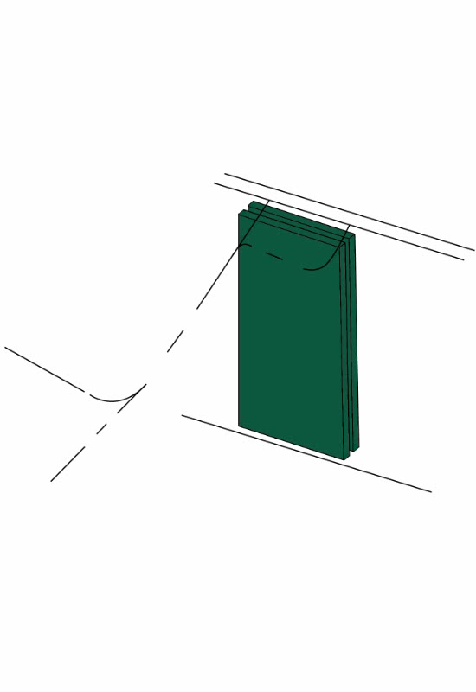
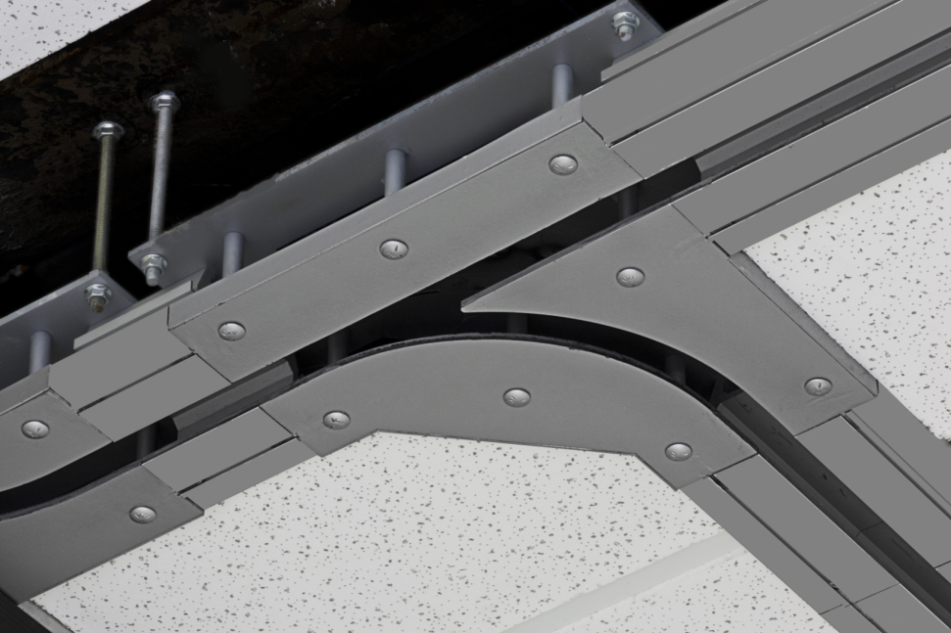
Operable Partition Systems
MULTI-DIRECTIONAL TRACK SYSTEM
TRACK SYSTEM: Curve & Diverter Featuring Pre-Programmed Radius Intersections
STACK ARRANGEMENTS: Parallel, Perpendicular & Remote.

Slide 28
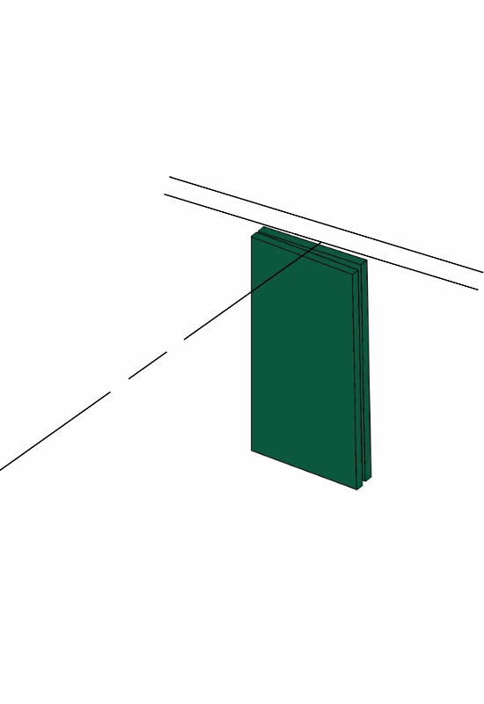
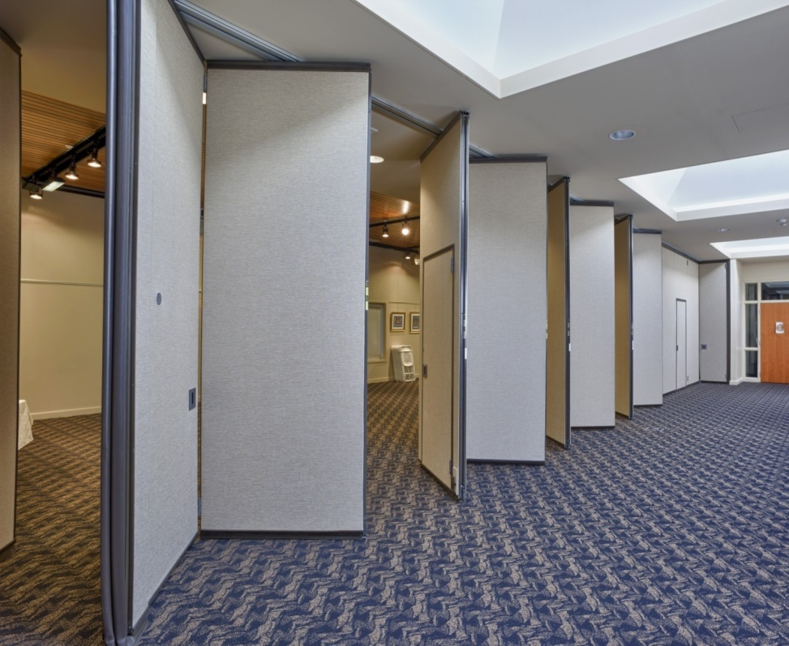
Operable Partition Systems
HINGED-PAIRED PANELS
CENTERLINE STACKING
TRACK SYSTEM: Straight run.
STACK ARRANGEMENT: Centered at one or both ends.

Slide 29
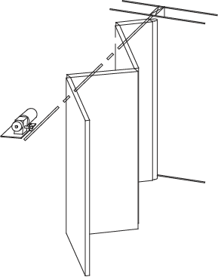
Operable Partition Systems
CONTINUOUSLY-HINGED ELECTRIC

Slide 30
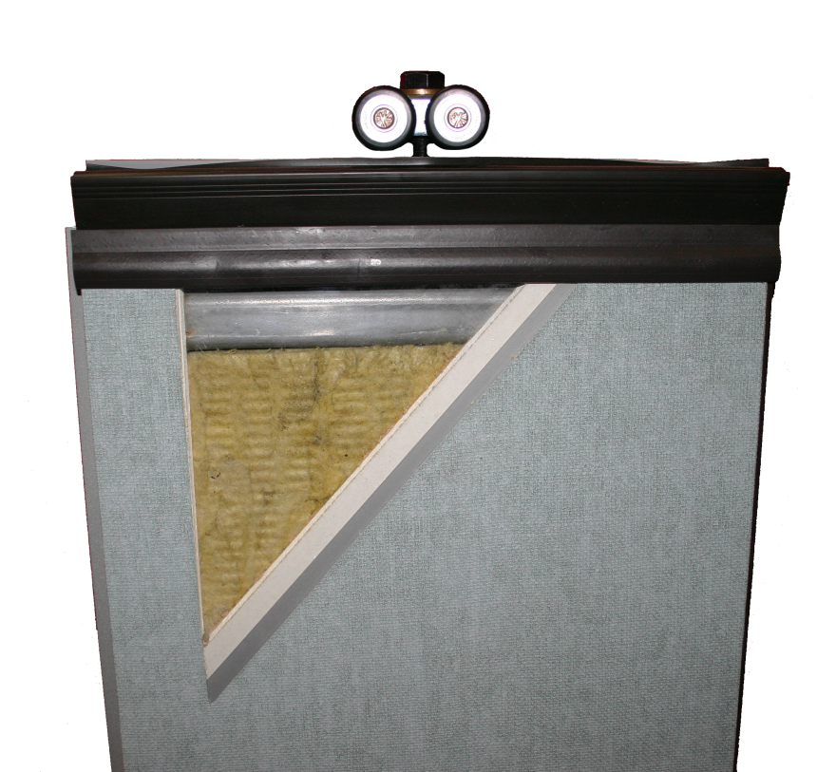
What’s on the inside?
WELDED STEEL FRAMES
STEEL CORNER GUSSETS
STEEL SKIN / ACOUSTIC SUBSTRATE
PANEL WIDTH < 4’-0” [1.22 M]
PANEL THICKNESS 3” OR 4” [76.2 MM – 102 MM]

Slide 31
Acoustical Ratings
4” THICK FRAMES
Steel frame with steel face has STC ratings ranging from 46 to 56.
Steel frame with acoustical face has STC ratings ranging from 43 to 50.
3” THICK FRAMES
Steel frame with steel face has STC ratings ranging from 49 to 51.
Steel frame with acoustical face has STC ratings ranging from 42 to 50.

Slide 32
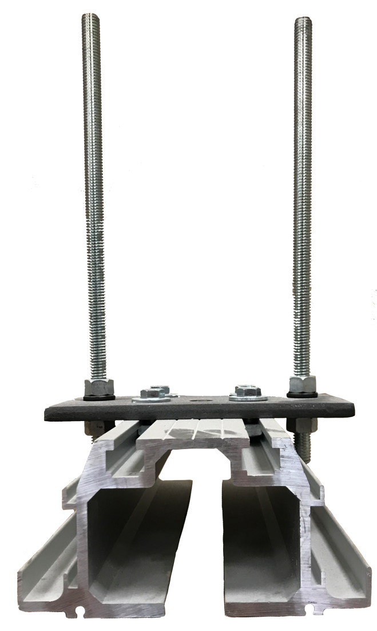
Support System
Direct Mount (not shown)
Wood header
Lag screw with flat washer
Drop Rod
Structural support
3/8” all thread hanger rods
Drop rod track bracket

Slide 33
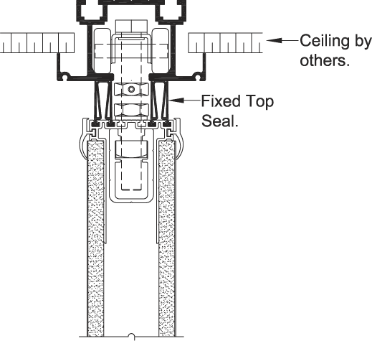
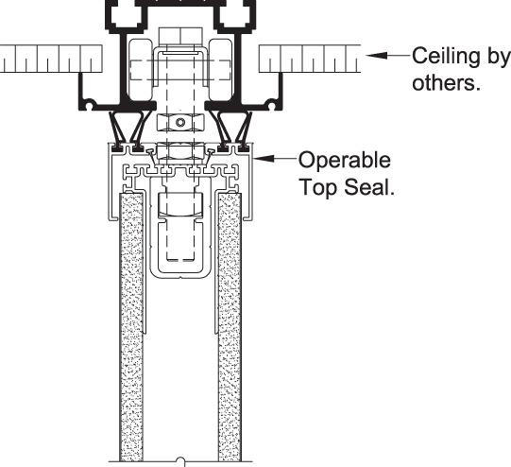
Top Seals

Slide 34
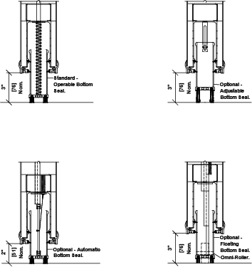
Bottom Seals
OPERABLE
An edge activated seal using a removable wrench. Seal provides 2”[50.8] of nominal travel.
ADJUSTABLE
Consists of field adjustable continuous-contact vinyl sweep seals with 2” [50.8] nominal height and ¾ [19] of adjustment.
AUTOMATIC
Self-activated seals that provide 2” [50.8] of nominal travel.

Slide 35
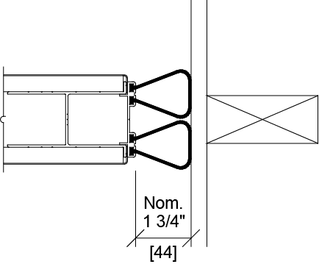
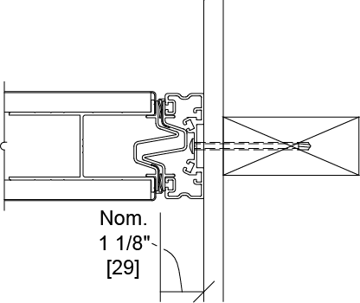
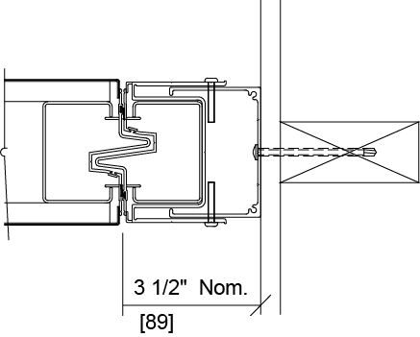
Initial Closures
BULB SEAL
FIXED STARTER JAMB
ADJUSTABLE STARTER JAMB

Slide 36
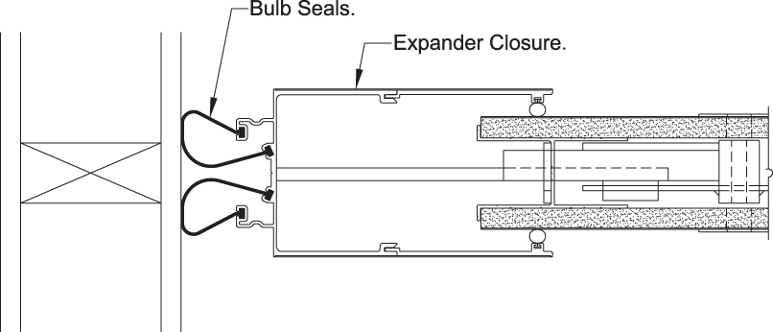
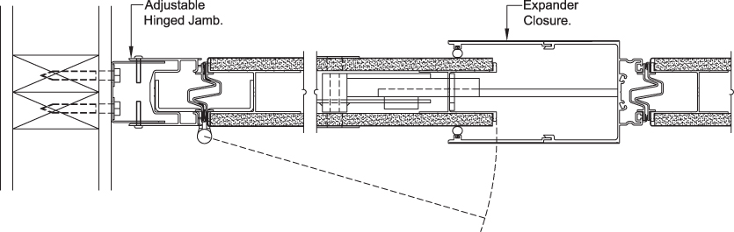
Final Closures
EXPANDER PANEL
HINGED PANEL

Slide 37
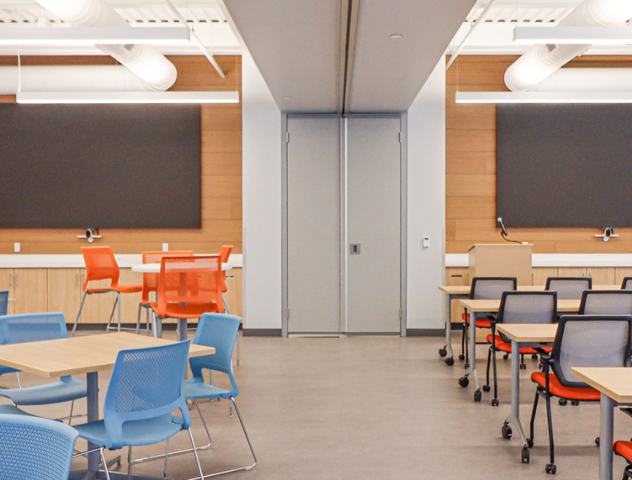
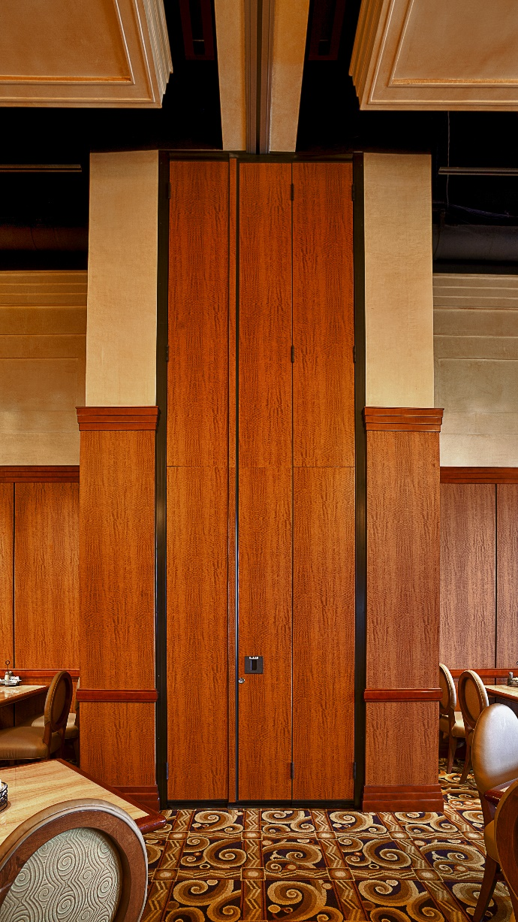
Pocket Doors

Slide 38
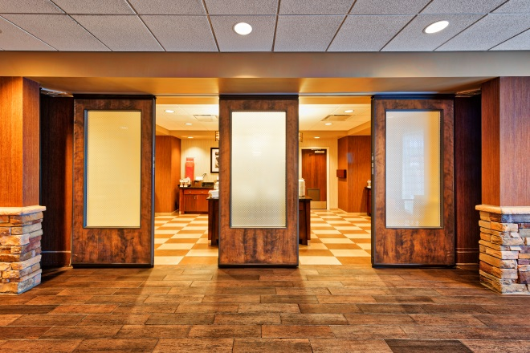
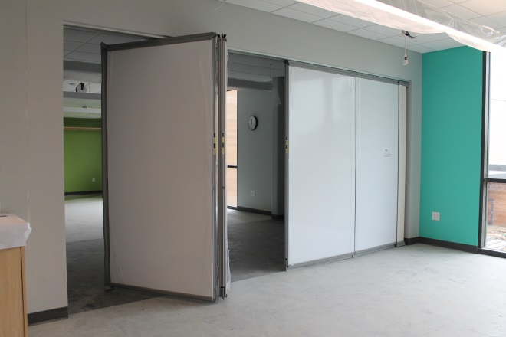
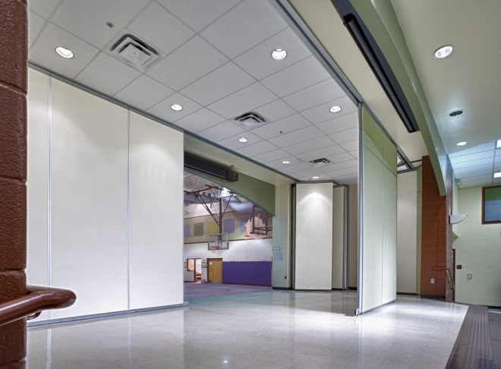
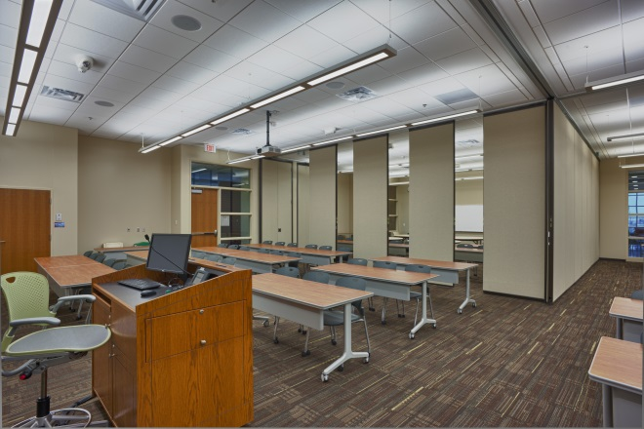
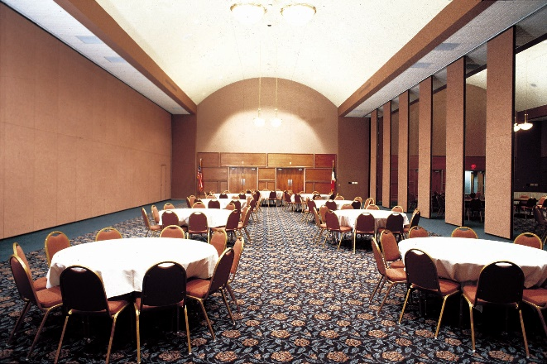
Finish Materials
Wood Veneer
LCS Board
Vinyl
Fabric
Carpet

Slide 39
Finish Materials
N.R.C. – Noise Reduction Coefficient.
Arithmetic average of the sound absorption coefficients in the octave bands centered at 250 Hz, 500 Hz, 1000 Hz, and 2000 Hz. (Refer to ASTM C 423. The “Standard Test Method for Sound Absorption and Sound Absorption Coefficients by the Reverberation Room Method”.)

Slide 40

Smoke & Flame
ASTM E 84 – Standard Test Method for surface burning characteristics of building materials.
FIRE RATING = 0 TO 25
(CLASS A FLAME SPREAD RATING)
SMOKE DEVELOPMENT = 0 TO 50

Slide 41
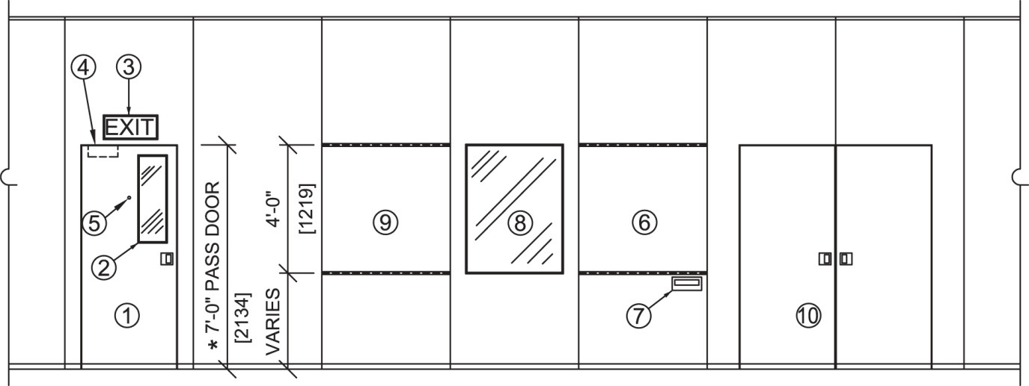
Additional Options
Pass Door
Pass Door Vision Lite
Exit Signs
Door Closure
Room Viewer
Writing Surfaces
Chalk Trays
Panel Vision Lite
Tack Board
Double Pass Door(s)

Slide 42

WELL V2
Air, Water, Nourishment, Light, Movement, Thermal Comfort, Sound, Materials, Mind, and Community
Notes:
WELL V2

Slide 43
WELL v2 SOUND
INTERIOR WALL TYPE | MINIMUM STC OR RW
Between Loud zones and other occupiable spaces. | 60
Between areas for conferencing, learning or sleeping and other regularly occupied spaces. | 55
Between adjacent Quiet zones. | 50
Between rooms for concentration and other regularly occupied spaces. | 45
Between Circulation zones and regularly occupied spaces. | 40
Notes:
“For All Spaces
The following requirements are met:
Interior walls meet the following sound transmission class (STC) or weighted sound reduction (Rw) values. If an interior wall meets multiple categories listed, use the highest (i.e., more stringent) STC/Rw value listed.
(Refer to chart on slide)
Doors that connect two occupiable rooms and doors to mechanical equipment rooms have a non-hollow core, minimum STC/Rw of 30 and seals at the head, jamb and base.”
The WELL v2 Sound concept aims to provide a comprehensive and holistic approach to addressing the concerns of acoustical comfort through research-based design considerations that buildings can accommodate for the purposes of improving occupant health and well-being.

Slide 44

WELL v2 LIGHT
“The lighting environments where humans spend their time impact their visual, circadian and mental health. Currently, lighting conditions in most spaces are designed to meet the visual needs of individuals, but do not take into account circadian rhythms and mental health. This presents an opportunity for projects to provide lighting conditions required by humans for improved health and well-being.”
Notes:
For workstations used during the daytime, electric lighting is used to achieve the following thresholds:
1. The following light levels are achieved for at least four hours (beginning by noon at the latest) at a height of 18 in above the work-plane for all workstations in regularly occupied spaces:
2. The light levels are achieved on the vertical plane at eye level to simulate the light entering the eye of the occupant.
The following requirement is met:
1. The project demonstrates that the following conditions are achieved in each floor:
“The lighting environments where humans spend their time impact their visual, circadian and mental health. Currently, lighting conditions in most spaces are designed to meet the visual needs of individuals but do not take into account circadian and mental health. This presents an opportunity for projects to provide lighting conditions required by humans for improved health and well-being.”

Slide 45
CASE STUDIES
Notes:
In this final section we will, analyze case studies related to Movable wall systems that highlight the variety of settings these systems positively impact

Slide 46
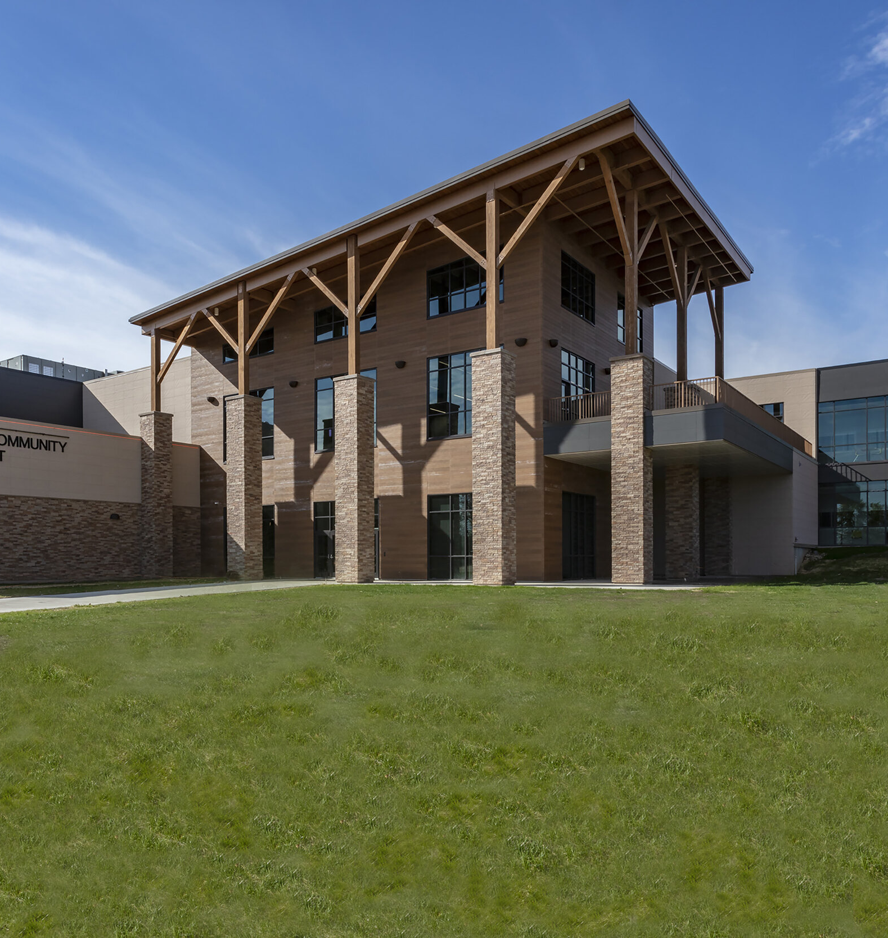
CASE STUDY 1
BACKGROUND
Facing the challenges of rapid enrollment growth, aging facilities, concerns about equity, and a desire to develop future-focused educational environments, the Iowa City Community School District commissioned the BLDD/Unicom•ARC team to develop long-term facilities master plan. The “ONE VISION” facilities master planning process created a 10-year master plan that serves as the district’s roadmap for future facilities decision-making.
Notes:
Case Study 1 Background
Facing the challenges of rapid enrollment growth, aging facilities, concerns about equity, and a desire to develop future-focused educational environments, the Iowa City Community School District commissioned the BLDD/Unicom•ARC team to develop long-term facilities master plan. The “ONE VISION” facilities master planning process created a 10-year master plan that serves as the district’s roadmap for future facilities decision-making.

Slide 47
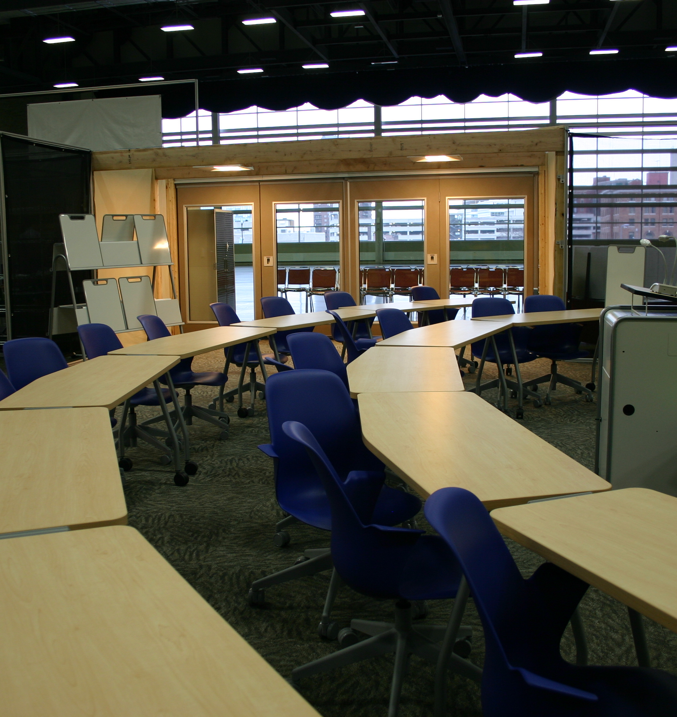
CASE STUDY 1
CHALLENGE
Create open classroom spaces that allowed students to move into open spaces for collaboration but could also be closed to use the spaces for a standard classroom. These classrooms also had to use as much natural light as possible while maintaining sound control.
Notes:
Challenge
Create open classroom spaces that allowed students to move into open spaces for collaboration but could also be closed to use the spaces for a standard classroom. These classrooms also had to use as much natural light as possible while maintaining sound control.

Slide 48
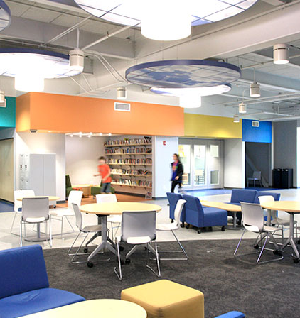
CASE STUDY 1
SOLUTION
To create the opening into the collaboration area, use acoustically rated glass walls that allowed sunlight into the areas, maintain sound control, and with the use of pass doors, allow access into the rooms when the movable wall was in place.
Notes:
Solution
To create the opening into the collaborations area use acoustically rated glass walls that allowed sunlight into the areas, maintained sound control, and with the use of pass doors allowed access into the rooms when the Movable wall was in place. Between classrooms, an operable wall with marker boards was used to effectively use the space.

Slide 49
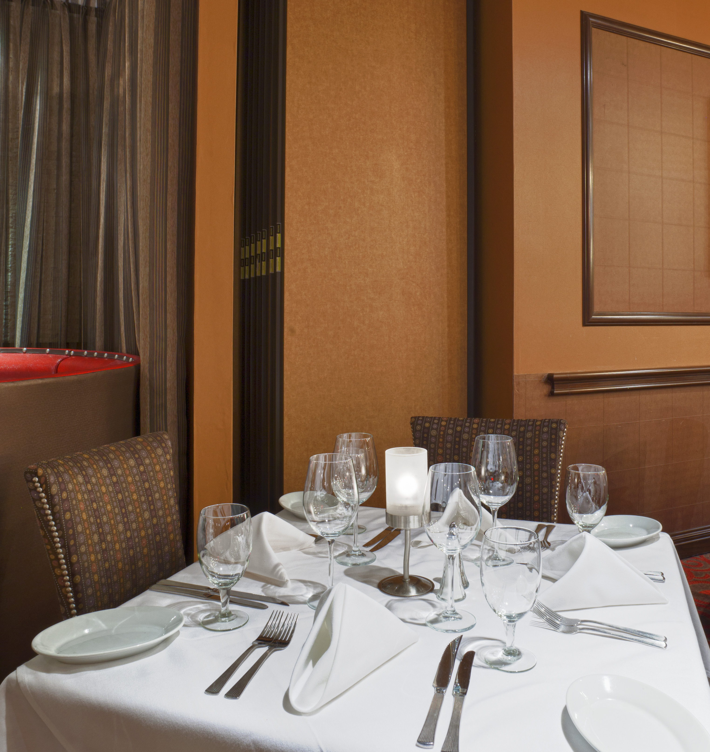
CASE STUDY 2
BACKGROUND
Ruth’s Chris wanted to create a space that could be used for private dining and entertaining.
Notes:
Case Study 2 Background
Ruth’s Chris wanted to create a space that could be used for private dining and entertaining.

Slide 50
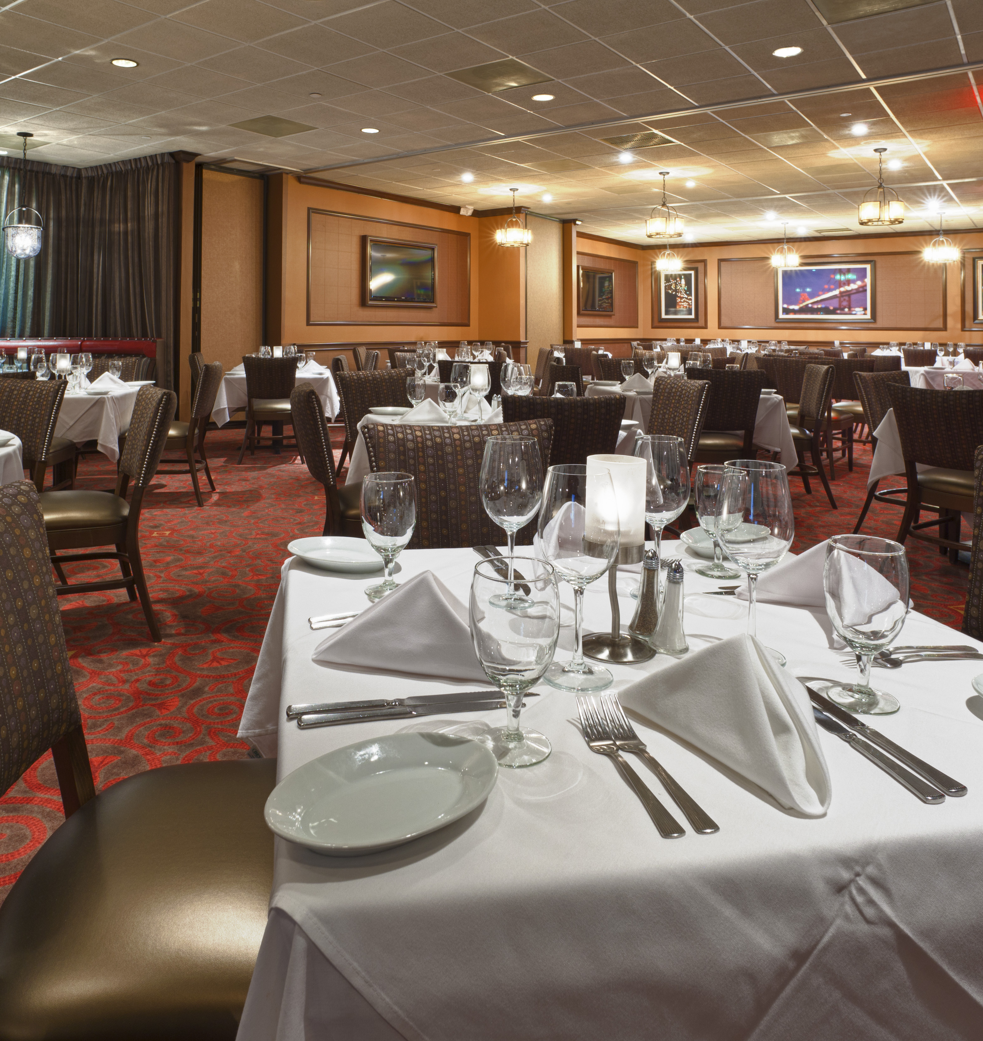
CASE STUDY 2
CHALLENGE
They need an area needed to create space separation, sound control for the guests outside the private dining area, and sight division. This space also needed to be opened to use as a standard area when not being used as a PDR, and the panels stacked out of the room. The wall had to be of the quality to maintain Ruth’s Chris standards.
Notes:
Case Study 2 Challenge
They need an area needed to create space separation, sound control for the guests outside the private dining area, and sight division. This space also needed to be opened to use as a standard area when not being used as a PDR, and the panels stacked out of the room. The wall had to be of the quality to maintain Ruth’s Chris standards

Slide 51
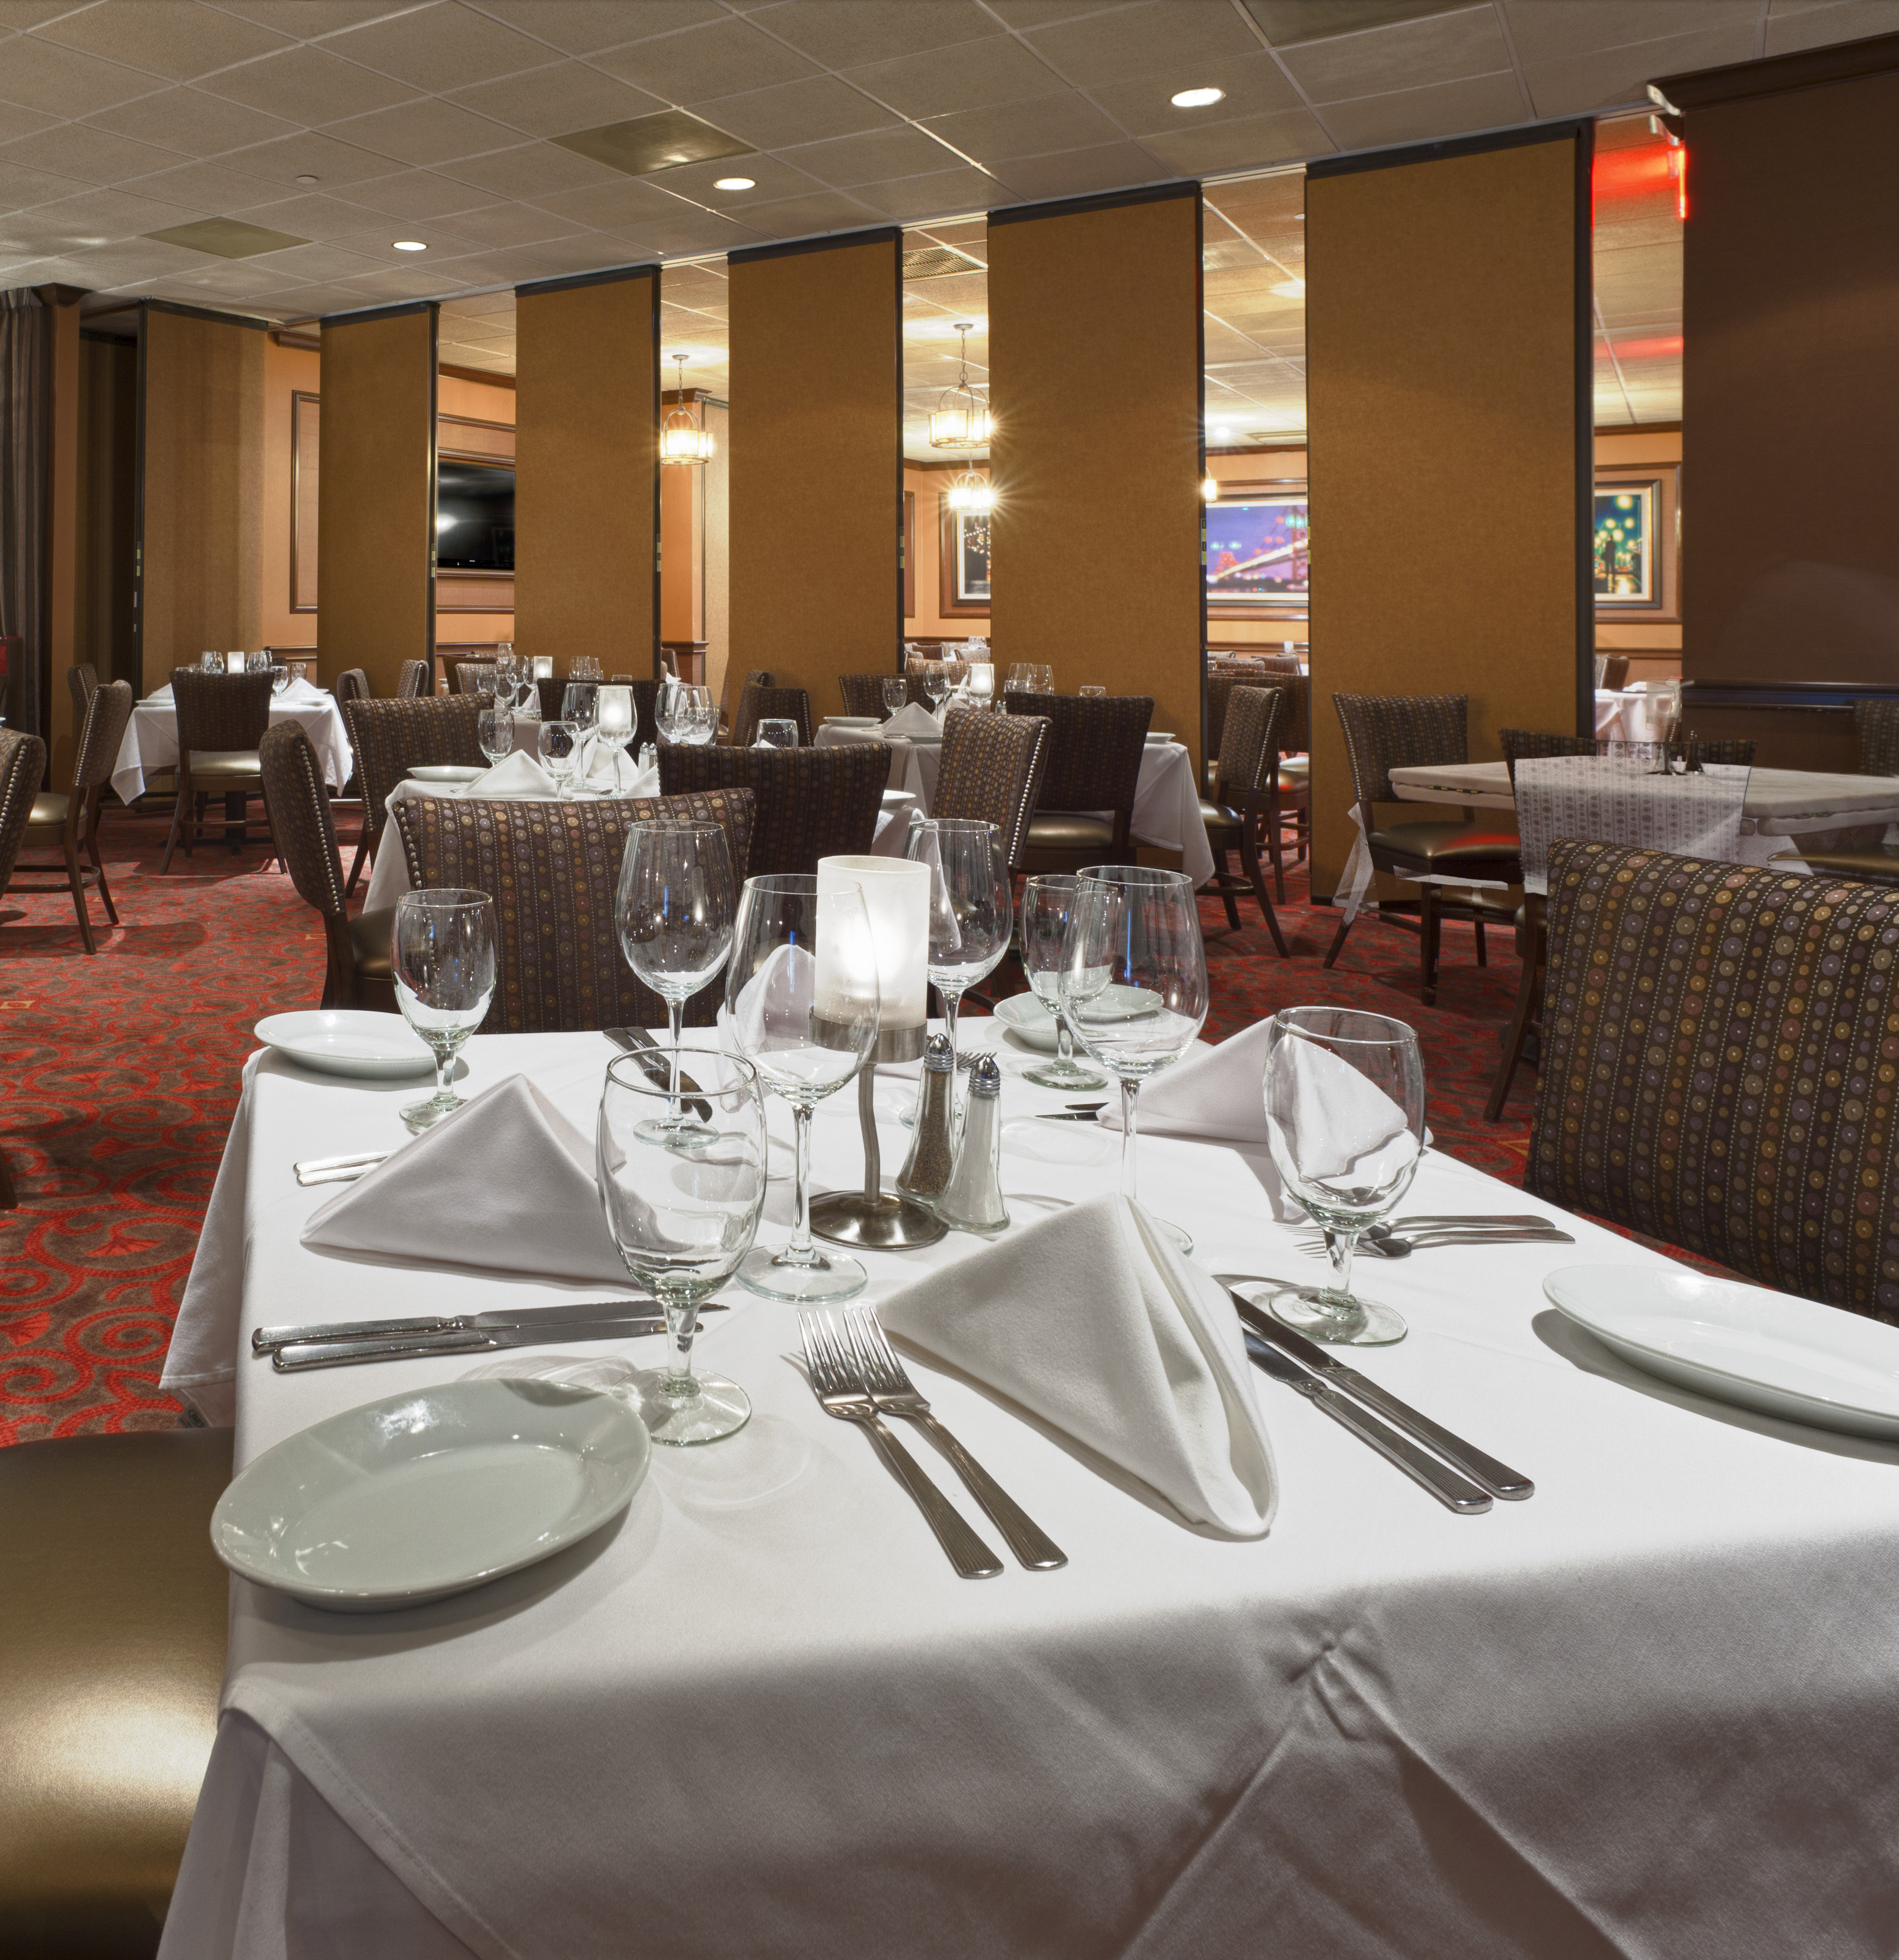
CASE STUDY 2
SOLUTION
Individual panels that could be perpendicularly stacked to the private dining area so that they would be out of the dining area when not in use. This Movable wall also uses an STC of 52 to provide sound control between the areas.
Notes:
Case Study 2 Solution
Individual panels that could be perpendicularly stacked to the private dining area so that they would be out of the dining area when not in use. This Movable wall also uses an STC of 52 to provide sound control between the areas.

Slide 52
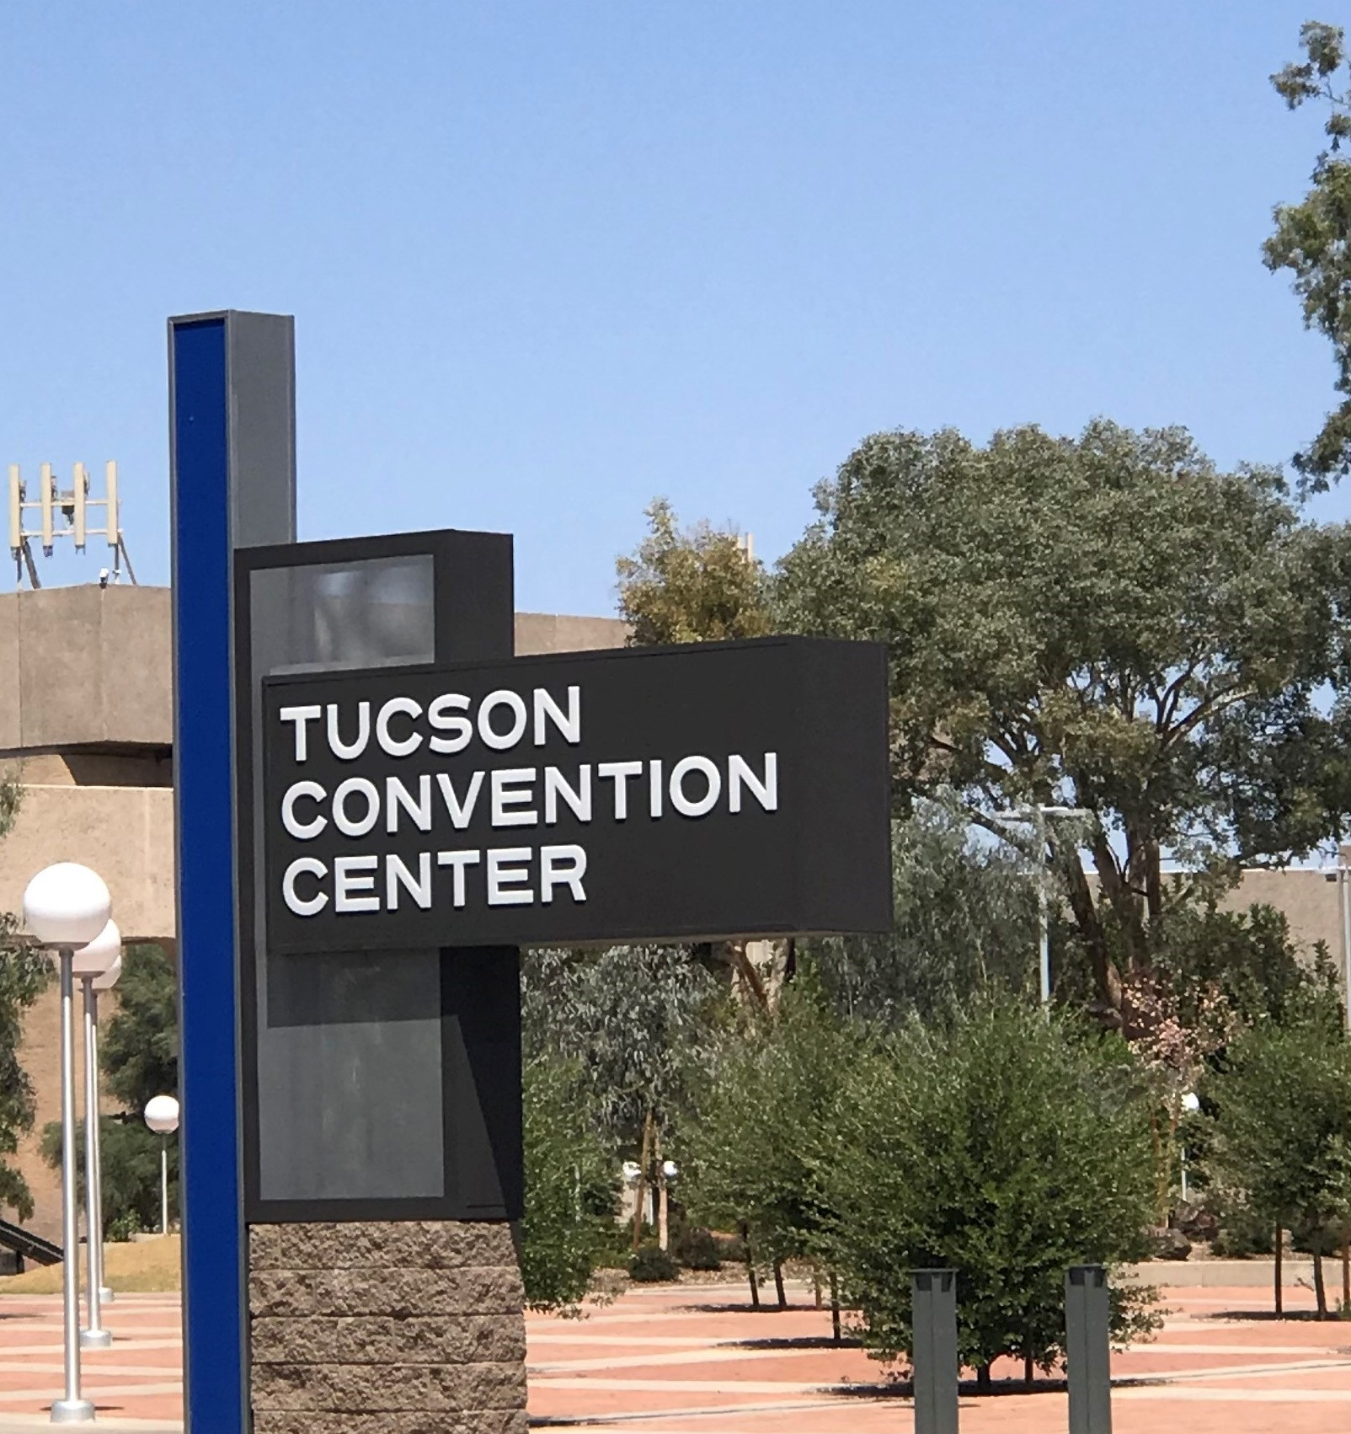
CASE STUDY 3
BACKGROUND
Since November 6, 1971, when the Tucson Convention Center opened as the Tucson Community Center it has hosted various events within its structure. From November of 2018 through October 2022, a plan and schedule were developed to rejuvenate and bring much needed upgrades to the center.
The project focused on many new features, including placement of the arena’s ice plant and floor, 350 spot parking structure, the main convention complex, the Tucson Arena, the Leo Rich Theater, Tucson Music Hall and the historic Eckbo plaza and fountain.
The budget for the scope of work was set at $16.8 million and allocated funds to renovate the existing rooms within the structures such as meeting rooms, Ball Room, South Exhibit Hall. Within the budget, a new meeting room expansion was a primary focus.
Notes:
Background
Since November 6, 1971, when the Tucson Convention Center opened as the Tucson Community Center it has hosted various events within its structure. From November of 2018 through October 2022, a plan and schedule were developed to rejuvenate and bring much needed upgrades to the center. The project focused on many new features. Within the project design plan included placement of the arena’s ice plant and floor, 350 spot parking structure, the main convention complex, the Tucson Arena, the Leo Rich Theater, Tucson Music Hall and the historic Eckbo plaza and fountain. The budget for the scope of work was set at $16.8 million and allocated funds to renovate the existing rooms within the structures such as meeting rooms, Ball Room, South Exhibit Hall. Within the budget, a new meeting room expansion was a primary focus.

Slide 53
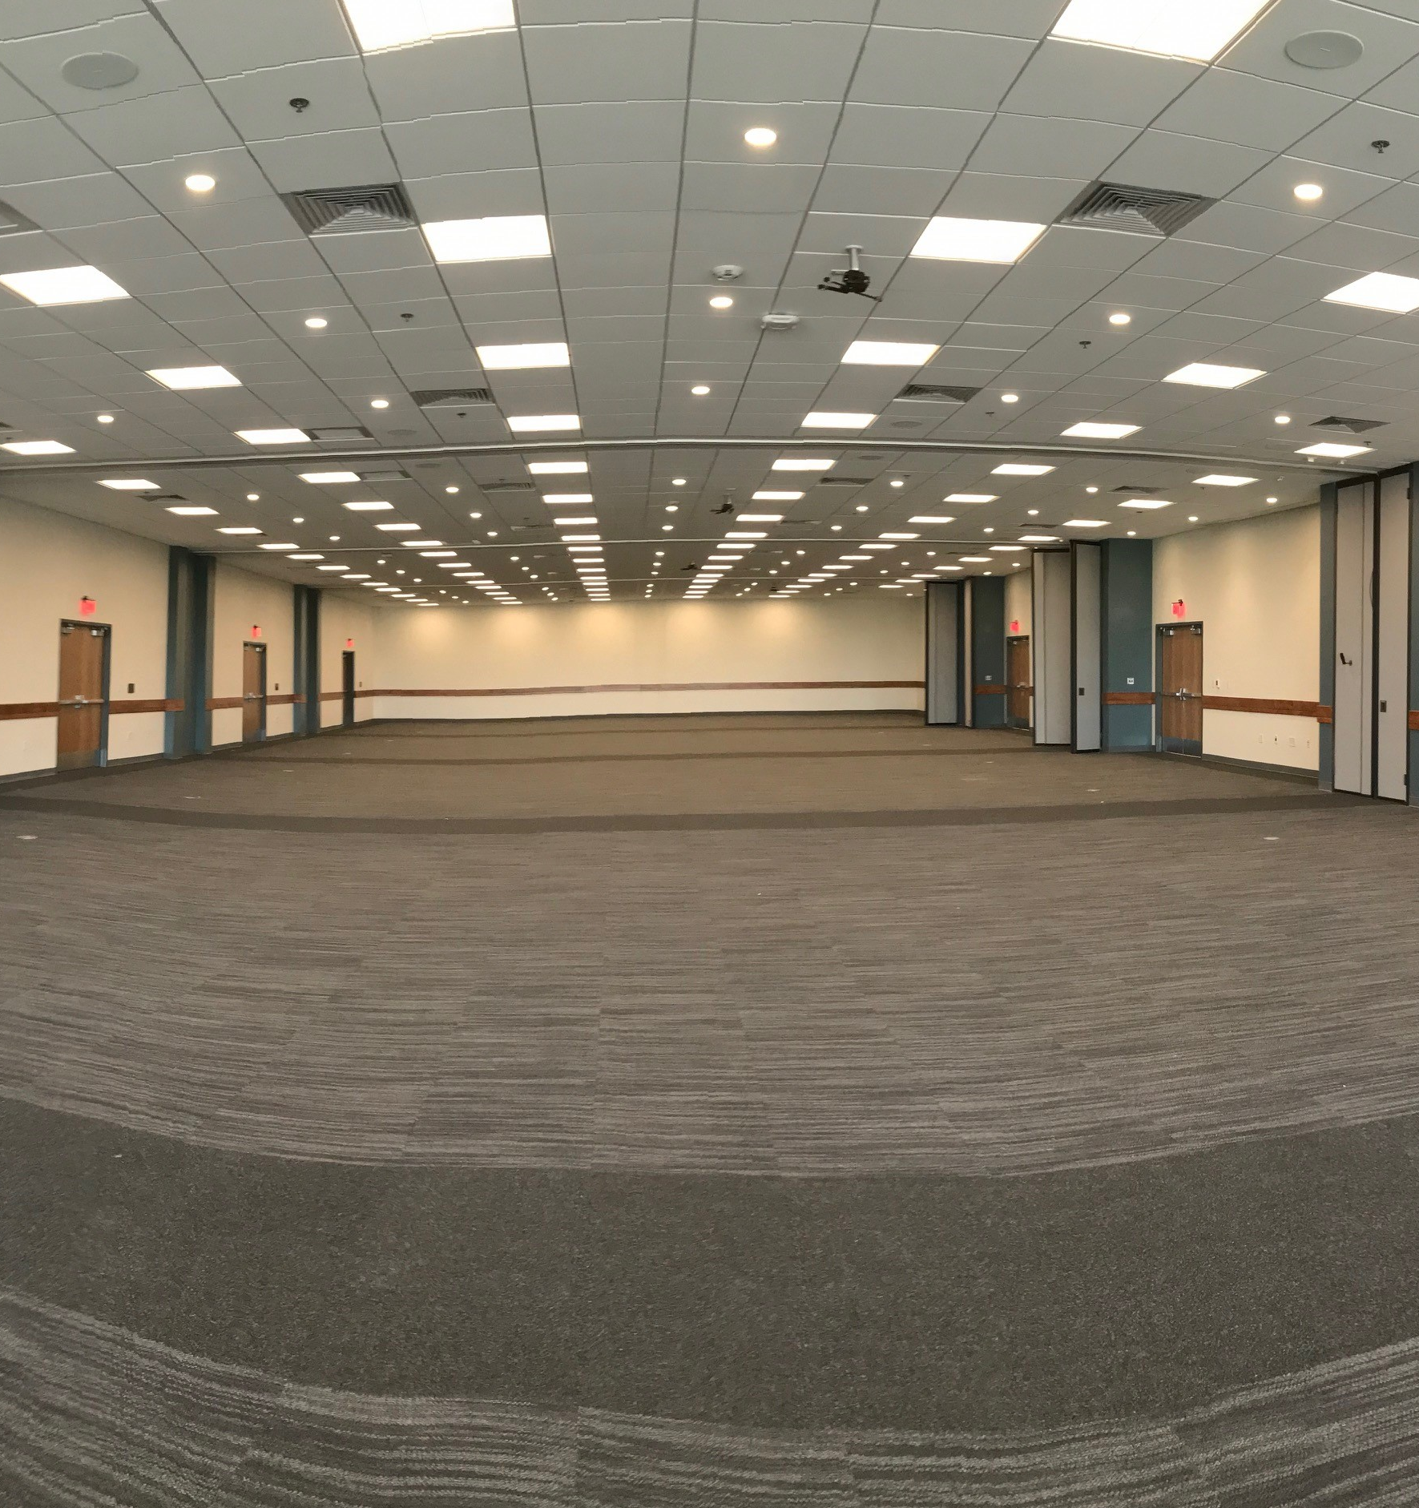
CASE STUDY 3
CHALLENGE
Create many large open spaces that could be sectioned off for multiple uses in a convention, classroom, exhibit hall, trade show or conference setting, keeping the acoustics at a comfortable level for the attendees of such events. STC ratings compliance was a key consideration for each space within the scope of the building design plan.
Notes:
Challenge
Create many large open spaces that could be sectioned off for multiple uses in a convention, classroom, exhibit hall, trade show or conference setting, keeping the acoustics at a comfortable level for the attendees of such events. STC ratings compliance was a key consideration for each space within the scope of the building design plan.

Slide 54
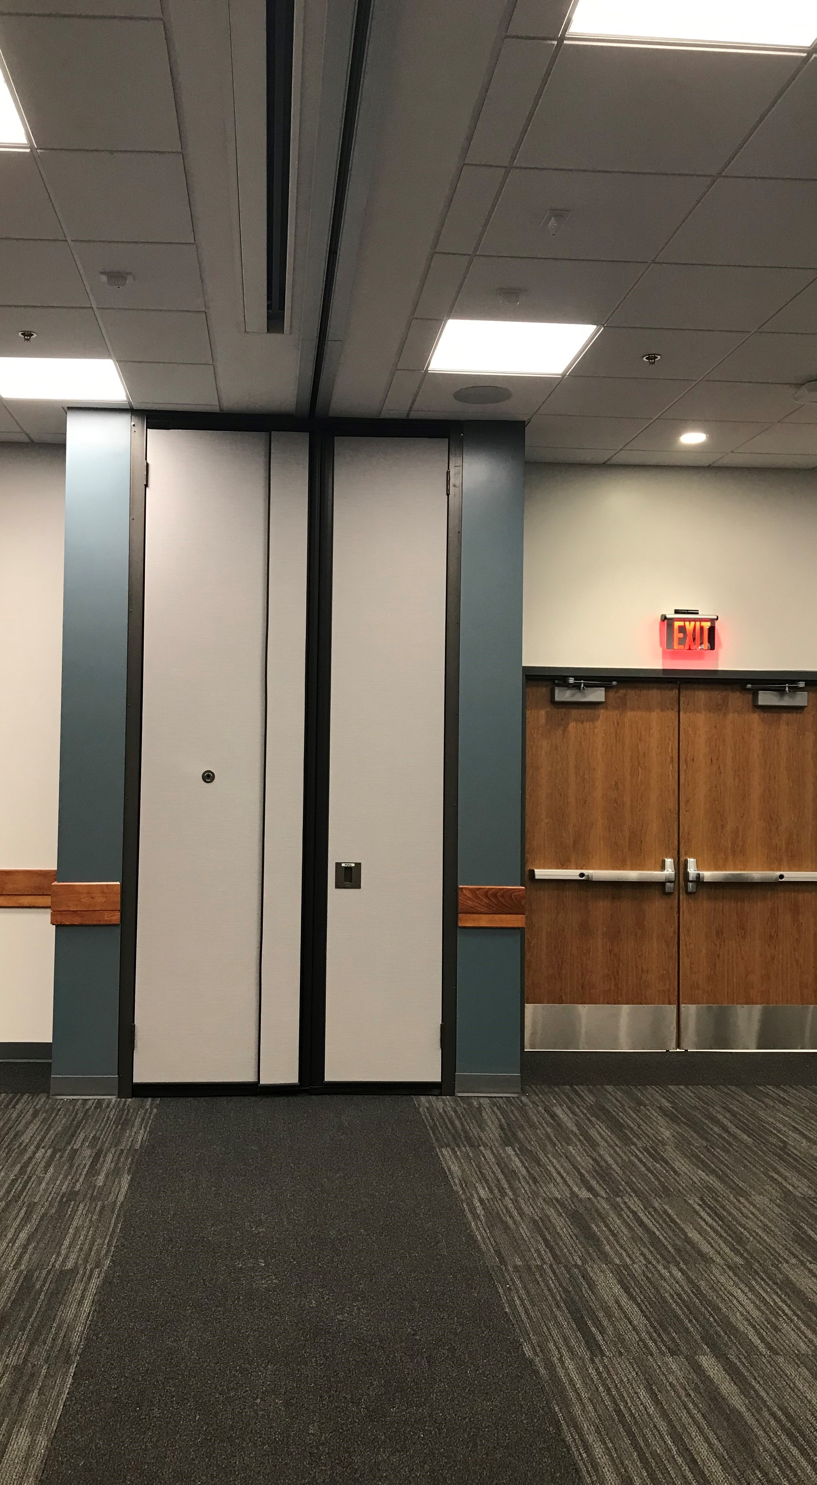
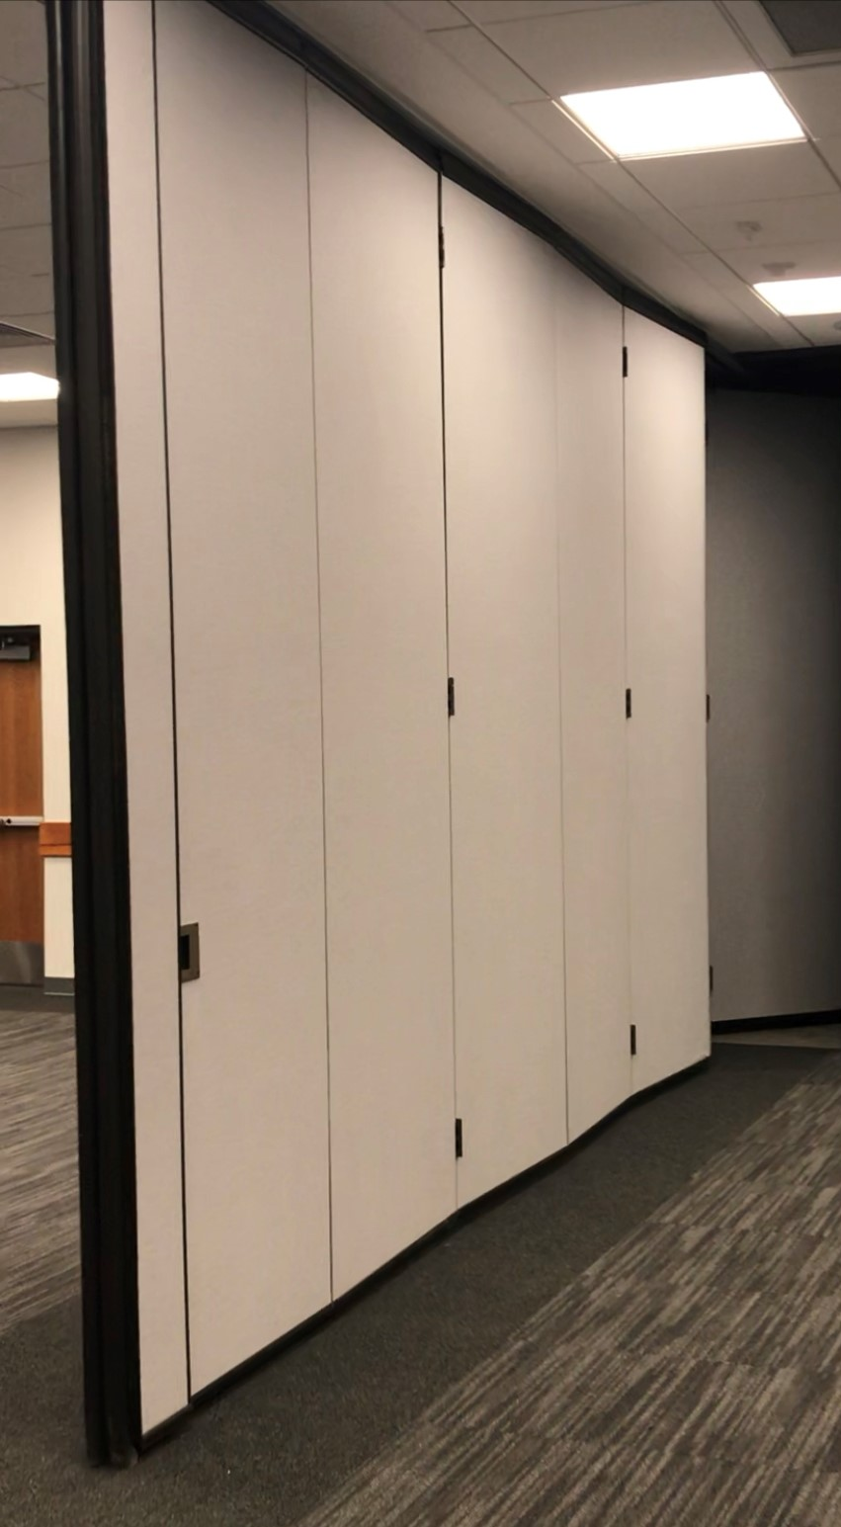
CASE STUDY 3
SOLUTION
To design with a minimum STC rating of 52 between rooms. Multiple walls on motorized tracks and a manual wall to separate one area into two smaller area with the same STC rating. The design allows collaboration in one large open area or event and customizing the same room for individual events. Pockets were created for each wall with an extension of wall material to lock down and minimize any sound leaks from either side of the room when closed.
Notes:
Solution
To design with a minimum STC rating of 52 between rooms. Multiple walls on motorized tracks and a manual wall to separate one area into two smaller area with the same STC rating. The design allows collaboration in one large open area or event and customizing the same room for individual events. Pockets were created for each wall with an extension of wall material to lock down and minimize any sound leaks from either side of the room when closed.

Slide 55
SUMMARY
Movable wall systems have a great range of benefits that create flexible design spaces focused on aesthetic, practical applications and sound considerations.
Throughout this course, we have reviewed these details in depth from the review of ASTM standards and how they relate to movable wall systems and STC ratings and how they effect product standards and selections, to material options that coincide with interior design selections and case studies that highlight the real-life practical applications of movable wall systems.
We have explored many beneficial aspects of these systems for design projects.
Notes:
Summary
Movable wall systems have a great range of benefits that create flexible design spaces focused on aesthetic, practical applications and sound considerations. Throughout this course, we have reviewed these details in depth from the review of ASTM standards and how they relate to Movable wall systems and STC ratings and how they effect product standards and selections, to material options that coincide with interior design selections and case studies that highlight the real-life practical applications of Movable wall systems. We have explored many beneficial aspects of these systems for design projects

Slide 56
LEARNING OBJECTIVES RECAP
1
2
3
4
Explore flexible space management design through movable wall systems that provide sight division and consider acoustic separation in a myriad of applications.
Evaluate ASTM standards and terminology regarding sound and space and how they relate to movable wall systems.
Examine codes and specifications such as ADA, ASTM, LEED and WELLv2 and how they relate to movable wall systems.
Analyze case studies related to movable wall systems that highlight the variety of settings these systems positively impact.
Notes:
Now you will be able to:
Explore carefully designed flexible space management through Movable wall systems that provide sight division and consider acoustic needs in a myriad of applications
Evaluate ASTM standards and terminology regarding sound and space and how they relate to Movable wall systems.
Examine codes and specifications such as ADA, ASTM, LEED and WELLv2 and how they relate to Movable wall systems.
Analyze case studies related to Movable wall systems that highlight the variety of settings these systems positively impact.

Slide 57
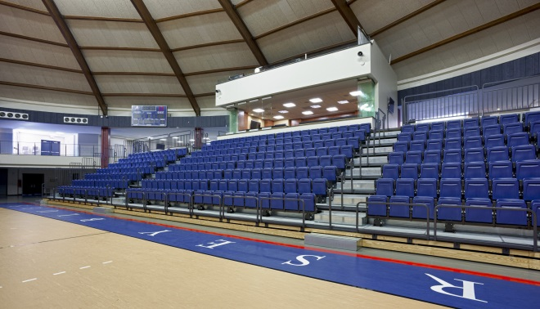
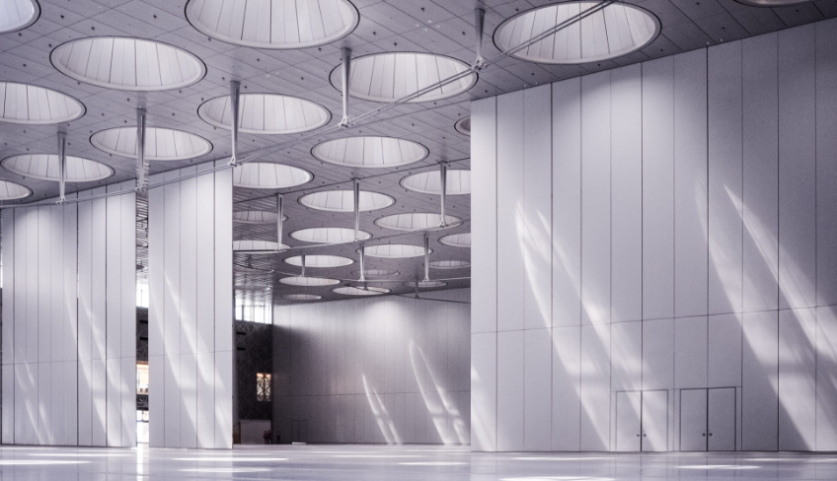
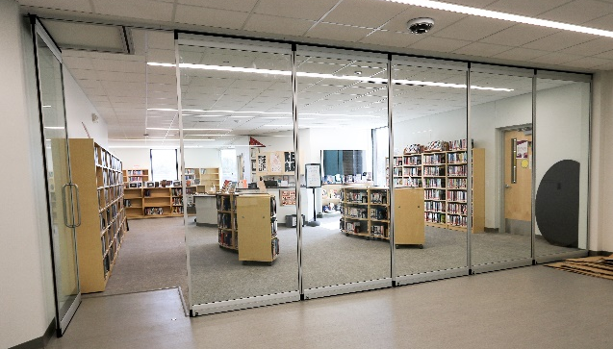
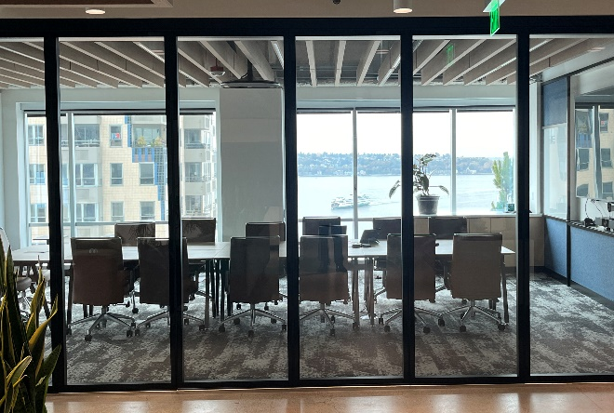
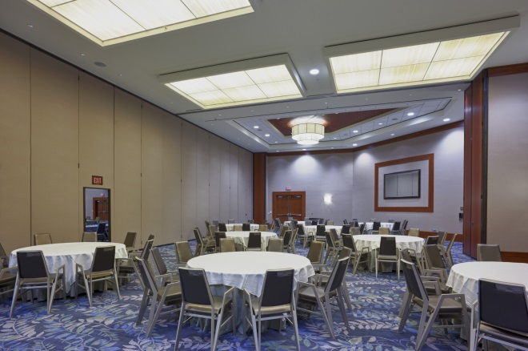
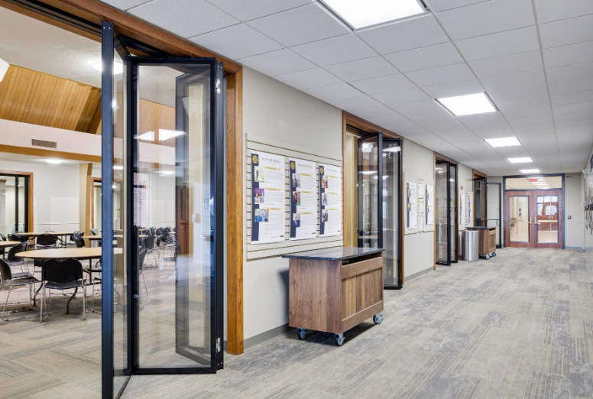
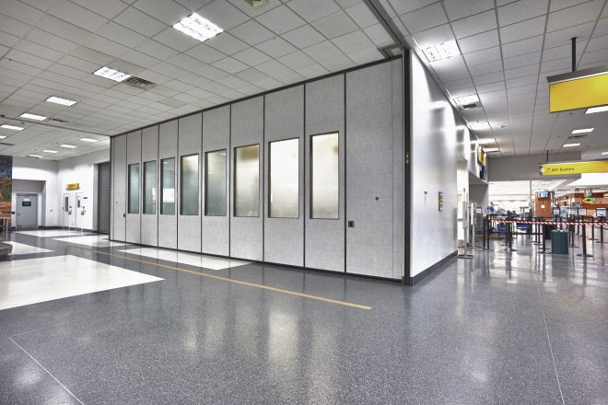
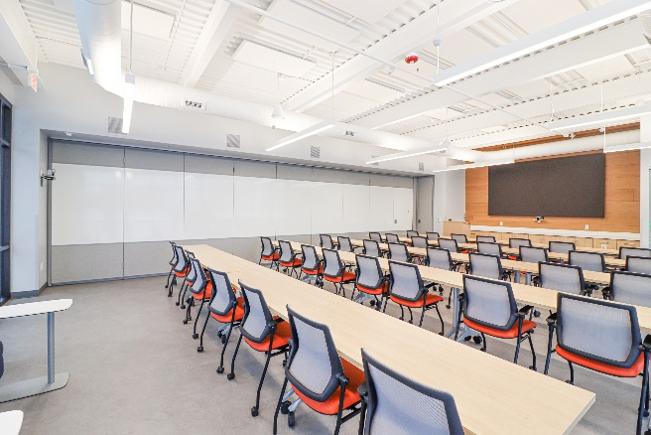
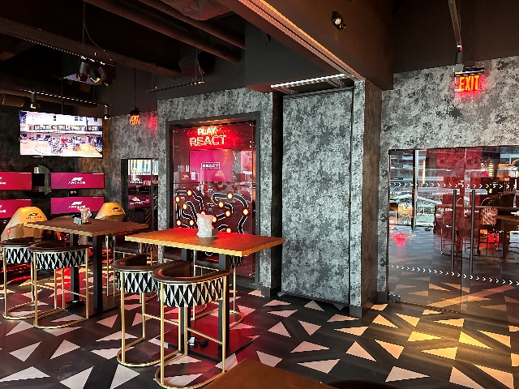
Popular Applications
Sports Arenas
Convention Centers
Libraries
Offices
Hotels
Churches
Airports
Schools
Restaurants

Slide 58
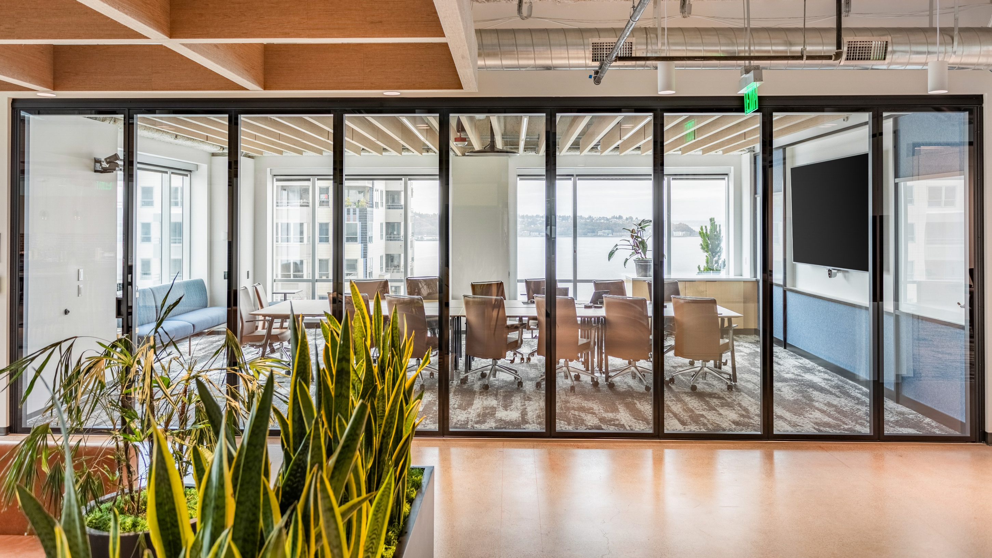
Thanks for coming!

