Slide 1
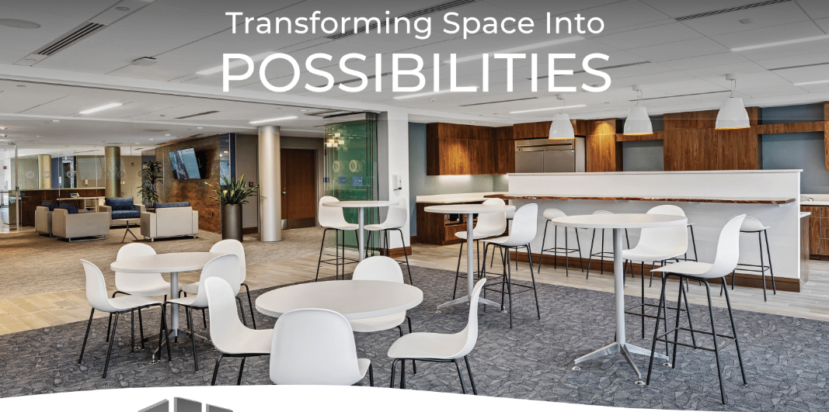
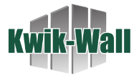

Slide 2
Transforming Space Into
POSSIBILITIES
MOVABLE WALL SYSTEMS
Continuing Education Unit (CEU) - Current Offering
Building Better Spaces: Enhancing Environments with Movable Walls (ONLINE ONLY)
Acoustical Engineering & Applications of Movable Wall Systems (expires in March ’26 – we will do a new one then)
Mastering Operable Partition Design & Specifications (NEW)
Interior Moveable Glass Walls: Optimal aesthetics with Flexibility, daylighting, and acoustic performance. (NEW)
Branded Product Presentations (future/in progress)

Slide 3
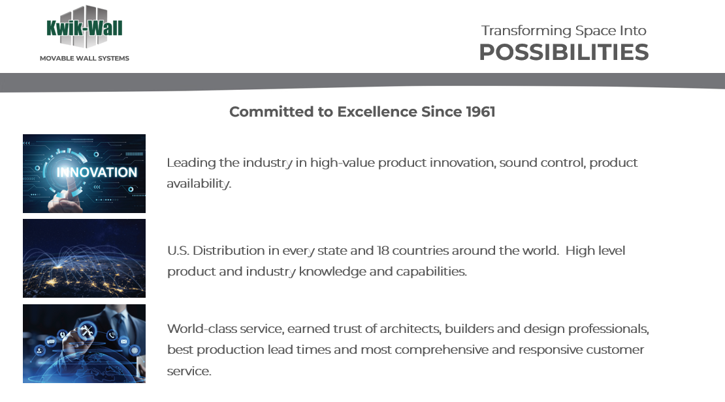
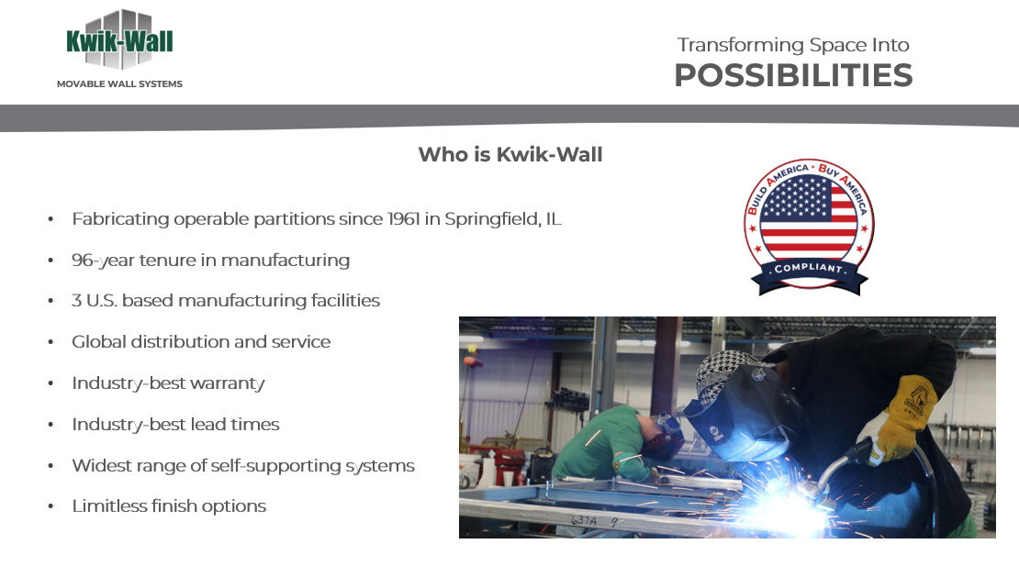
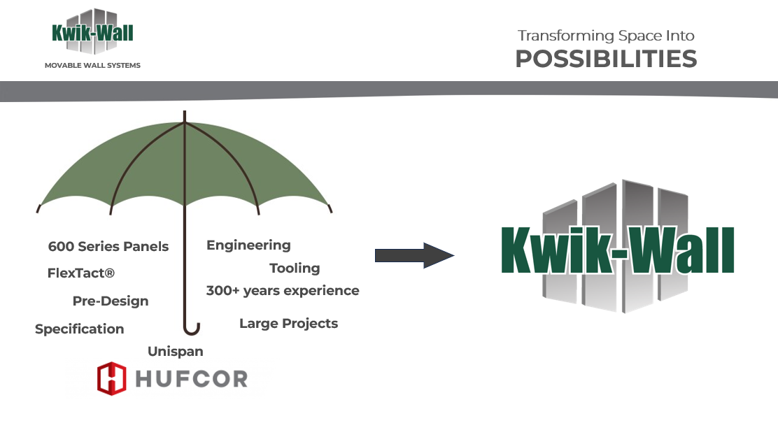
Transforming Space Into
POSSIBILITIES
MOVABLE WALL SYSTEMS
Key Elements & Considerations in CEU Design
1) Tell the story. Establish credibility to what we are about to say

Slide 4
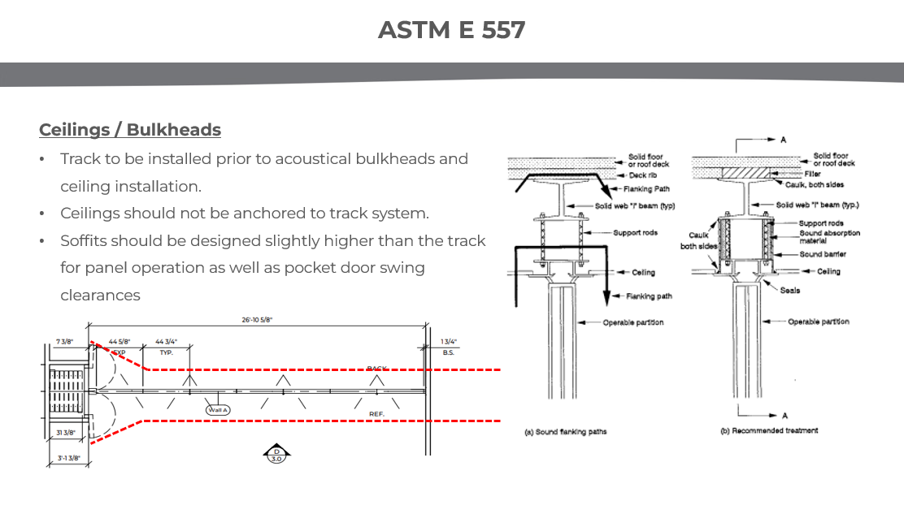
Transforming Space Into
POSSIBILITIES
MOVABLE WALL SYSTEMS
Key Elements & Considerations in CEU Design
2) Branding to Match

Slide 5
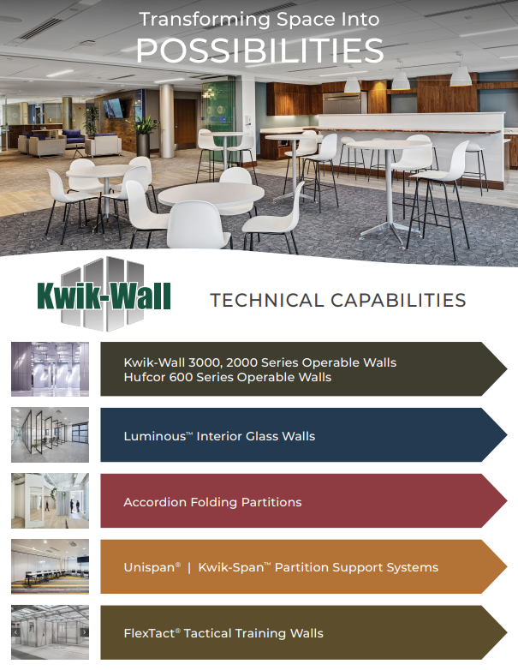
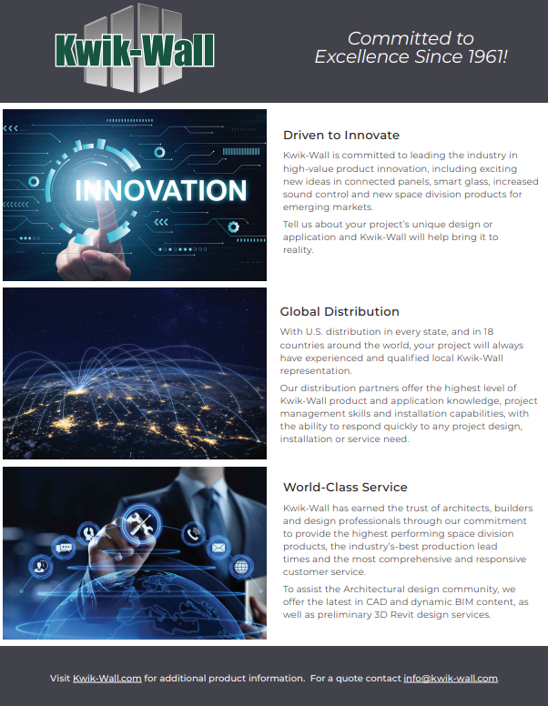
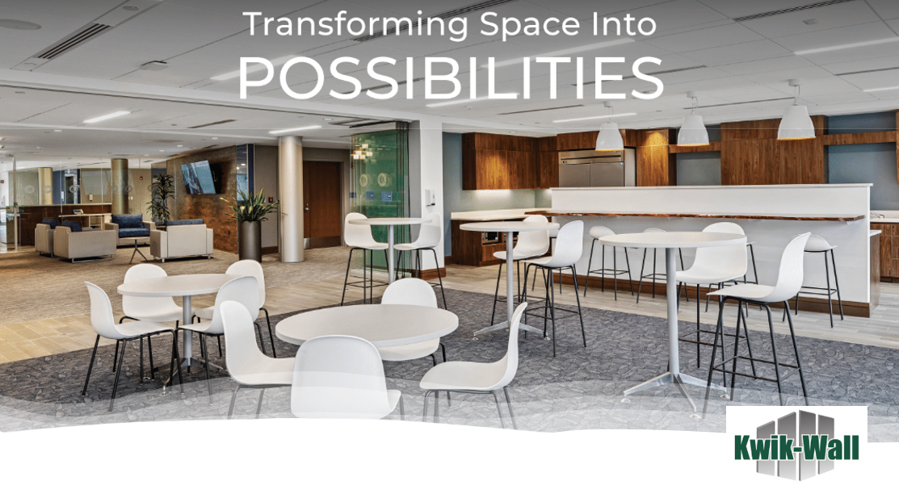

Transforming Space Into
POSSIBILITIES
MOVABLE WALL SYSTEMS
Key Elements & Considerations in CEU Design
2) Branding to Match

Slide 6
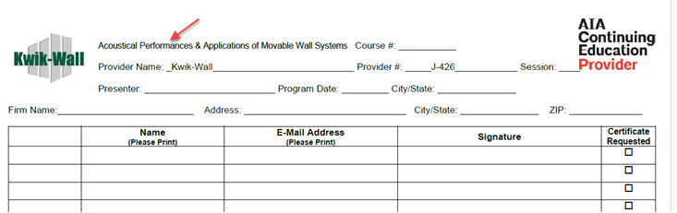
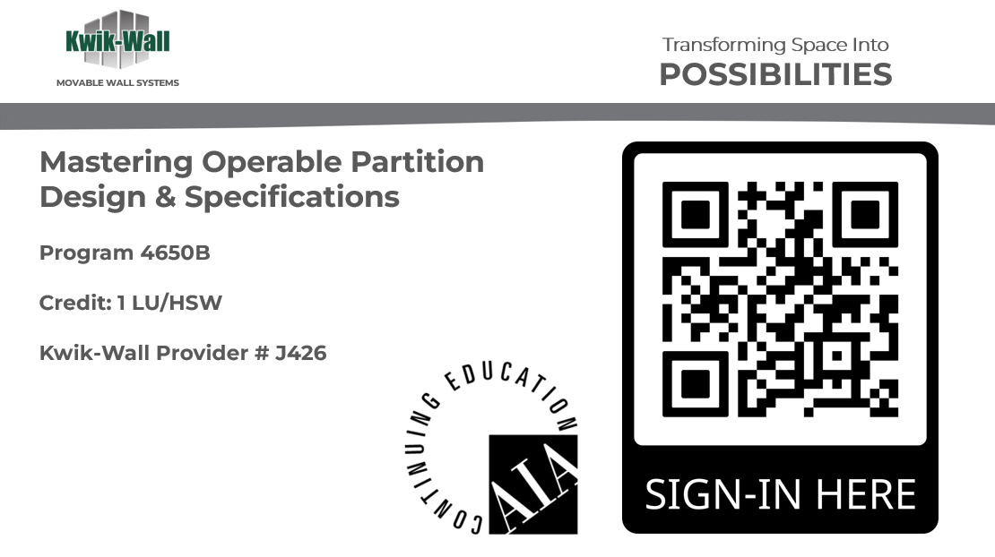
Transforming Space Into
POSSIBILITIES
MOVABLE WALL SYSTEMS
Key Elements & Considerations in CEU Design
3) Professional Appeal

Slide 7
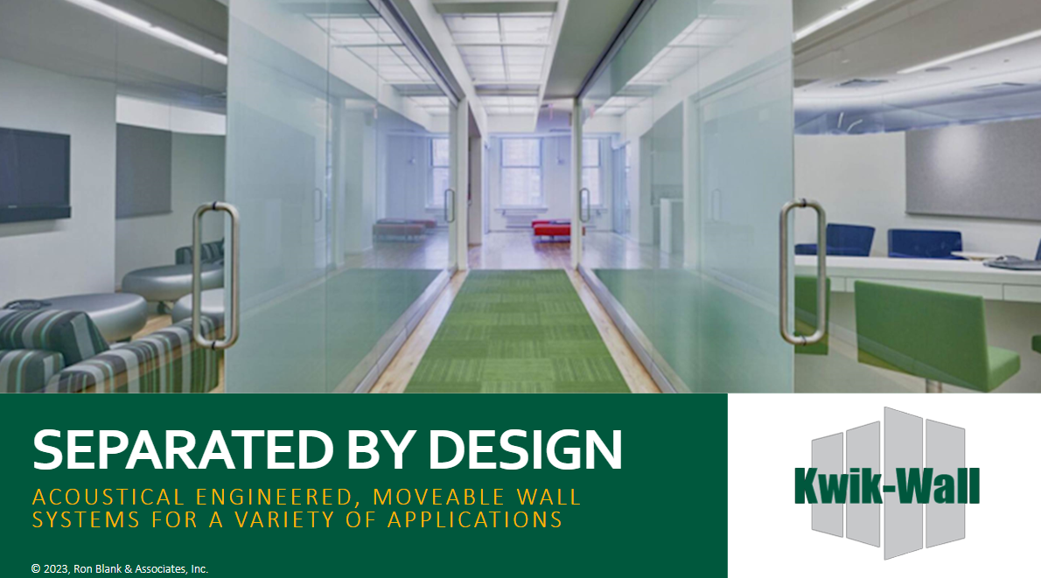

Transforming Space Into
POSSIBILITIES
MOVABLE WALL SYSTEMS
Key Elements & Considerations in CEU Design
3) Professional Appeal

Slide 8
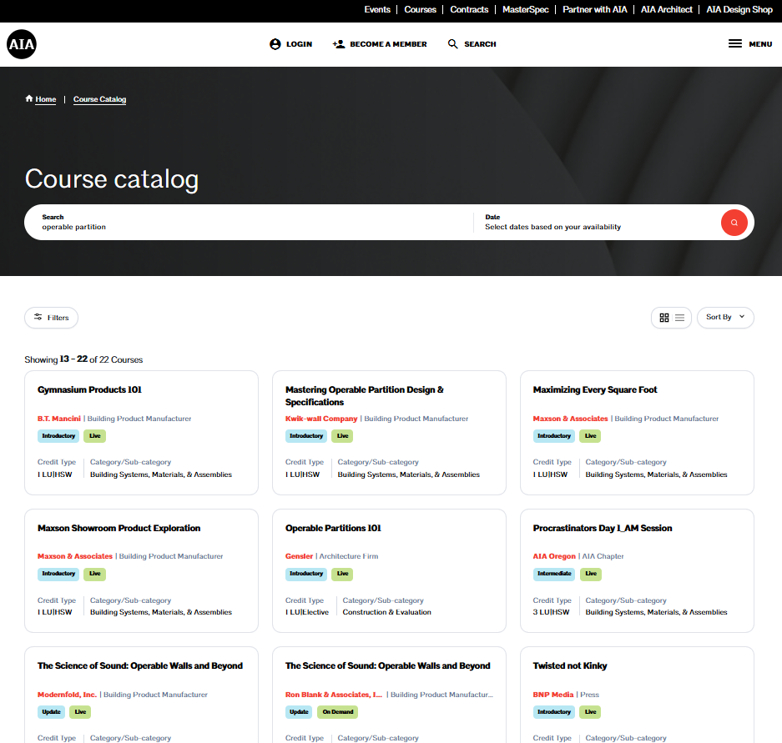
Transforming Space Into
POSSIBILITIES
MOVABLE WALL SYSTEMS
Key Elements & Considerations in CEU Design
4) Topics
Currently 22 Courses on Operable Partitions
Kwik-Wall (4)
Modernfold (3), Skyfold (2)
Moderco (1)
Corflex (2)
Advanced Equipment (0)
Product Reps (3+)

Slide 9
Transforming Space Into
POSSIBILITIES
MOVABLE WALL SYSTEMS
Key Elements & Considerations in CEU Design
4) Topics
Currently 22 Courses on Operable Partitions
Operable Partitions Manufacturers
Local AIA Chapters
“Operable Partitions 101”
Message: We are all missing the mark on education

Slide 10
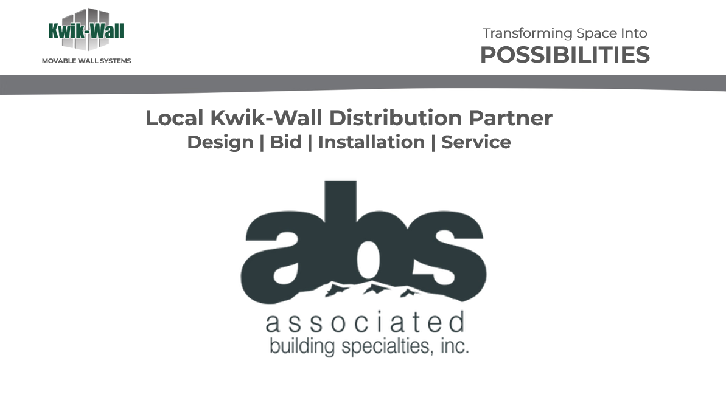
Transforming Space Into
POSSIBILITIES
MOVABLE WALL SYSTEMS
Key Elements & Considerations in CEU Design
5) Purpose of CEU’s
Why give product presentations?
CEU’s don’t sell projects, but…
A&D look for trusted reps and resources
Being present builds trust
Spec ownership = Industry Leadership

Slide 11
Transforming Space Into
POSSIBILITIES
MOVABLE WALL SYSTEMS
Who to call on
Call on architectural and design firms that you know and offer in-person visits
AIA Accredited Continuing Education Units (CEU) – Lunch & Learn
Product Presentations (branded) – Lunch or Fly-By or Tabletop
Search Information Services like Dodge (DCN) or ConstructConnect
Search Bid Opportunities
Spec Rate Analysis
Architectural firm spec habits
Design-Build General Contractors, Construction Managers
Product Presentations

Slide 12
Transforming Space Into
POSSIBILITIES
MOVABLE WALL SYSTEMS
Scheduling a Meeting
When making an appointment:
Is the firm interested in learning more about Kwik-Wall operable walls or moveable glass walls?
Provide an option for product presentation (preferred) or accredited presentation
  AIA credits (most common)
    Easy QR code scan to register and get credits
  IDCEC credits (less common)
    Requires registration before the course and follow up immediately after for credits.

Slide 13
Transforming Space Into
POSSIBILITIES
MOVABLE WALL SYSTEMS
AIA Rules
Course duration to be 45-60 minutes long
Must be educational only – look for the Kwik-Wall logo
Penalty if rules are not followed:
  Kwik-Wall loses Education Provider status
  Removal of course from AIA
  Damage to reputation
  AIA members denied credits if the course is invalidated.

Slide 14
Transforming Space Into
POSSIBILITIES
MOVABLE WALL SYSTEMS
Best Practices
Always follow the AIA CES Provider Manual (latest version from AIA)
Keep course content educational, not promotional
Ensure accurate tracking and reporting of attendance and CEU
  Cadie Hoyle is Kwik-Wall contact to assist

