Slide 1



Slide 2


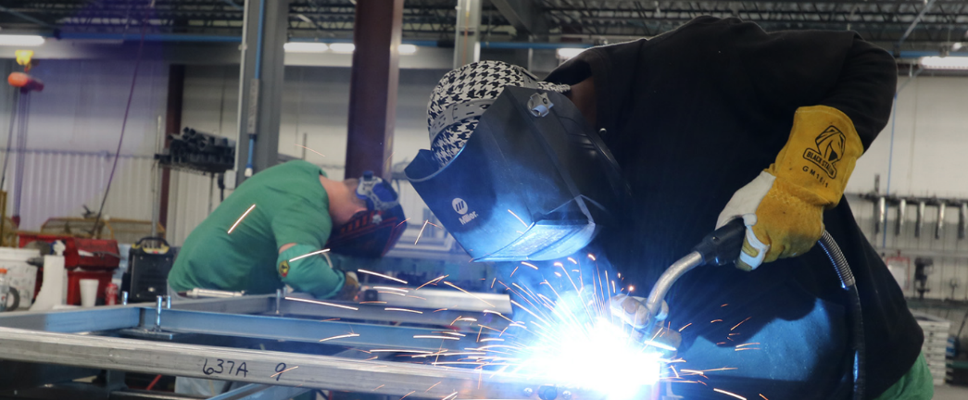
Transforming Space Into
POSSIBILITIES
MOVABLE WALL SYSTEMS
Who is Kwik-Wall
Fabricating operable partitions since 1961 in Springfield, IL
96-year tenure in manufacturing
3 U.S. based manufacturing facilities
Global distribution and service
Industry-best warranty
Industry-best lead times
Widest range of self-supporting systems
Limitless finish options

Slide 3



Transforming Space Into
POSSIBILITIES
MOVABLE WALL SYSTEMS
Committed to Excellence Since 1961
Committed to leading the industry in high-value product innovation, sound control, product availability.
U.S. Distribution in every state and 18 countries around the world. High level product and industry knowledge and capabilities.
World-class service, earned trust of architects, builders and design professionals, best production lead times and most comprehensive and responsive customer service.

Slide 4
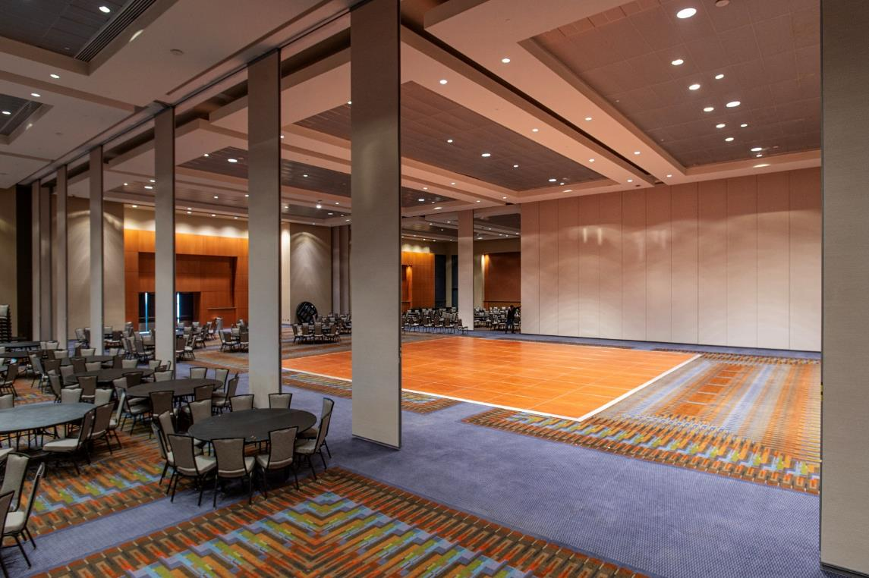
Transforming Space Into
POSSIBILITIES
MOVABLE WALL SYSTEMS
Operable Partitions

Slide 5
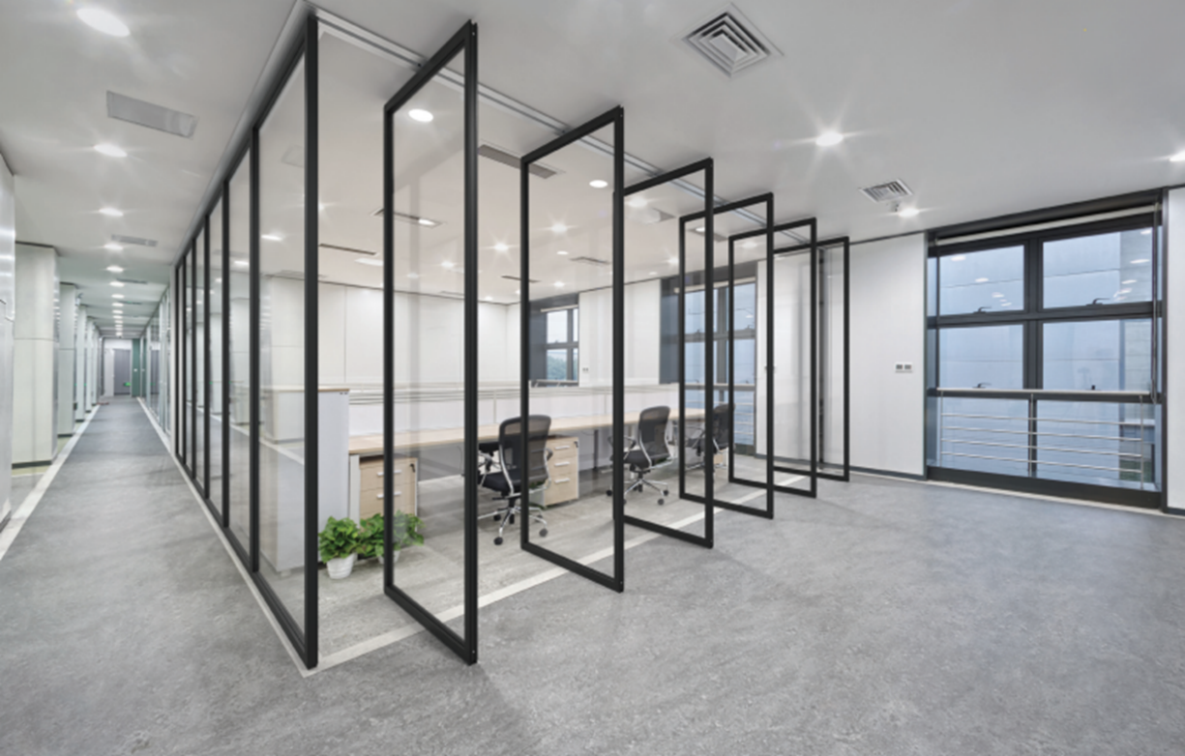
Transforming Space Into
POSSIBILITIES
MOVABLE WALL SYSTEMS
Glass Operable Partitions

Slide 6
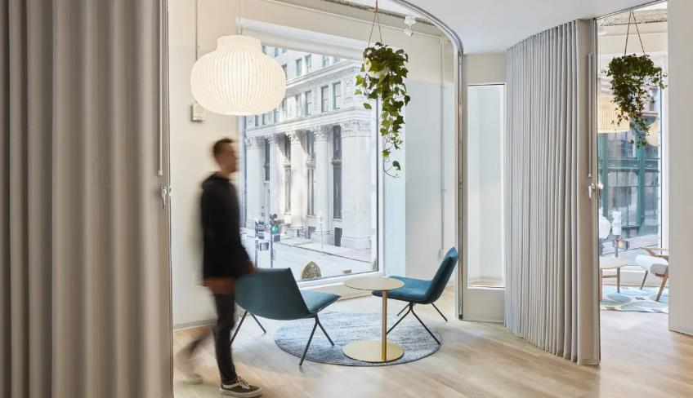
Transforming Space Into
POSSIBILITIES
MOVABLE WALL SYSTEMS
Accordion Partitions

Slide 7
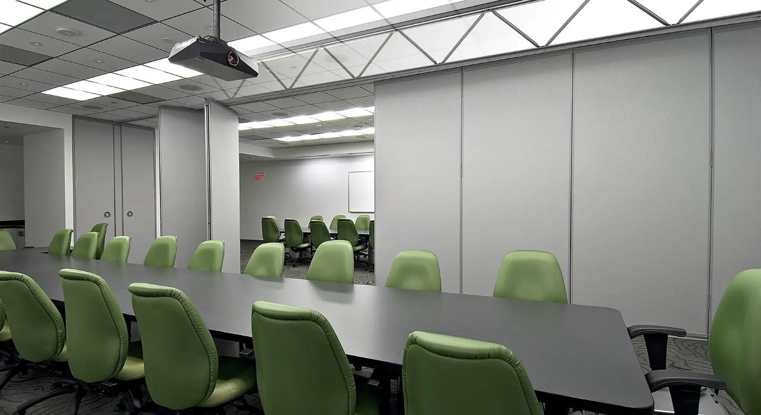
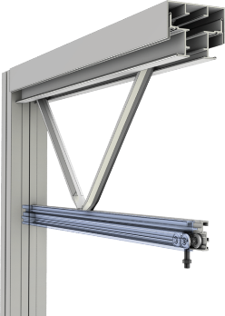
Transforming Space Into
POSSIBILITIES
MOVABLE WALL SYSTEMS
Self-Supporting Operable Partition Systems

Slide 8
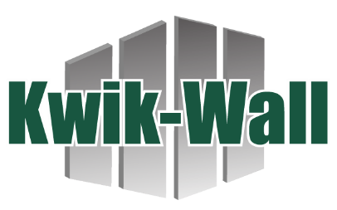

Transforming Space Into
POSSIBILITIES
MOVABLE WALL SYSTEMS
Hufcor Acquisition
125-year-old global leader in the manufacturing and distribution of operable partitions.
In 2023, the demise of the once iconic brand, closed its doors leaving in it’s wake countless people without work in many factories across the globe as well as it’s mark on the architectural, engineering, specification and design communities.
Domestically, the IP was purchased by Kwik-Wall
Internationally it was purchased by Hufcor licensees in the UAE.
Products, trademarks, industry leading configurator, engineering and know-how are now under the KW umbrella

Slide 9

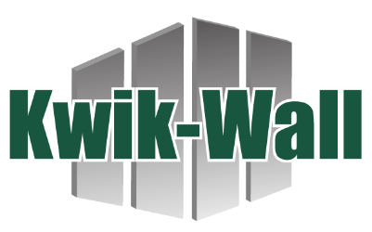
Transforming Space Into
POSSIBILITIES
MOVABLE WALL SYSTEMS
600 Series Panels
Engineering
FlexTact®
Tooling
300+ years experience
Pre-Design
Specification
Large Projects
Unispan

Slide 10


Transforming Space Into
POSSIBILITIES
MOVABLE WALL SYSTEMS
Interior Movable Glass Walls:
Optimal aesthetics with flexibility, daylighting, and acoustic performance
AIA Program 4650C, 1 LU/HSW
IDCEC Program: CEU-124371

Slide 11


AIA / CES Credit
This course is registered with AIA CES for continuing professional education. As such, it does not include content that may be deemed or construed to be an approval or endorsement by the AIA of any material of construction or any method or manner of handling, using, distributing, or dealing in any material or product.
*Questions related to specific materials, methods, and services will be addressed at the conclusion of this presentation.
This presentation is protected by US and International Copyright laws.
Reproduction, distribution, display and use of the presentation without written permission of the speaker is prohibited.
© 2025

Slide 12




Learning Objectives
1) Understand the applications and product selection differences between movable interior glass vs exterior walls
2) Review the importance of acoustic performance and how overhead structural, floor support, glass type and surrounding seals effect performance.
3) Learn how movable glass walls optimize sustainable building design including materials, indoor air quality and daylighting.
4) Review how movable glass partitions add to the human experience within the built environment.

Slide 13
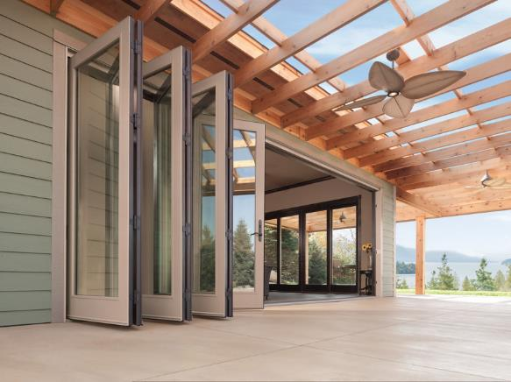
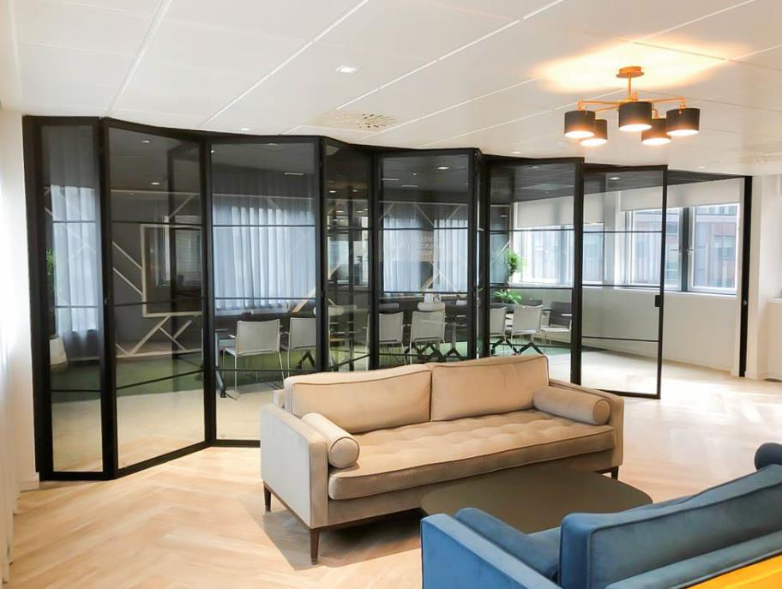
Learning Objective 1
Understand the applications and product selection differences
between movable interior glass vs exterior walls.

Slide 14
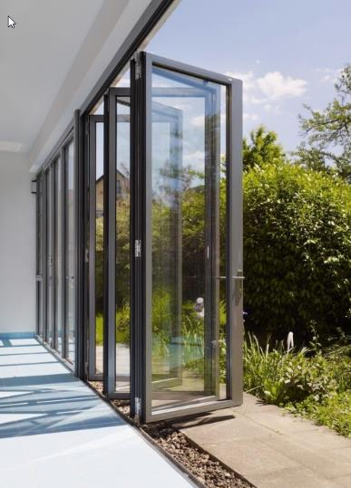
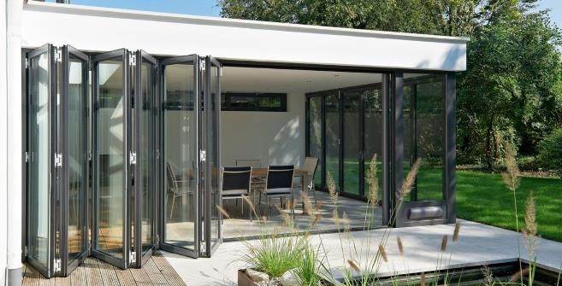
Exterior Glass Walls – Key Performance Criteria
Water Infiltration and drainage
Air Infiltration (residential vs commercial)
Structural Wind Loading
Thermal transmission
Impact Resistance – Hurricane Zones
Overhead or floor support
Operation
Locking (force entry)

Slide 15
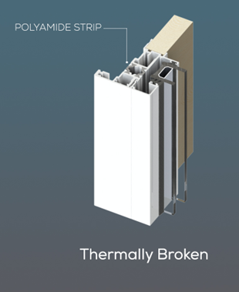
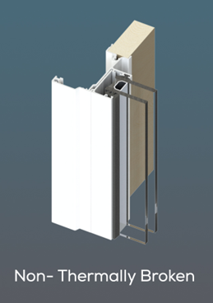
Exterior Glass Walls – Complexity is Costly
Thermal break systems are more complex to manufacture and more expensive than non-thermal frames.
This complexity can lead to potential issues during installation or require specialized knowledge for maintenance.
Systems with thermal breaks also most likely will require “insulated glass units” for thermal performance
Yet, interior glass systems don’t require these performance criteria in most cases.

Slide 16
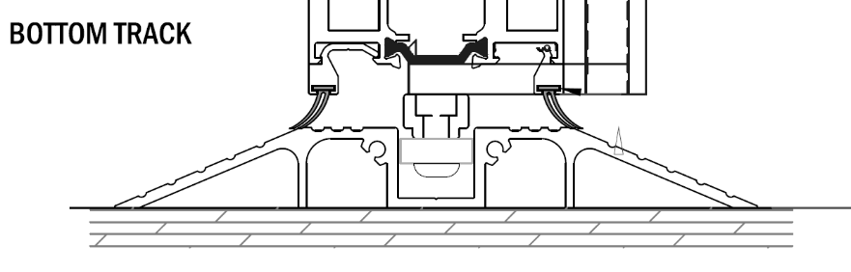
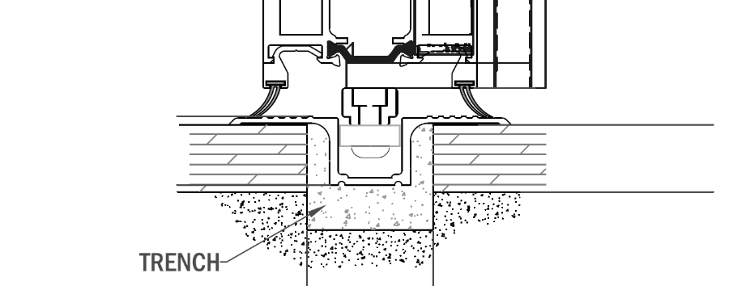
Exterior Glass Walls – Track Implications
Exterior glass wall systems require basically two types of bottom tracks – floor mounted or recessed
Using recessed tracks for interior applications also adds complexity to projects often requiring concrete embeds or cutting the trench during installation of the system.

Slide 17
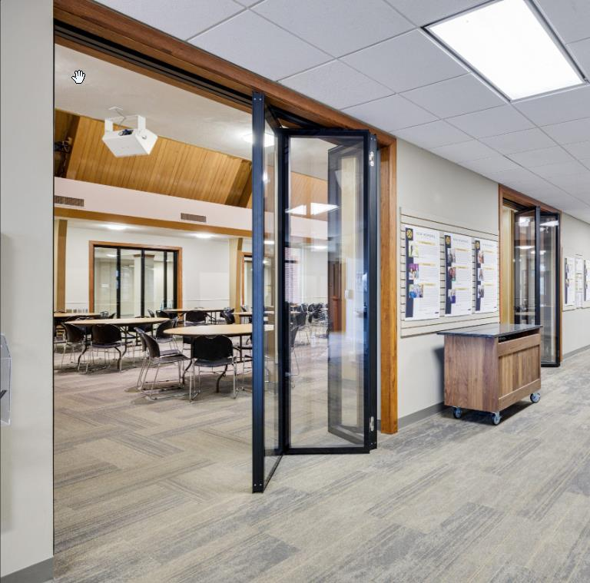
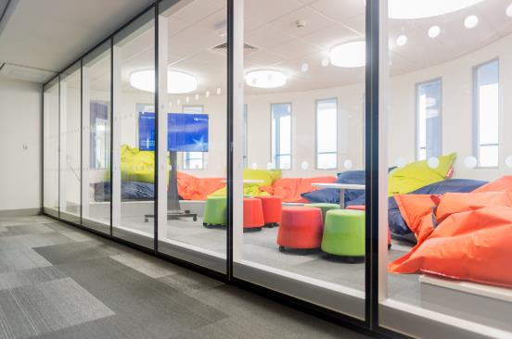
Interior Glass Walls – Key Performance Criteria
Glass Type
Overhead or floor support
Configuration & Operation
Acoustics (learning objective 2)
Sustainability/IAQ (learning objective 3)
Aesthetics (learning objective 4)

Slide 18
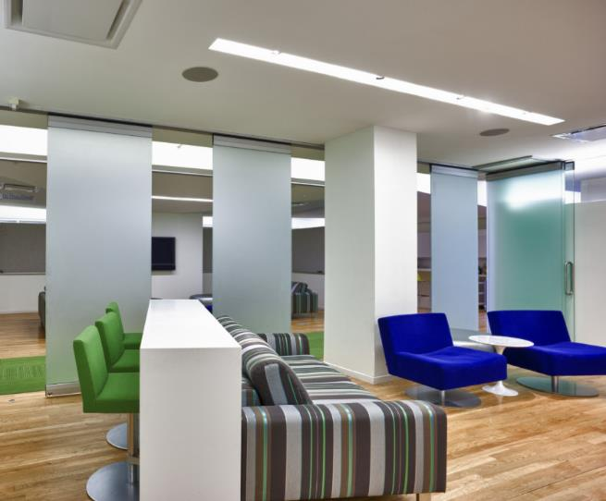
Interior Glass Walls – Key Performance Criteria
Acoustics
Glass Type
Overhead or floor support
Configuration & Operation
Sustainability/IAQ
Aesthetics (color, style, frame thickness)

Slide 19
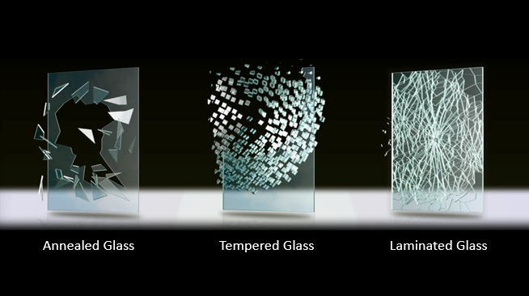
Interior Glass Walls – Key Performance Criteria, Glass

Slide 20
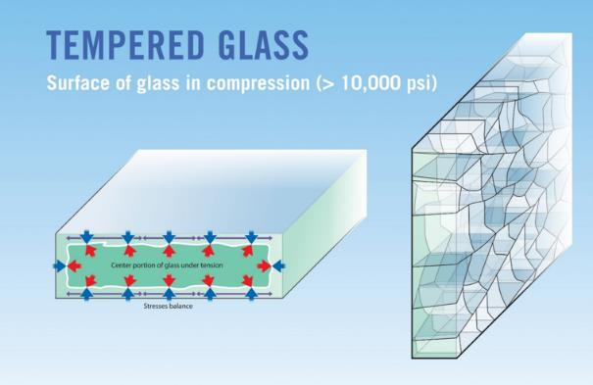
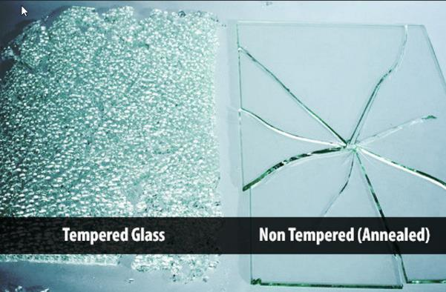
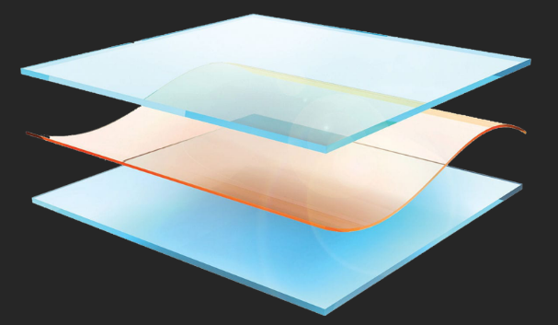
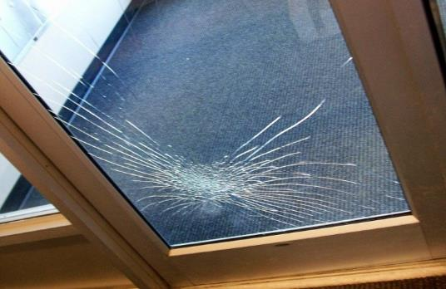
Interior Glass Walls – Key Performance Criteria, Glass

Slide 21
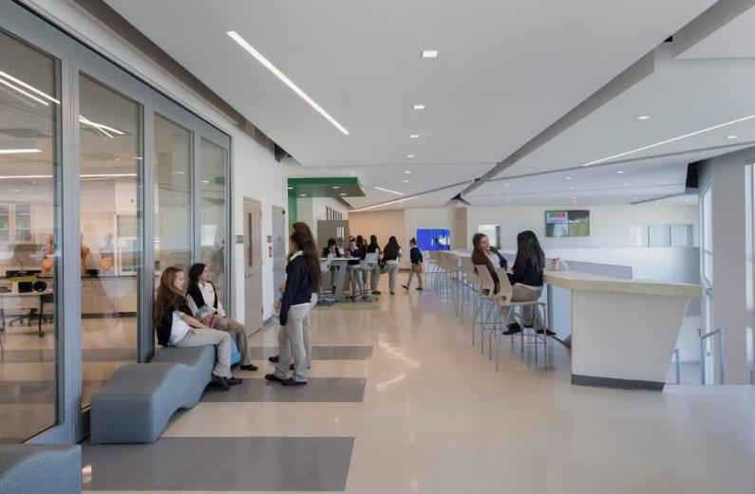
Interior Glass Walls – Key Performance Criteria, Glass

Slide 22
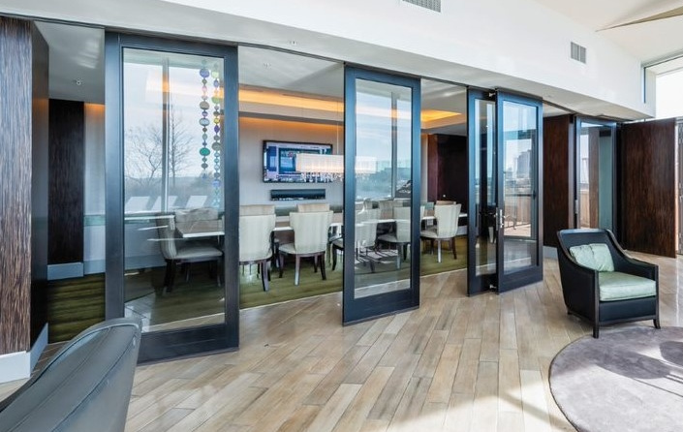
Interior Glass Walls – Performance Criteria, Support
Acoustics
Glass Type
Overhead or floor support
Configuration & Operation
Sustainability/IAQ
Aesthetics (color, style, frame thickness)

Slide 23
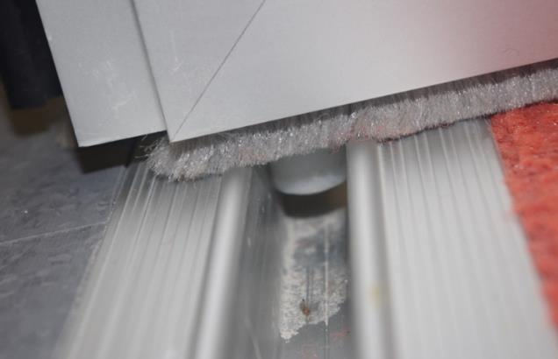
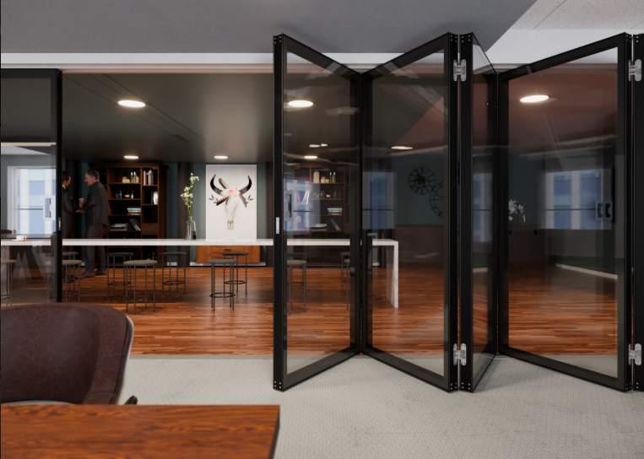
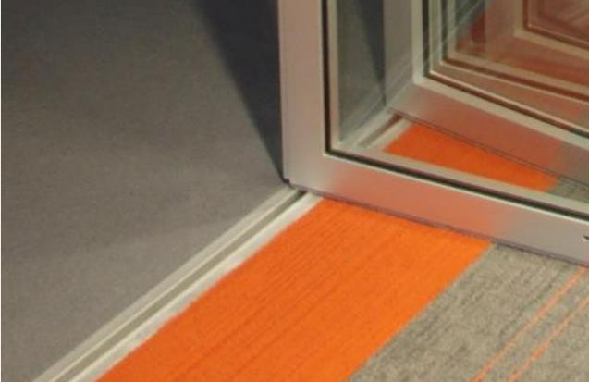
Interior Glass Walls – Performance Criteria, Support

Slide 24
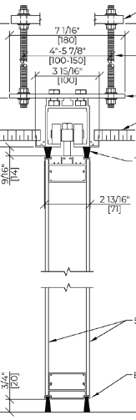
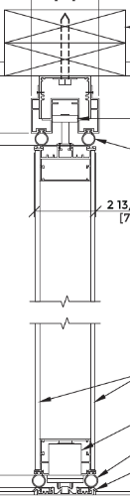
Interior Glass Walls – Performance Criteria, Support
Overhead support
Floor support

Slide 25
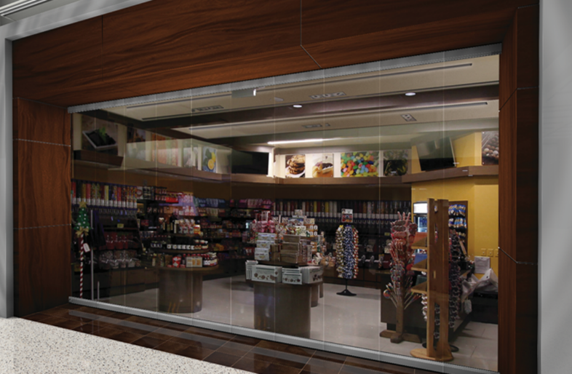
Interior Glass Walls – Performance Criteria, Support

Slide 26
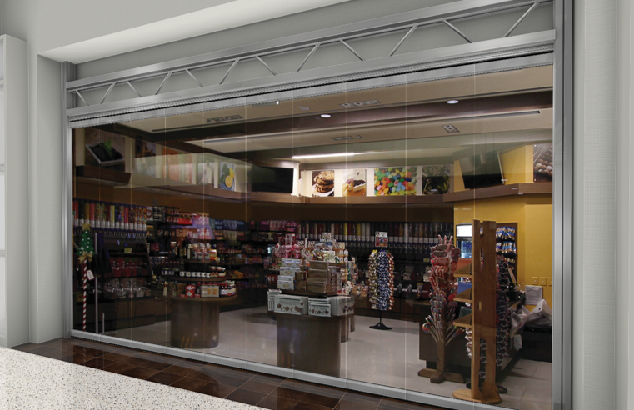
Interior Glass Walls – Performance Criteria, Support

Slide 27
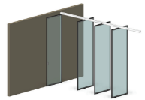
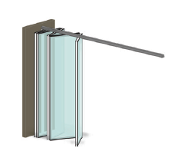
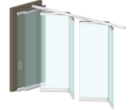
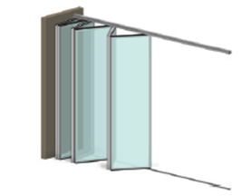
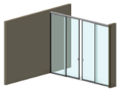
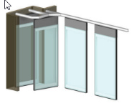
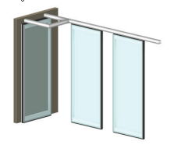
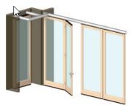
Interior Glass Walls – Performance Criteria, Configuration
Acoustics
Glass Type
Overhead or floor support
Configuration & Operation
Sustainability/IAQ
Aesthetics
Pivoting w/Center Stack
Hinged Pairs
Continuous Hinged Center Stack
Sliding Folding Edge Support
Sliding Telescopic
Fully Auto Single
Semi Auto Single
Single with Hinged Door

Slide 28
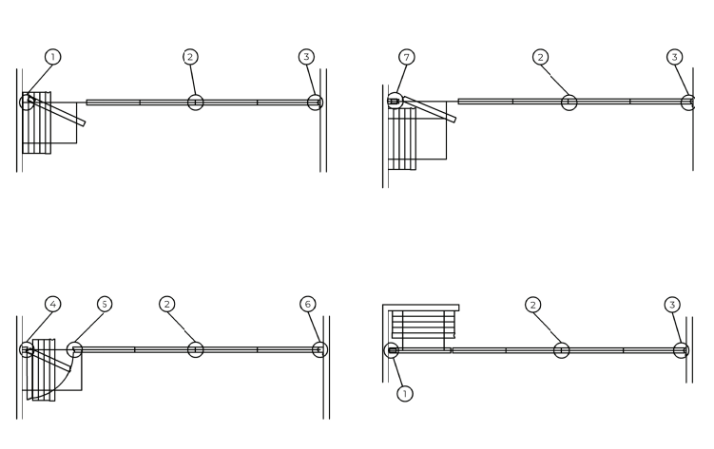
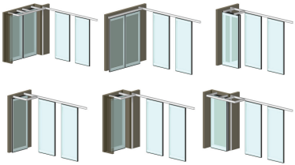
Interior Glass Walls – Performance Criteria, Configuration
Stacking Configurations
Individual Panels

Slide 29
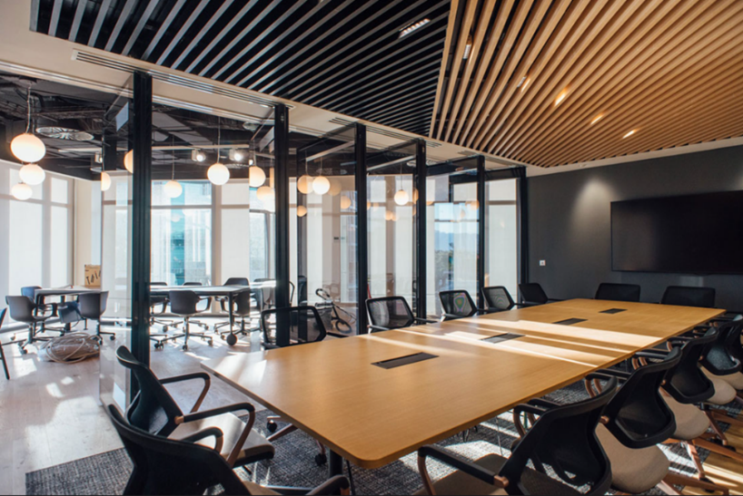
Interior Glass Walls – Performance Criteria, Configuration
Single Panel
  Center Carrier
  Two Carrier,
  Multi-Directional
Hinged Pair Panels
Sliding Folding
  Continuously Hinged
  Side Stacking
Pivoting
Telescopic

Slide 30
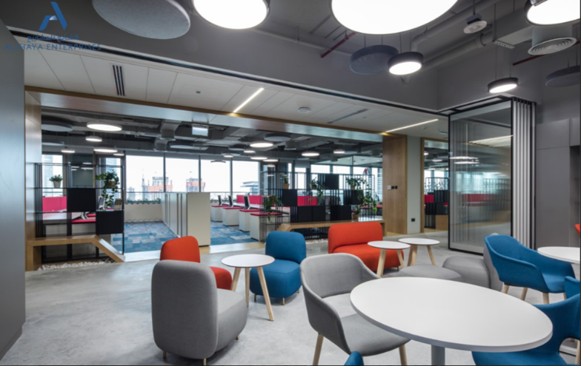
Interior Glass Walls – Performance Criteria, Configuration
Single Panel
  Center Carrier
  Two Carrier,
  Multi-Directional
Hinged Pair Panels
Sliding Folding
  Continuously Hinged
  Side Stacking
Pivoting
Telescopic

Slide 31
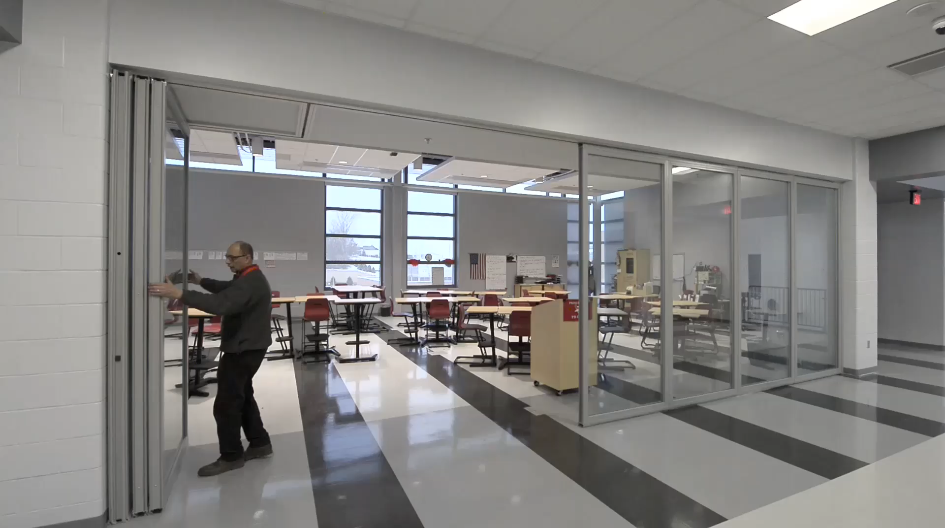
Interior Glass Walls – Performance Criteria, Configuration
Single Panel
  Center Carrier
  Two Carrier,
  Multi-Directional
Hinged Pair Panels
Sliding Folding
  Continuously Hinged
  Side Stacking
Pivoting
Telescopic

Slide 32
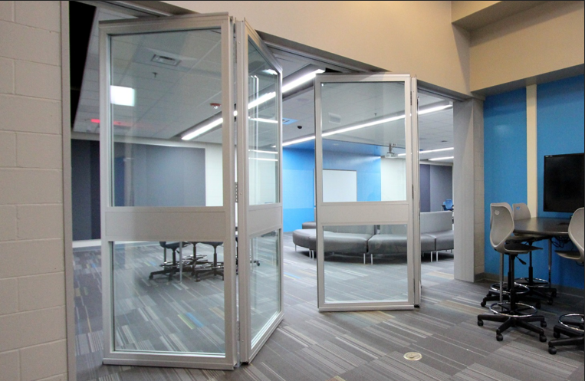
Interior Glass Walls – Performance Criteria, Configuration
Single Panel
  Center Carrier
  Two Carrier,
  Multi-Directional
Hinged Pair Panels
Sliding Folding
  Continuously Hinged
  Side Stacking
Pivoting
Telescopic

Slide 33
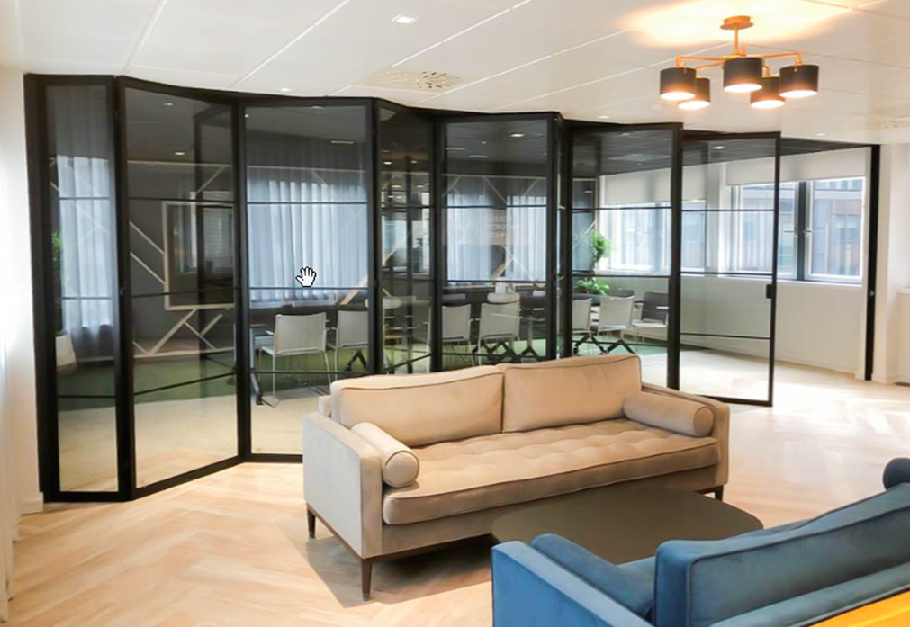
Interior Glass Walls – Performance Criteria, Configuration
Single Panel
  Center Carrier
  Two Carrier,
  Multi-Directional
  Hinged Pair Panels
Sliding Folding
  Continuously Hinged
  Side Stacking
Pivoting
Telescopic

Slide 34
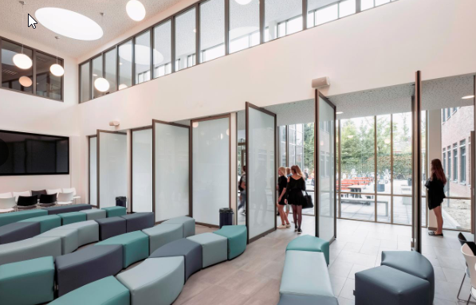
Interior Walls – Key Performance Criteria, Configuration
Single Panel
  Center Carrier
  Two Carrier,
  Multi-Directional
  Hinged Pair Panels
Sliding Folding
  Continuously Hinged
  Side Stacking
Pivoting
Telescopic

Slide 35
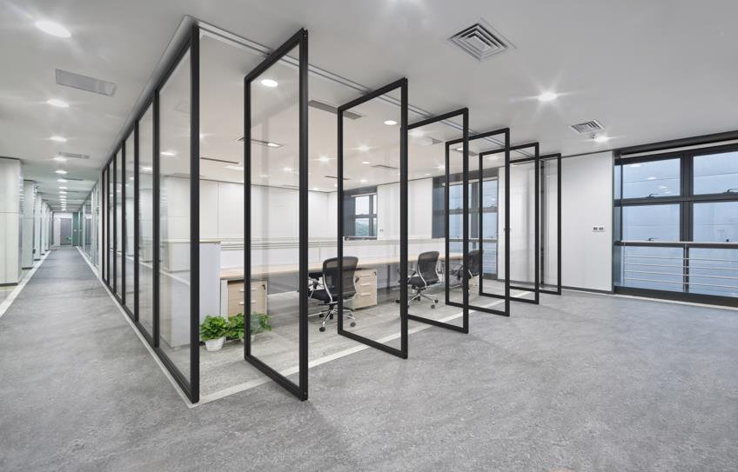
Interior Glass Walls – Performance Criteria, Configuration
Single Panel
  Center Carrier
  Two Carrier,
  Multi-Directional
  Hinged Pair Panels
Sliding Folding
  Continuously Hinged
  Side Stacking
Pivoting
Telescopic

Slide 36

Interior Glass Walls – Performance Criteria, Configuration
Single Panel
  Center Carrier
  Two Carrier,
  Multi-Directional
  Hinged Pair Panels
Sliding Folding
  Continuously Hinged
  Side Stacking
Pivoting
Telescopic

Slide 37

Interior Glass Wall – Performance Criteria, Configuration
Single Panel
  Center Carrier
  Two Carrier,
  Multi-Directional
  Hinged Pair Panels
Sliding Folding
  Continuously Hinged
  Side Stacking
Pivoting
Telescopic

Slide 38

Learning Objective 2
Review the importance of acoustic performance, structural support, glass type and surrounding seals affect performance of interior movable partitions.

Slide 39

Interior Glass Walls – Acoustics
Acoustic performance as measured by ASTM E90 in movable glass walls are affected by three main factors:
Glass type
Panel thickness
Partition seal systems (seal force pressure)

Slide 40

Interior Glass Wall – Acoustics
Movable glass walls range in STC value between 28 to 51 STC.
Traditionally in offices the STC is specified from 43STC to 51 STC.

Slide 41



Interior Glass Walls – Acoustics
Single pane tempered
½” glass walls achieve estimated 32 STC - 35 STC
Single pane laminated
½” glass walls
achieve 35 STC - 37 STC
Sealed and IGU systems achieve 43 STC – 51 STC based on combinations

Slide 42



Interior Glass Walls – Acoustics
Single pane tempered
½” glass walls achieve estimated 32 STC - 35 STC
Single pane laminated
½” glass walls
achieve 35 STC – 39 STC
Sealed and IGU systems achieve 43 STC – 51 STC based on combinations

Slide 43

Interior Glass Walls – Acoustics

Slide 44

Interior Glass Walls – Acoustics

Slide 45

Interior Glass Walls – Acoustics, Seals
Floor strikes
Manual (Bottoms/Top & Bottoms)
Manual Automatic (Bayonet)
Electric Semi-Automatic
Electric Fully Automatic

Slide 46

Interior Glass Walls – Acoustics, Seals
Floor strikes
Manual (Bottoms/Top & Bottoms)
Manual Automatic (Bayonet)
Electric Semi-Automatic
Electric Fully Automatic

Slide 47

Interior Glass Walls – Acoustics, Seals
Floor strikes
Manual (Bottoms/Top & Bottoms)
Manual Automatic (Bayonet)
Electric Semi-Automatic
Electric Fully Automatic

Slide 48


Interior Glass Walls – Acoustics, Seals
Floor strikes
Manual (Bottoms/Top & Bottoms)
Manual Automatic (Bayonet)
Electric Semi-Automatic
Electric Fully Automatic

Slide 49

Interior Glass Walls – Acoustics, Seals
Floor strikes
Manual (Bottoms/Top & Bottoms)
Manual Automatic (Bayonet)
Electric Semi-Automatic
Electric Fully Automatic

Slide 50

Interior Glass Walls – Acoustics, Seals
Floor strikes
Manual (Bottoms/Top & Bottoms)
Manual Automatic (Bayonet)
Electric Semi-Automatic
Electric Fully Automatic

Slide 51

Interior Glass Walls – Acoustics, Seals
Floor strikes
Manual (Bottoms/Top & Bottoms)
Manual Automatic (Bayonet)
Electric Semi-Automatic
Electric Fully Automatic

Slide 52

Interior Glass Wall – Acoustics, Seals
Floor strikes
Manual (Bottoms/Top & Bottoms)
Manual Automatic (Bayonet)
Electric Semi-Automatic
Electric Fully Automatic

Slide 53



Interior Glass Walls – Acoustic Standards
Field acoustical performance will be enhanced if you build the surrounding conditions using guidelines provided by ASTM E557. This standard outlines key construction requirement that reduce sound flanking paths around the glass movable wall.

Slide 54



Interior Glass Walls – Acoustic Standards
ASTM E557 Key Points:
Compressing carpets with seal pressure or transition divides installed
Bracing and insulation where partitions seals up to permanent walls
Sound barriers above the track systems in the plenum

Slide 55

Interior Glass Walls – Acoustic Recap
Glass type and panel thicknesses are keys to movable glass wall acoustics
Sealed dual glazed systems provide highest levels of acoustics
Bottom seals that provide pressure both electric and manual improve field performance
Design surrounding conditions per ASTM E557

Slide 56

Learning Objective 3
Learn how movable glass walls optimize sustainable building design
including materials, indoor air quality and daylighting.

Slide 57



Interior Glass Walls – Sustainability & Daylighting
Field acoustical performance will be enhanced if you build the surrounding conditions using guidelines provided by ASTM E557. This standard outlines key construction requirement that reduce sound flanking paths around the glass movable wall.

Slide 58

Interior Glass Walls – Sustainability & Daylighting
Common Materials
Aluminum frames
Aluminum and steel tracks
Glass
EDM/PVC gasketing

Slide 59

Interior Glass Walls – Sustainability & Daylighting
Common Materials
Wood Frames

Slide 60

Interior Glass Walls – Sustainability & Daylighting
Common Materials
Polycarbonate

Slide 61

Interior Glass Walls – Sustainability & Daylighting
Daylighting
Movable glass wall allow more interior spaces to receive the benefits of daylight at the same time provide the privacy and space division to best utilize interior flexible spaces.

Slide 62

Interior Glass Walls – Sustainability & Daylighting

Slide 63

Interior Glass Walls – Sustainability & Daylighting

Slide 64

Learning Objective 4
Review how movable glass partitions add to the human experience
within the built environment.

Slide 65

Interior Glass Walls – The Built Environment

Slide 66

Interior Glass Walls – The Built Environment

Slide 67

Interior Glass Walls – The Built Environment

Slide 68

Interior Glass Walls – The Built Environment

Slide 69

Interior Glass Walls – The Built Environment

Slide 70

Interior Glass Walls – The Built Environment

Slide 71

Interior Glass Walls – The Built Environment

Slide 72

Interior Glass Walls – The Built Environment

Slide 73

Interior Glass Walls – The Built Environment

Slide 74

Interior Glass Walls – The Built Environment

Slide 75

Interior Glass Walls – The Built Environment

Slide 76

Interior Glass Walls – The Built Environment

Slide 77

Interior Glass Walls – The Built Environment

Slide 78

Interior Glass Walls – The Built Environment

Slide 79

Interior Glass Walls – The Built Environment

Slide 80

Interior Glass Walls – The Built Environment

Slide 81

Interior Glass Walls – The Built Environment

Slide 82

Interior Glass Walls – The Built Environment

Slide 83

Interior Glass Walls – The Built Environment

Slide 84

Interior Glass Walls – The Built Environment

Slide 85


Interior Glass Walls – The Built Environment

Slide 86

Interior Glass Walls – The Built Environment

Slide 87

Interior Glass Walls – The Built Environment

Slide 88

Interior Glass Walls – The Built Environment

Slide 89

Interior Glass Walls – The Built Environment

Slide 90

Interior Glass Walls – The Built Environment

Slide 91


Interior Glass Walls – The Built Environment

Slide 92

Interior Glass Walls – The Built Environment

Slide 93

Interior Glass Walls – The Built Environment

Slide 94



Interior Glass Walls – The Built Environment

Slide 95

Interior Glass Walls – The Built Environment

Slide 96


Interior Glass Walls – The Built Environment

Slide 97

Interior Glass Walls – The Built Environment
Notes:
all right, this edge and this edge, this actually is all the material. The aluminum that's on the edge is just this very little, this very little piece that's coming around the edge, and then it's back painted white.
194
00:48:28.390 --> 00:48:36.750
Scott Staedter: all right, and the interior frame is white as well, but it's back painted, and the glass is held in with a combination of
195
00:48:37.210 --> 00:49:05.950
Scott Staedter: glue and tape. All right. And so you have tape and glue, and why the back paint is that's there to hide how that piece of glass is actually glued into the frame, and it makes it allows it so. There's just a hairline of material between the 2 panels, very, very sleek. And so when you look at that from the side as this photo shows, it looks like you are. Just got a solid glass wall all the way across here.
196
00:49:06.390 --> 00:49:25.720
Scott Staedter: all right, very, very sleek looking looking design, because you have so much glass to the outside edge. Yes, you still have a back painting glass that makes the the vertical mullion look to it, but the the vertical style. Look to it. But, man it is. It is sleek looking stuff.

Slide 98

Interior Glass Walls – The Built Environment

Slide 99

Interior Glass Walls – The Built Environment

Slide 100

Interior Glass Walls – The Built Environment

Slide 101

Interior Glass Walls – The Built Environment

Slide 102

Interior Glass Walls – The Built Environment

Slide 103

Interior Glass Walls – The Built Environment

Slide 104

Thank You

Slide 105


Transforming Space Into
POSSIBILITIES
MOVABLE WALL SYSTEMS
Interior Movable Glass Walls
Optimal aesthetics with flexibility, daylighting, and acoustic performance
Program 4650C
Credit: 1 LU/HSW
Kwik-Wall Provider # J426

Slide 106
Transforming Space Into
POSSIBILITIES
MOVABLE WALL SYSTEMS
Local Kwik-Wall Distribution Partner
Design | Bid | Installation | Service

Slide 107

Transforming Space Into
POSSIBILITIES
MOVABLE WALL SYSTEMS
Interior Movable Glass Walls
Optimal aesthetics with flexibility, daylighting, and acoustic performance
IDCEC Program: CEU-124371
Enter QR Code Here for IDCEC Credit

Slide 108

Transforming Space Into
POSSIBILITIES
MOVABLE WALL SYSTEMS

Slide 109

Transforming Space Into
POSSIBILITIES
MOVABLE WALL SYSTEMS

Slide 110
Transforming Space Into
POSSIBILITIES
MOVABLE WALL SYSTEMS
Local Kwik-Wall Distribution Partner
Design | Bid | Installation | Service

