Slide 1
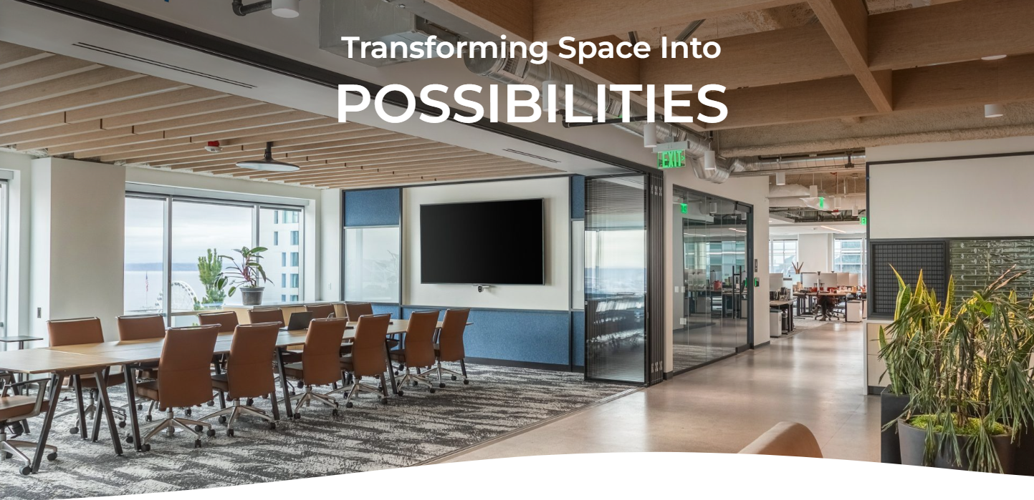


Slide 2

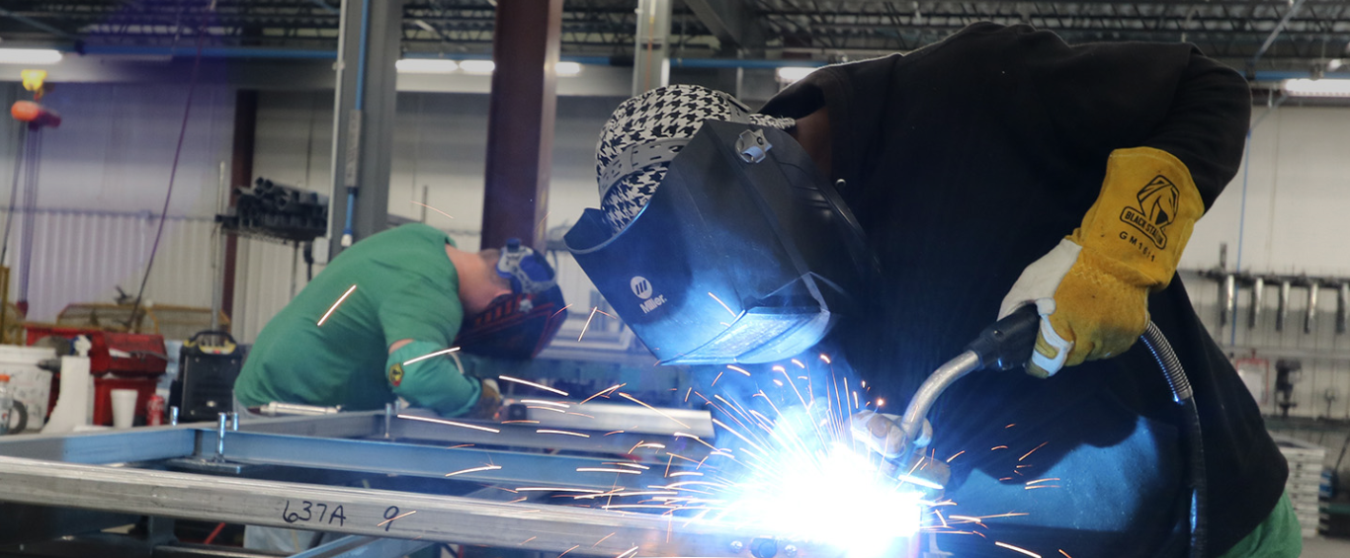
Transforming Space Into
POSSIBILITIES
MOVABLE WALL SYSTEMS
Who is Kwik-Wall
Fabricating operable partitions since 1961 in Springfield, IL
96-year tenure in manufacturing
3 U.S. based manufacturing facilities
Global distribution and service
Industry-best warranty
Industry-best lead times
Widest range of self-supporting systems
Limitless finish options

Slide 3



Transforming Space Into
POSSIBILITIES
MOVABLE WALL SYSTEMS
Committed to Excellence Since 1961
Committed to leading the industry in high-value product innovation, sound control, product availability.
U.S. Distribution in every state and 18 countries around the world. High level product and industry knowledge and capabilities.
World-class service, earned trust of architects, builders and design professionals, best production lead times and most comprehensive and responsive customer service.

Slide 4
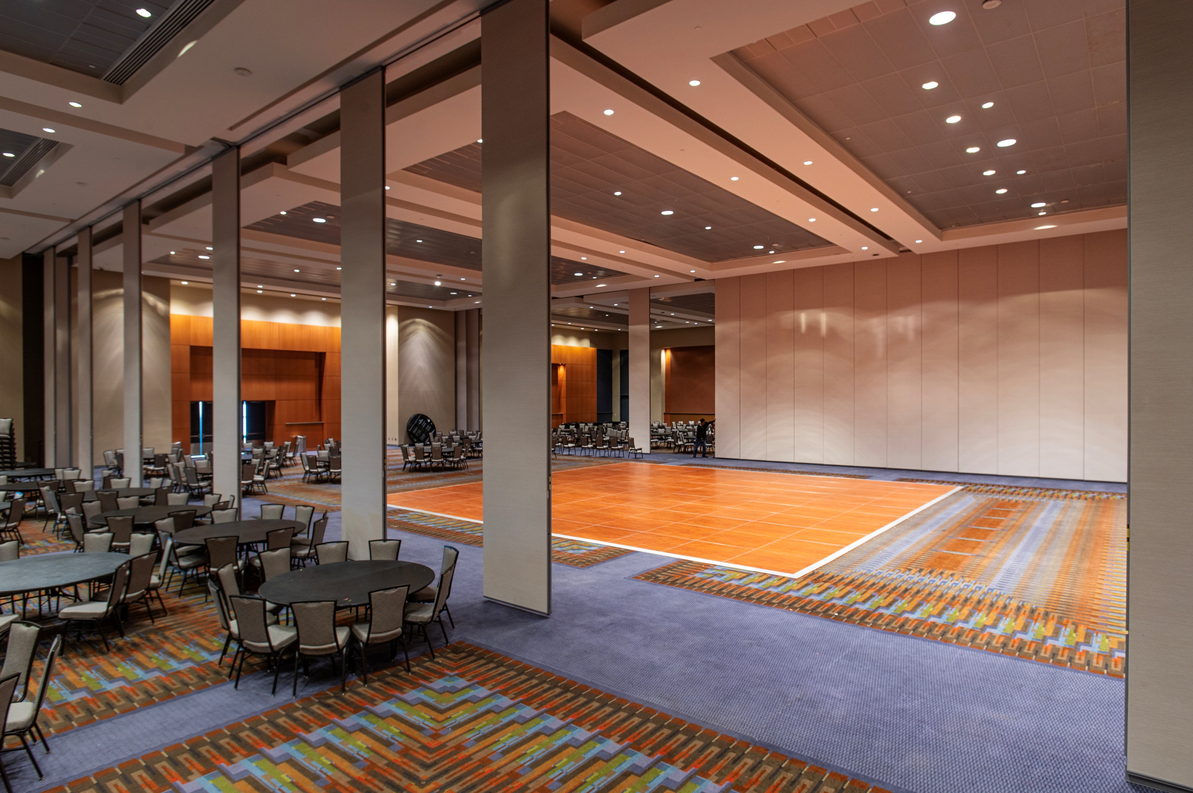
Transforming Space Into
POSSIBILITIES
MOVABLE WALL SYSTEMS
Operable Partitions

Slide 5
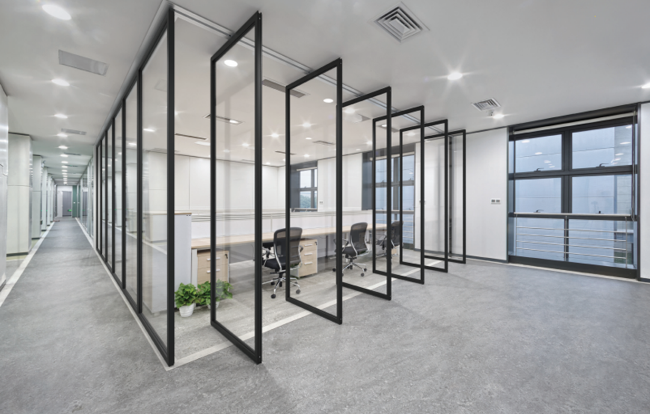
Transforming Space Into
POSSIBILITIES
MOVABLE WALL SYSTEMS
Glass Operable Partitions

Slide 6
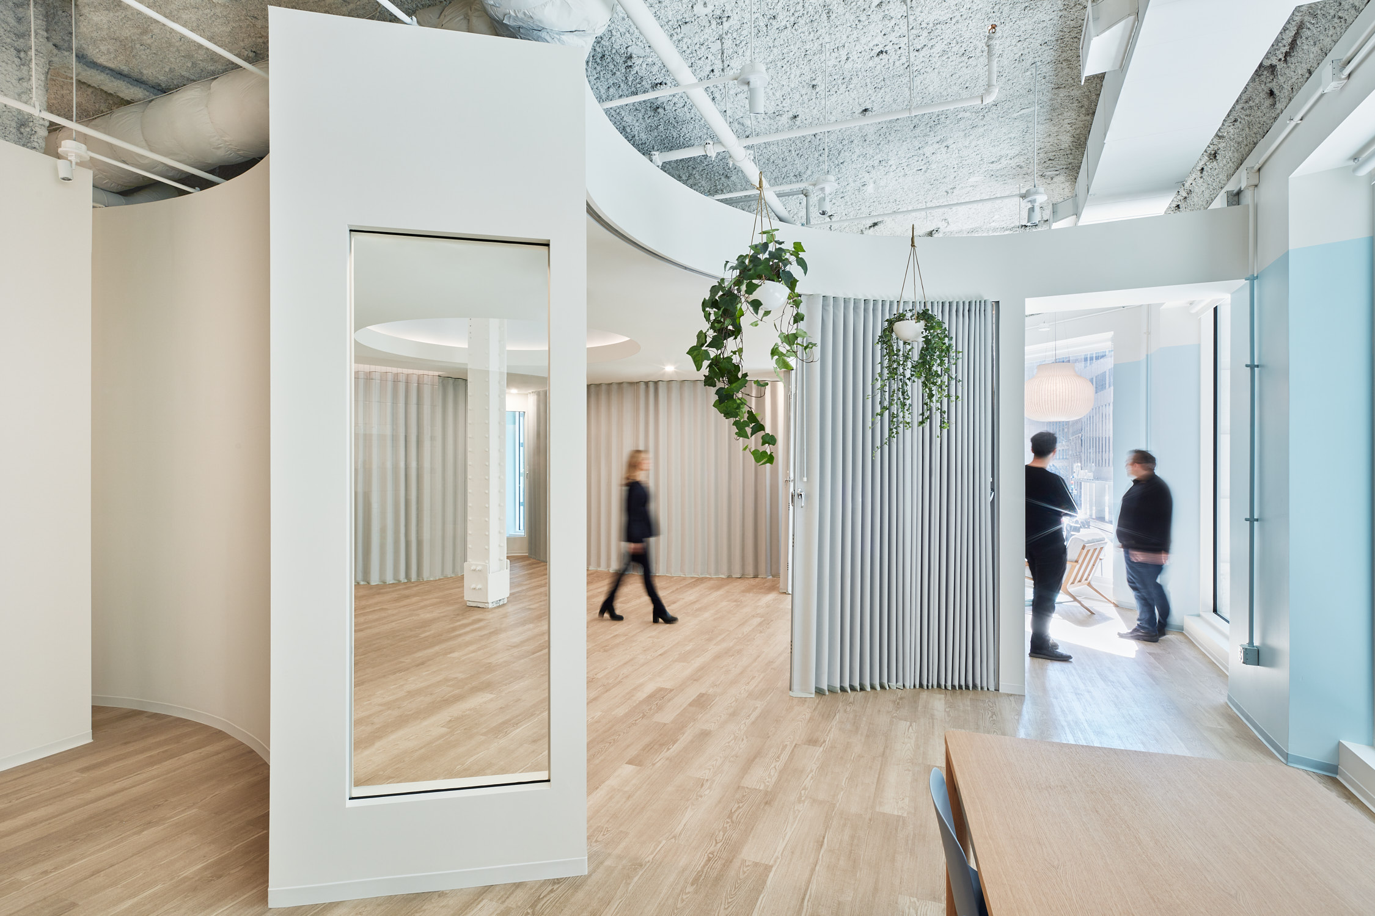
Transforming Space Into
POSSIBILITIES
MOVABLE WALL SYSTEMS
Accordion Partitions

Slide 7
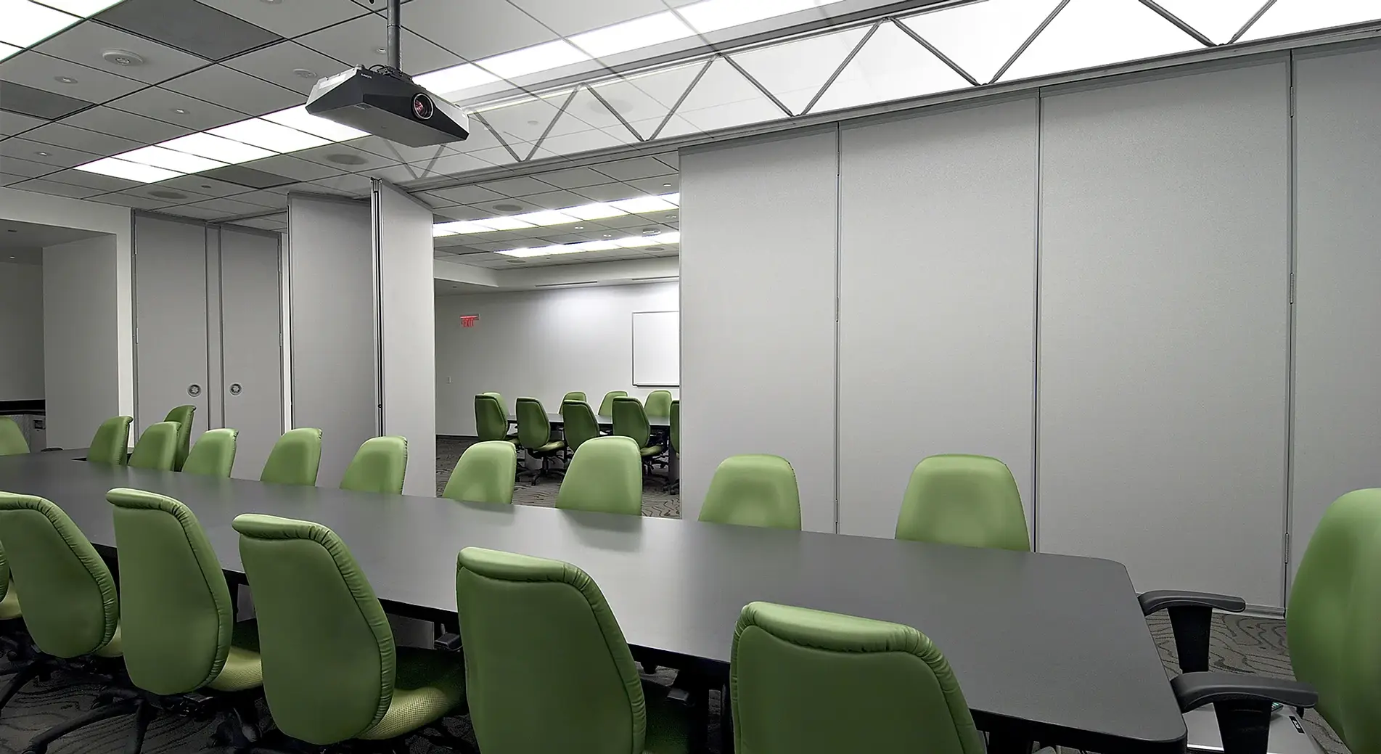
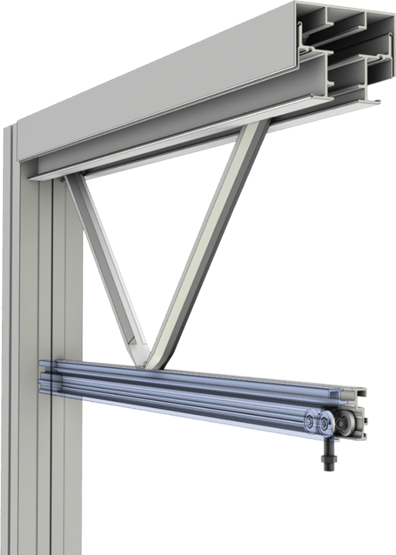
Transforming Space Into
POSSIBILITIES
MOVABLE WALL SYSTEMS
Self-Supporting Operable Partition Systems

Slide 8


Transforming Space Into
POSSIBILITIES
MOVABLE WALL SYSTEMS
Hufcor Acquisition
125-year-old global leader in the manufacturing and distribution of operable partitions.
In 2023, the demise of the once iconic brand, closed its doors leaving in it’s wake countless people without work in many factories across the globe as well as it’s mark on the architectural, engineering, specification and design communities.
Domestically, the IP was purchased by Kwik-Wall
Internationally it was purchased by Hufcor licensees in the UAE.
Products, trademarks, industry leading configurator, engineering and know-how are now under the KW umbrella

Slide 9

Transforming Space Into
POSSIBILITIES
MOVABLE WALL SYSTEMS
Engineering
600 Series Panels
NVLAP Accredited
Sound Lab
FlexTact® Tactical
training walls
Pre-Design Assistance
Tooling
300+ years of Hufcor personnel experience
Specifications
Large Global Projects
Unispan

Slide 10


Transforming Space Into
POSSIBILITIES
MOVABLE WALL SYSTEMS
Mastering Operable Partition Design & Specifications
AIA Program 4650B, 1 LU/HSW
IDCEC Program: CEU-124353

Slide 11

AIA / CES Credit
This course is registered with AIA CES for continuing professional education. As such, it does not include content that may be deemed or construed to be an approval or endorsement by the AIA of any material of construction or any method or manner of handling, using, distributing, or dealing in any material or product.
*Questions related to specific materials, methods, and services will be addressed at the conclusion of this presentation.
This presentation is protected by US and International Copyright laws.
Reproduction, distribution, display and use of the presentation without written permission of the speaker is prohibited.
© 2025

Slide 12

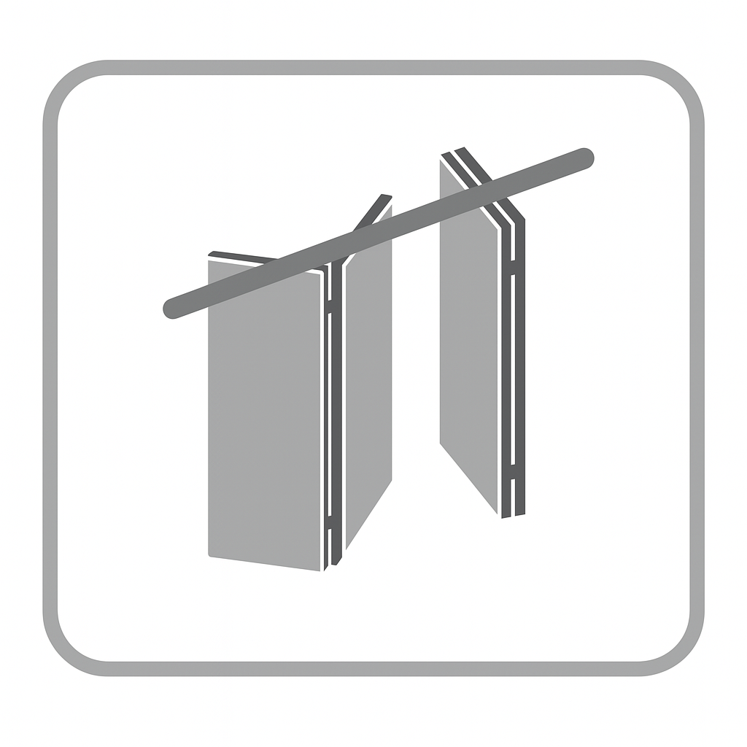


Learning Objectives
1) Identify different types of operable partitions and determine appropriate applications.
2) Understand how configuration, stacking, and suspension systems impact design and usability.
3) Write competitive, accurate specifications for operable partitions that meet project requirements.
4) Apply best architectural practices for reviewing operable partition submittals.

Slide 13

Section 1: Overview & Types of Operable Partitions

Slide 14
What Are Operable Partitions?
Flexible wall system used in buildings to divide spaces, creating space and flexibility
Designed to be stored at the perimeter of a room when not in use and moved into position to create separate rooms.
Common names: Folding Panel Partitions, Operable Walls, Movable Walls, Airwalls
Specification Sections:
10 22 39 Folding Panel Partitions
10 22 39.13 Folding Glass-Panel Partitions
10 22 33 & 08 35 13 Accordion Folding Partitions

Slide 15
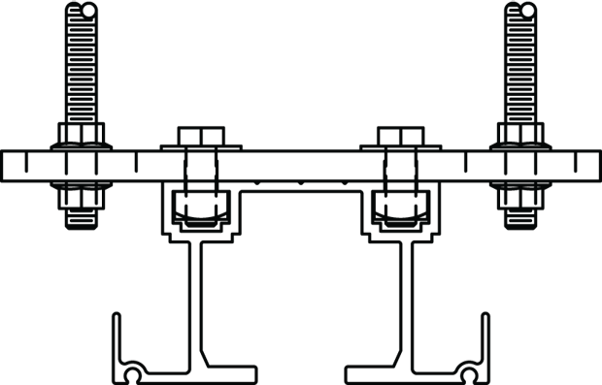
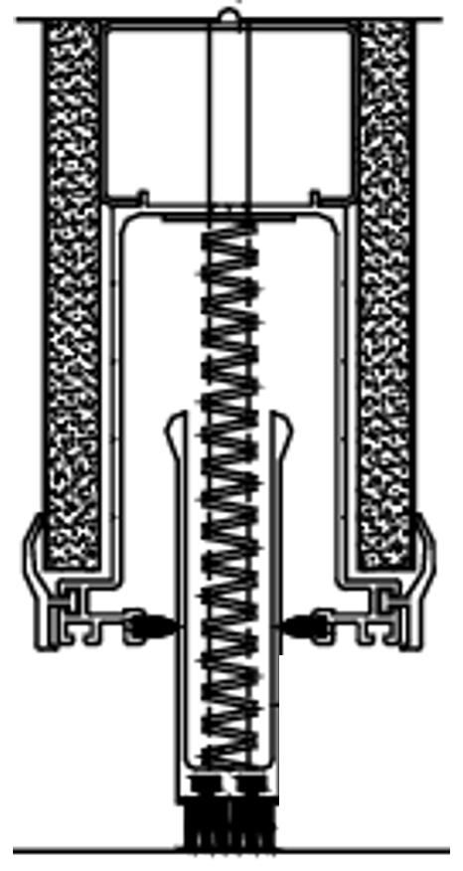


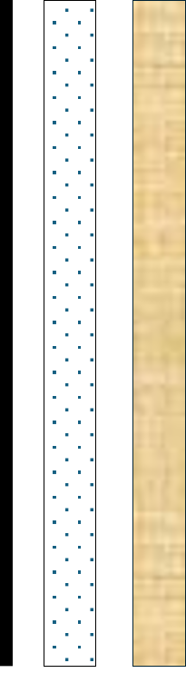
Operable Partitions – Key Features
Track Systems: Panels slide along an overhead track system
Top & Bottom Seals: Allows for panel movement and acoustic seal
Sound Transmission Class (STC): 42 - 56
Configuration & operation: manual operation or motorized
Hanging Weights: Correlated with STC Rating
Custom finishes: Vinyl, fabric, acoustic carpet, paint, or other materials.

Slide 16
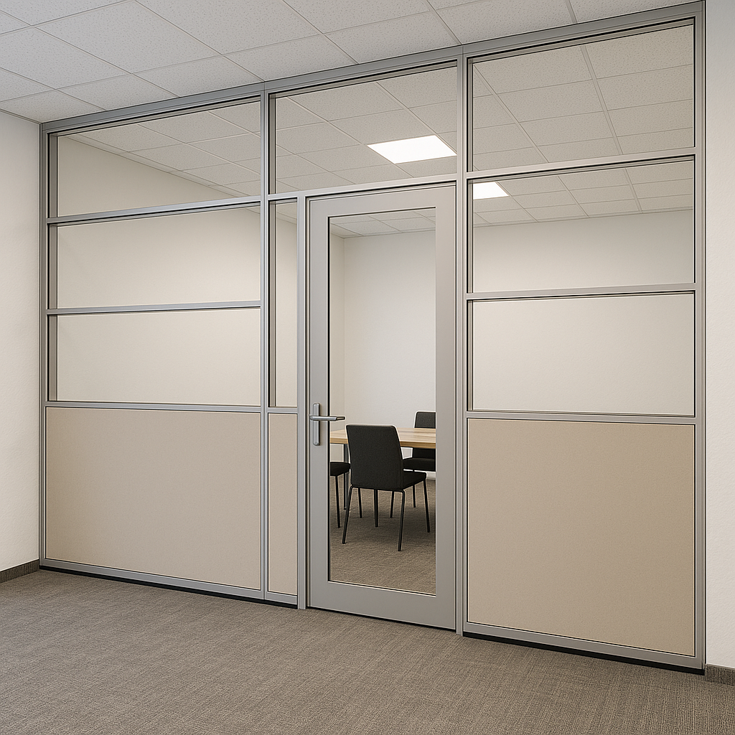
Types of Operable Partitions – What they are NOT
Demountable Partitions, Specification Section 10 22 19
Held in place with trim at top and bottom of system.
Modular components which allow for semi-permanent reconfiguration or movement without the use of track and trolley system.
Substitution for traditional construction like steel studs and gypsum.

Slide 17
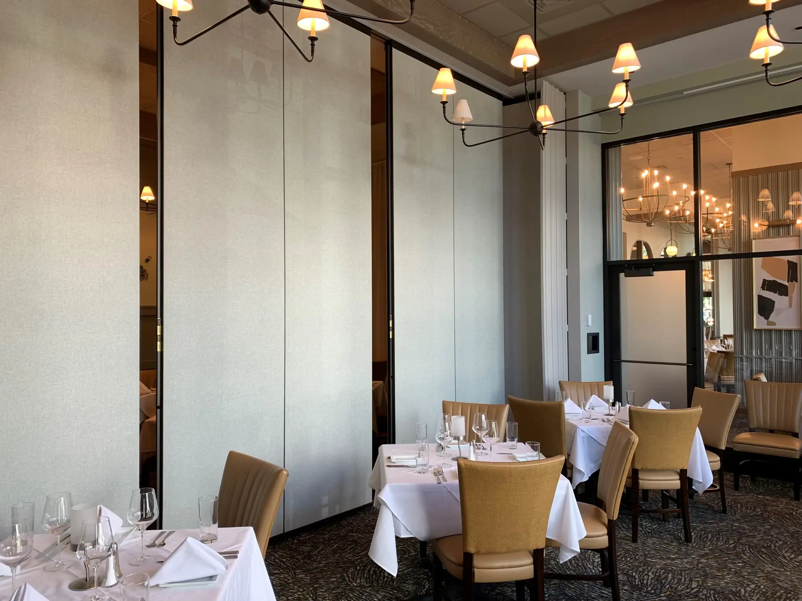
Types of Operable Partitions
Folding Panel Partitions, Operable Partitions, Movable Walls
Specification Section 10 22 26
Event Spaces
School Classrooms
Ballroom & Convention Centers

Slide 18

Types of Operable Partitions
Folding Panel Partitions, Operable Partitions, Movable Walls
Specification Section 10 22 26
Event Spaces
School Classrooms
Ballroom & Convention Centers

Slide 19
Types of Operable Partitions
Folding Panel Partitions, Operable Partitions, Movable Walls
Specification Section 10 22 26
Event Spaces
School Classrooms
Ballroom & Convention Centers

Slide 20
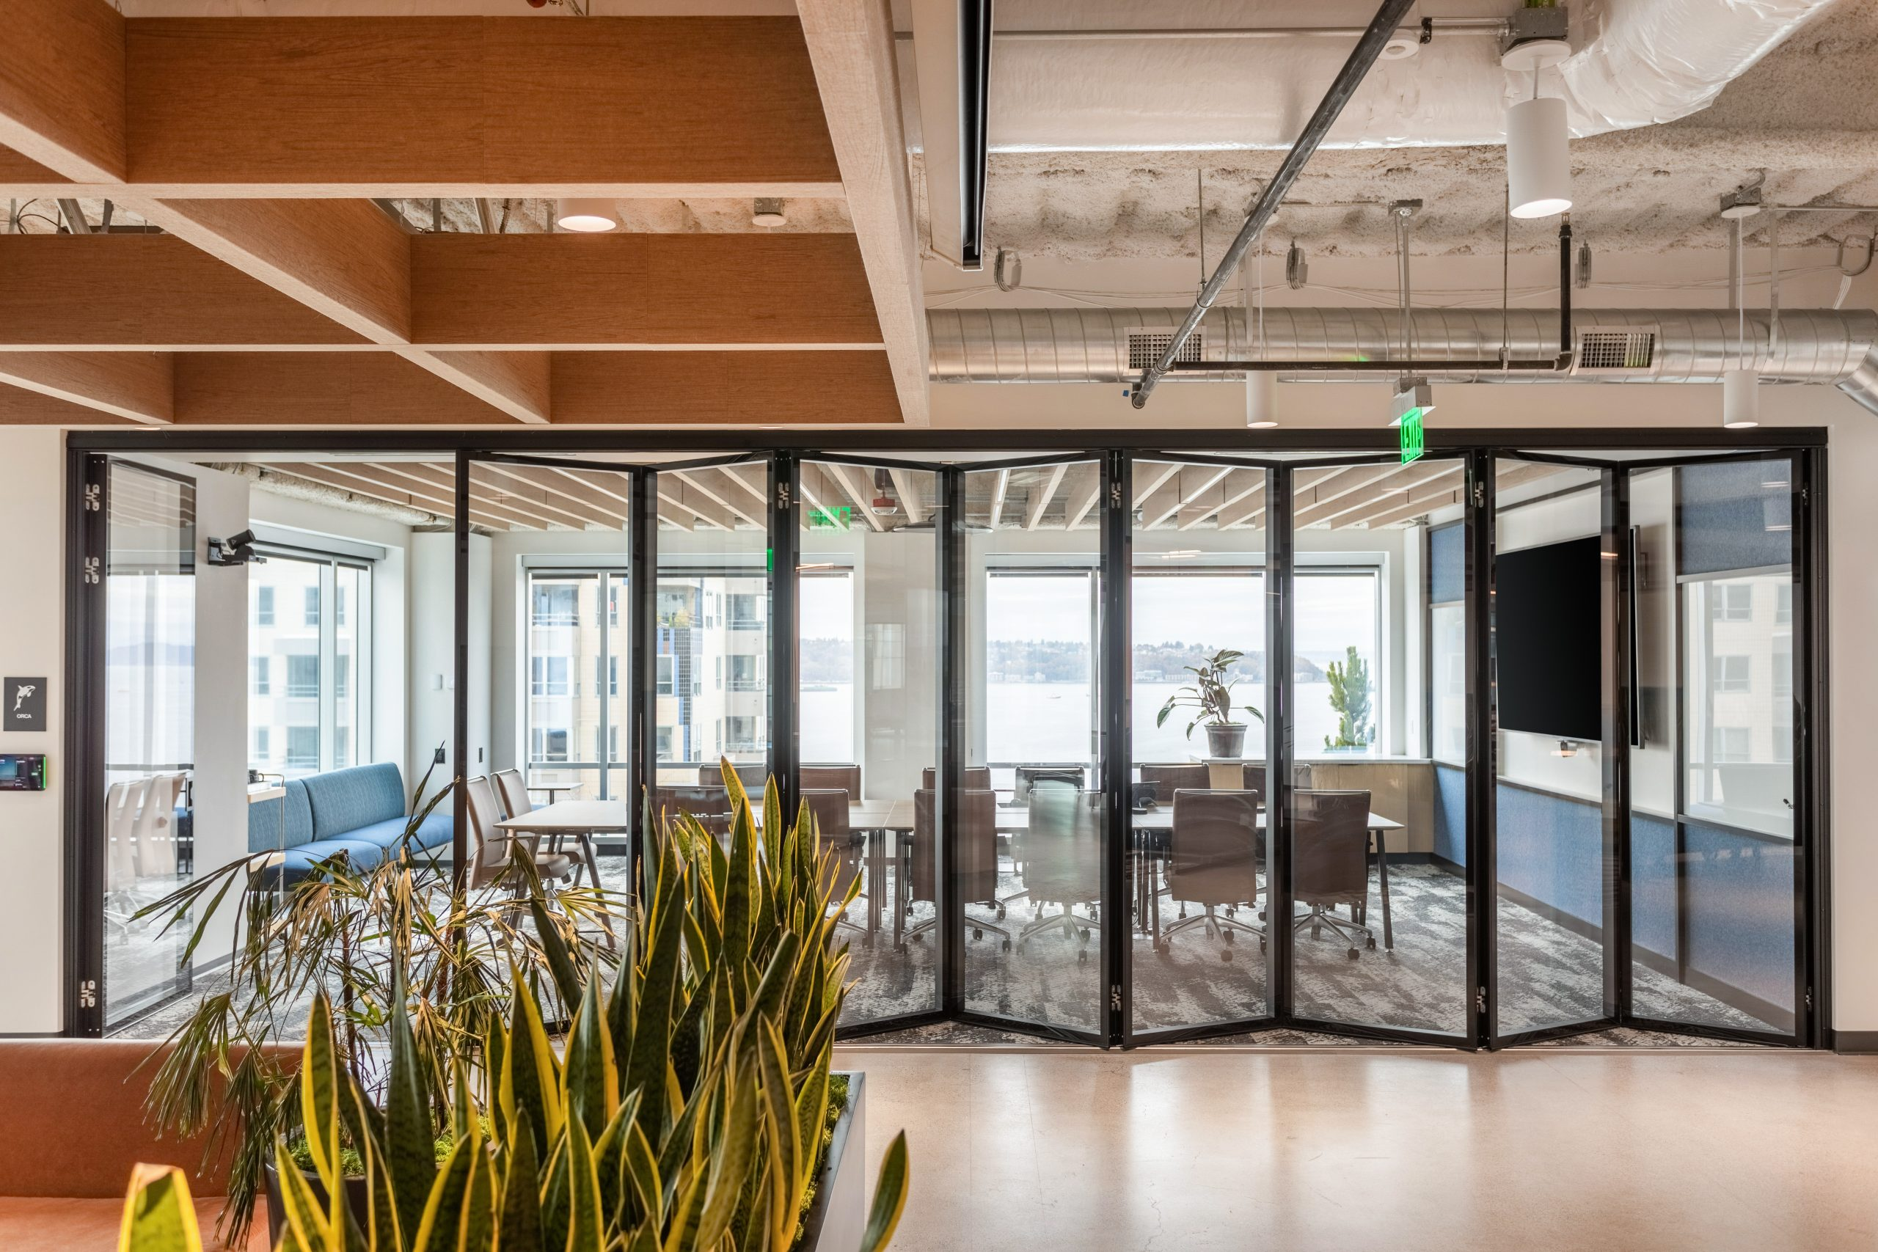
Types of Glass-Operable Partitions
Folding Glass-Panel Partitions, Specification Section 10 22 39
Office Conference Rooms
Training Centers
Dining Facilities / Restaurants

Slide 21
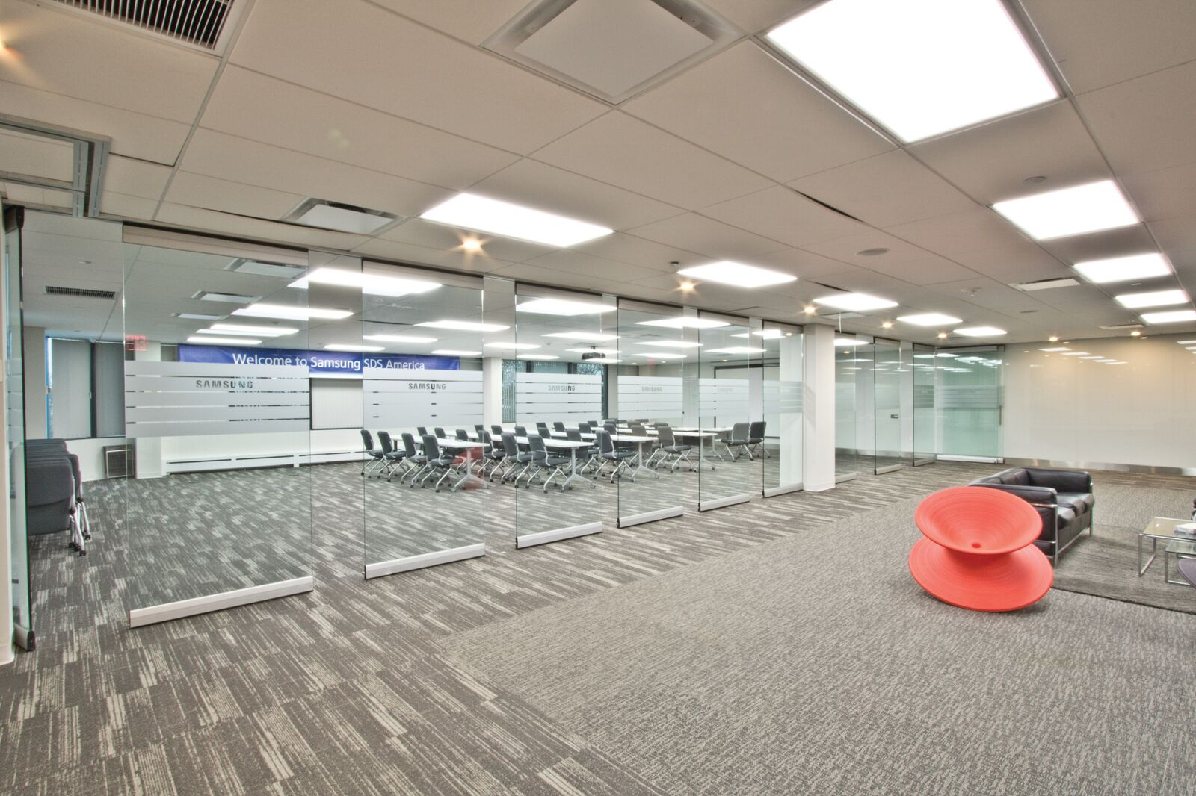
Types of Glass-Operable Partitions
Folding Glass-Panel Partitions, Specification Section 10 22 39
Office Conference Rooms
Training Centers
Dining Facilities / Restaurants

Slide 22
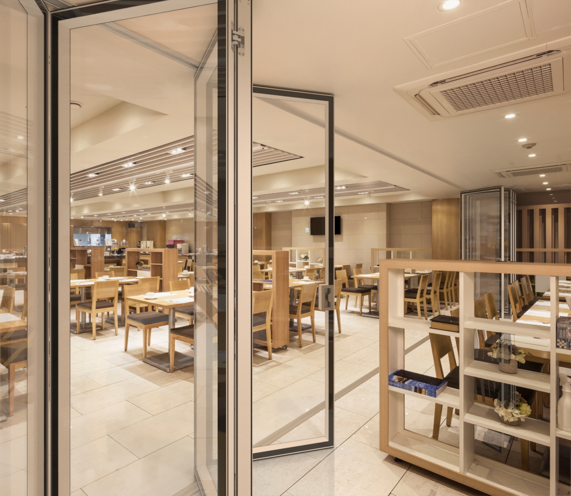
Types of Glass-Operable Partitions
Folding Glass-Panel Partitions, Specification Section 10 22 39
Office Conference Rooms
Training Centers
Dining Facilities / Restaurants

Slide 23
Types of Operable Partitions
Accordion Partitions, Section 08 35 13 & Section 10 22 33
Classrooms
Religious Facilities
Lightweight, cost-effective,
small openings

Slide 24
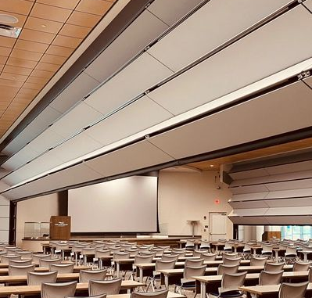
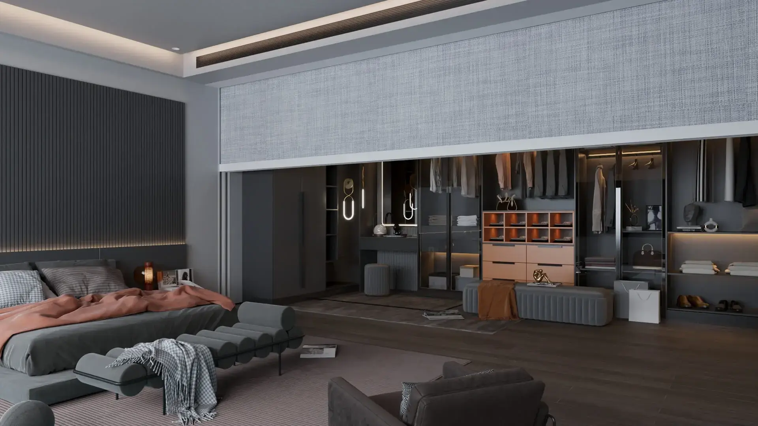
Types of Operable Partitions
Vertical Retractable Walls, Specification Section 10 22 39
Minimal Footprint spaces
Auditoriums, Large Venues

Slide 25
Product Selection Guide

Slide 26
Section 2: Design Configuration, Stacking, & Suspension

Slide 27
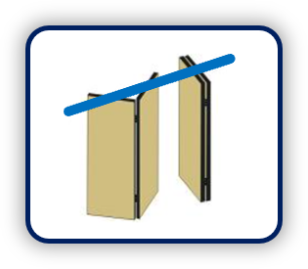
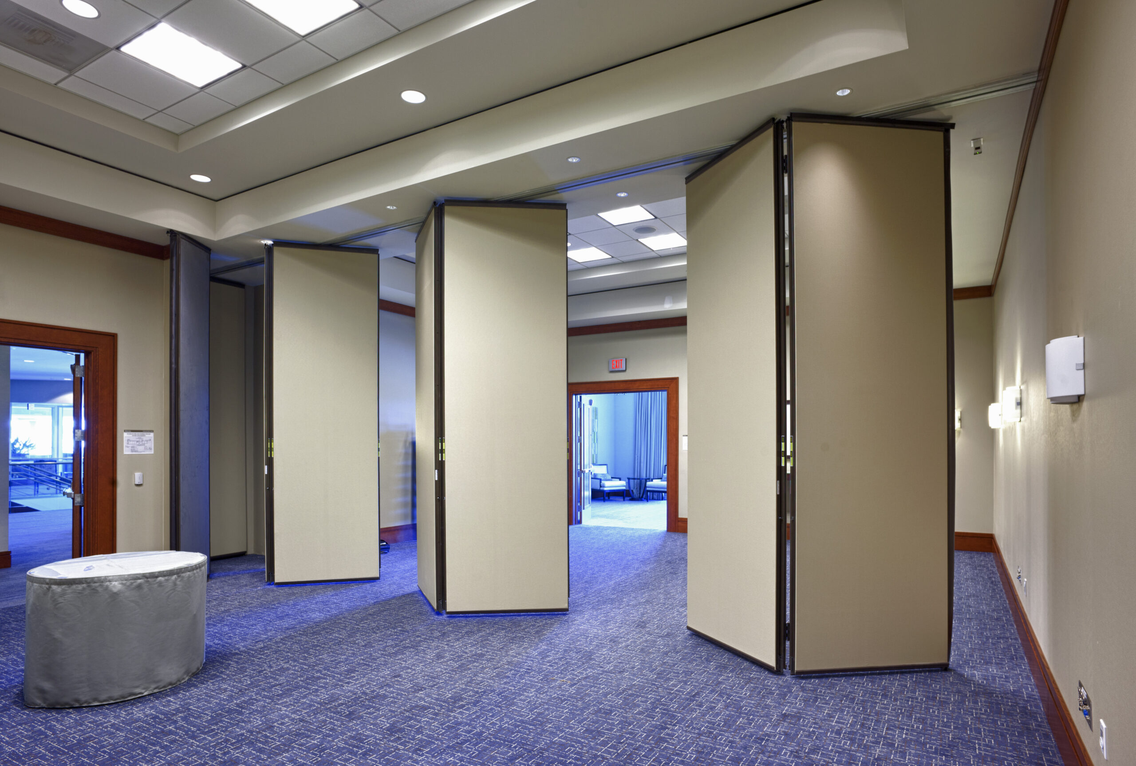
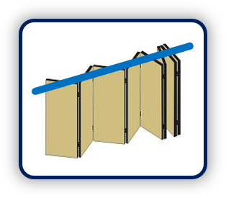
Panel Configuration: Hinged
Straight Line,
Center Stack
Continuously
Hinged

Slide 28
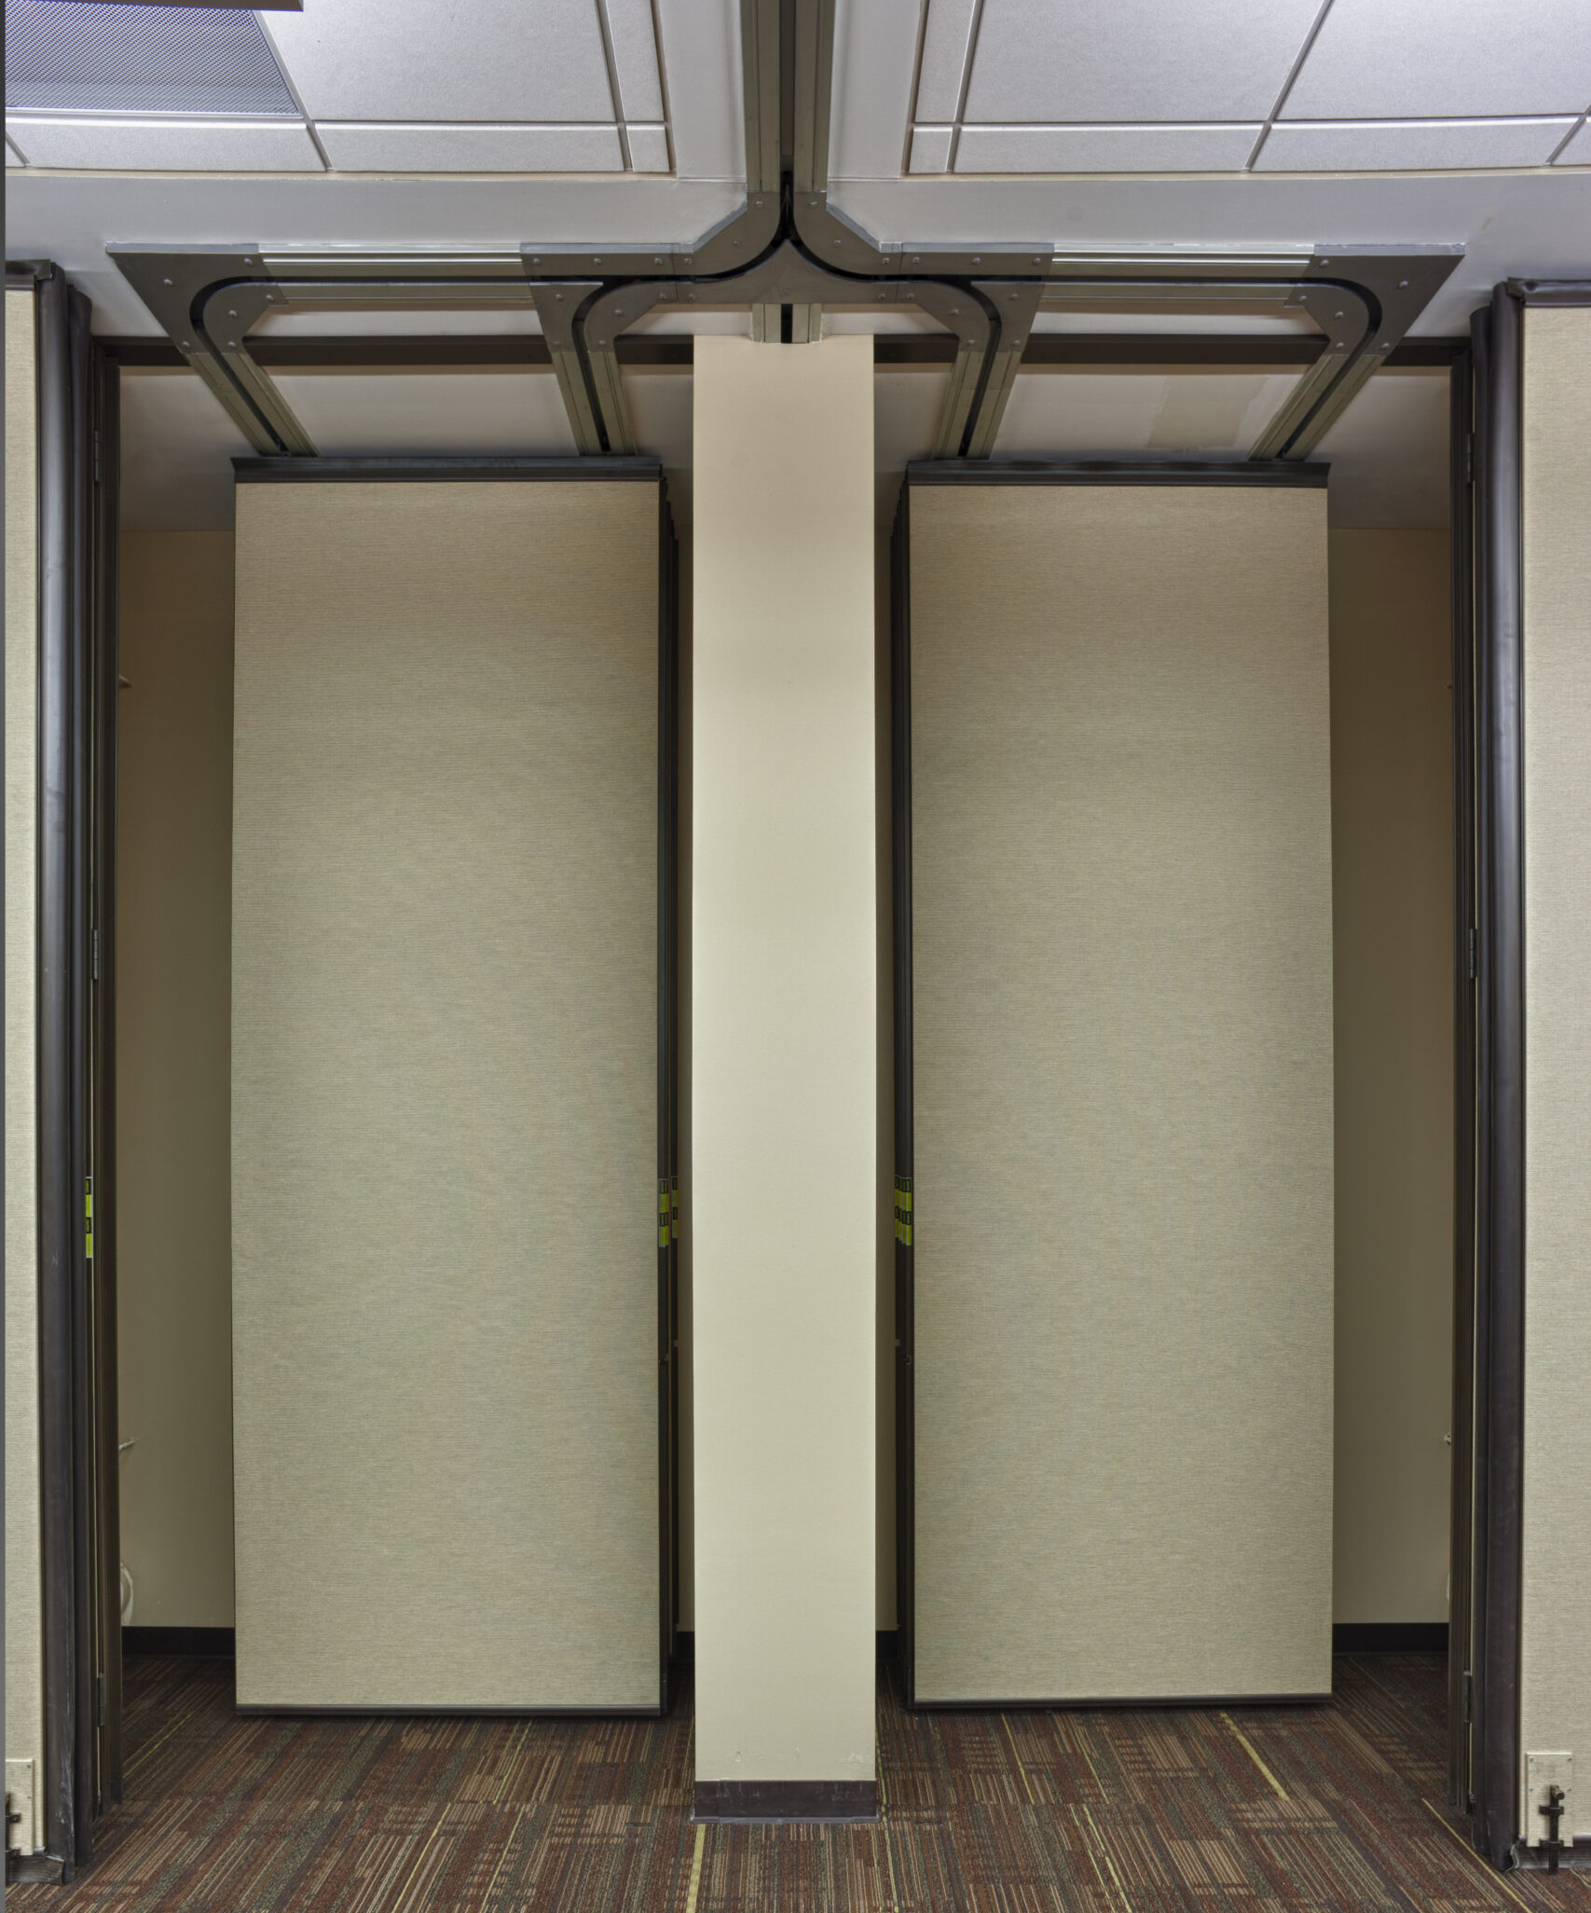

Panel Configuration: Individual Panels
Curve & Divert
Radius track and programmed carriers

Slide 29
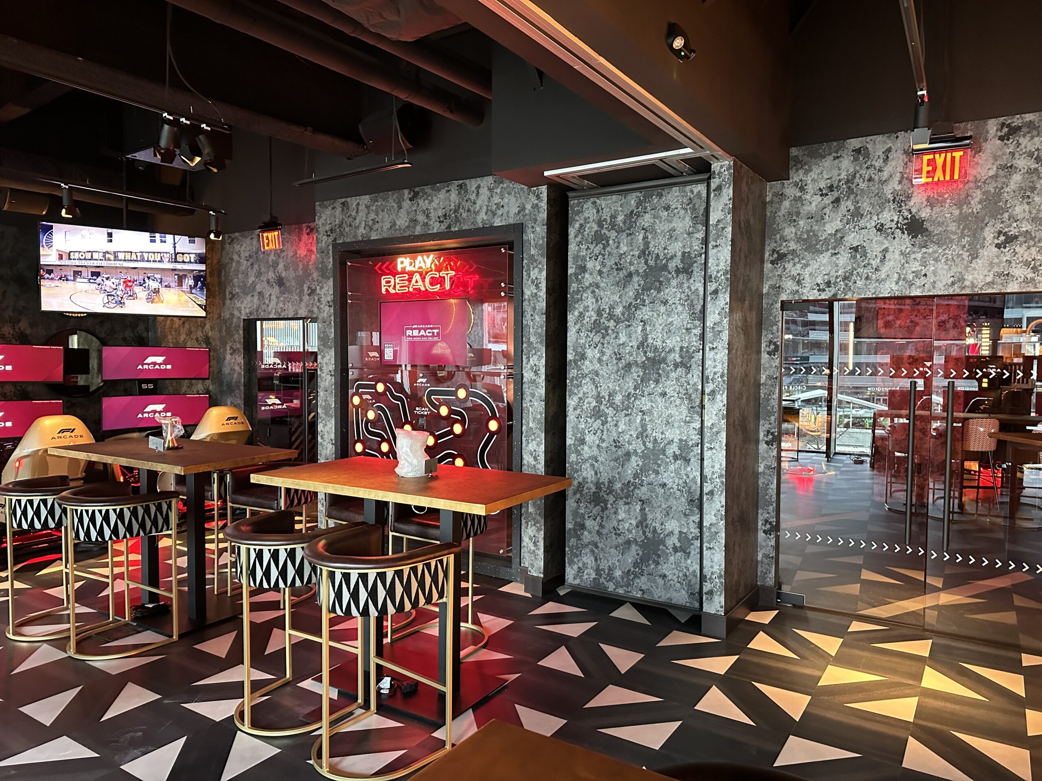
Panel Configuration: Individual Panels
Offset Stack, Remote Stack

Slide 30
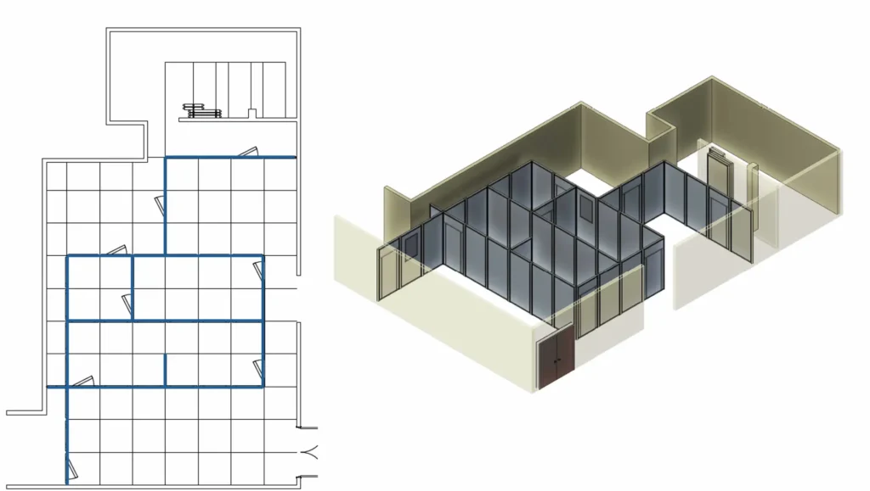
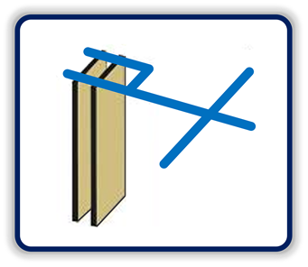
Panel Configuration: Individual Panels
Multi-Directional
Track with 90-degree
X – L – T track intersections

Slide 31

Operable Partition Options
Operable Partitions
STC Ranges: 42 – 56
ADA Pass-through Doors & Panic Hardware
Storage Pocket Doors
Finishes: Vinyl, Fabric, Acoustical Carpet, HPL, Veneer, COM
Vertical Panel Joints: Trimless or Cap Trimmed
Dry Erase Marker Surfaces
Glass Inserts
Electrically Operated

Slide 32

Operable Glass Partition Options
Operable Partitions
STC Ranges: 0 – 50
Pass-through Doors
Automation: Full or Semi
Exposed or concealed frame
Continuously Hinged
Individual Pivoting
Dry Erase Marker Surfaces

Slide 33

Accordion Options
Accordion Partitions
STC Ranges: 35 – 40
Bi-parting
Finishes: Vinyl, Fabric, Acoustical Carpet, COM
Locks
Radius track and partition layouts
Sliding Jambs for Pocket Storage

Slide 34
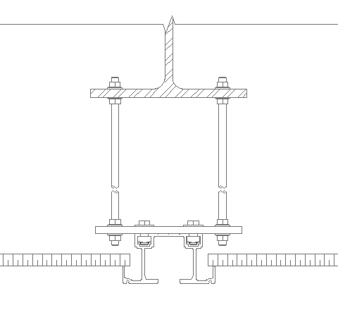
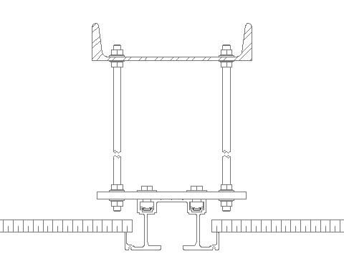
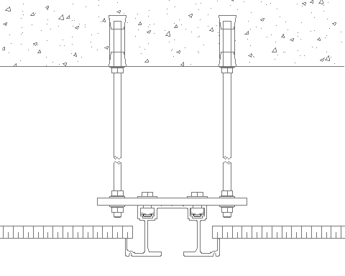
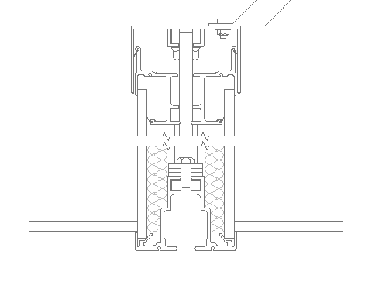
Suspension Systems
Track Systems and Support Options
Floor supported systems only available on some Glass Wall Systems
Coordinate operable partition hanging weight with structural engineer for correct support sizing
Common structural support:
Steel I-Beam
Steel C-Channel
Concrete Anchors
Steel I-Beam
Steel C-Channel
Concrete Anchors
Self-Supporting by Partition Manufacturer

Slide 35
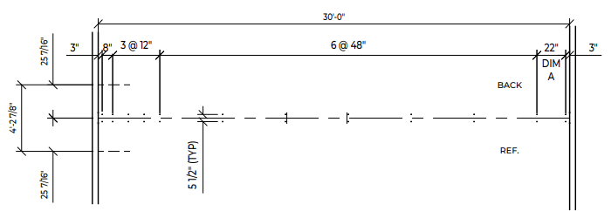
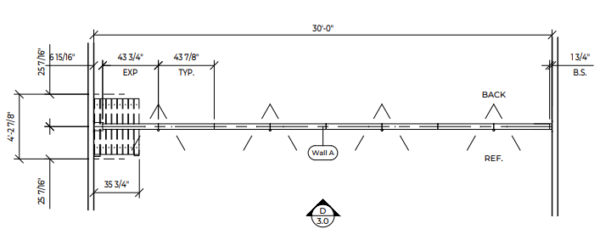
Suspension Systems
Structural Requirements
Coordinate operable partition hole-punching diagram so hanger rods are properly spaced per manufacturer’s recommendations

Slide 36
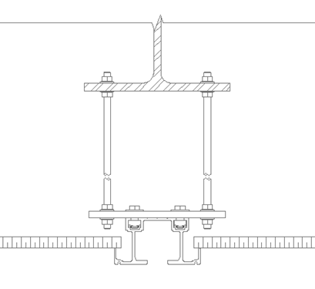
Coordination with Surrounding Trades
HVAC
Partition location, especially the stack area, needs to be clear of main truck lines.
Anywhere there is a hole to be punched needs to be free of ductwork.
Track should be installed directly after steel supports.
Support Structure
Clearance between connection to structure and ceiling height
needs to be per manufacturer’s recommendation, typically 12”
+/- 12”

Slide 37
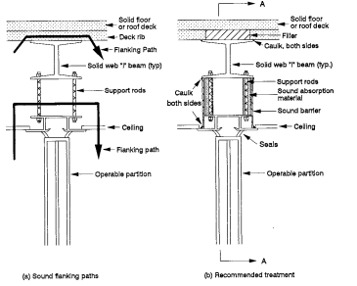
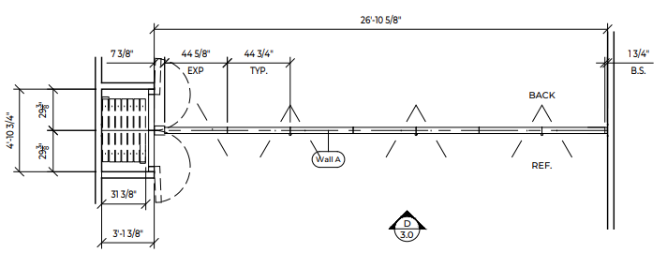
ASTM E 557
Ceilings / Bulkheads
Track to be installed prior to acoustical bulkheads and ceiling installation.
Ceilings should not be anchored to track system.
Soffits should be designed slightly higher than the track for panel operation as well as pocket door swing clearances

Slide 38
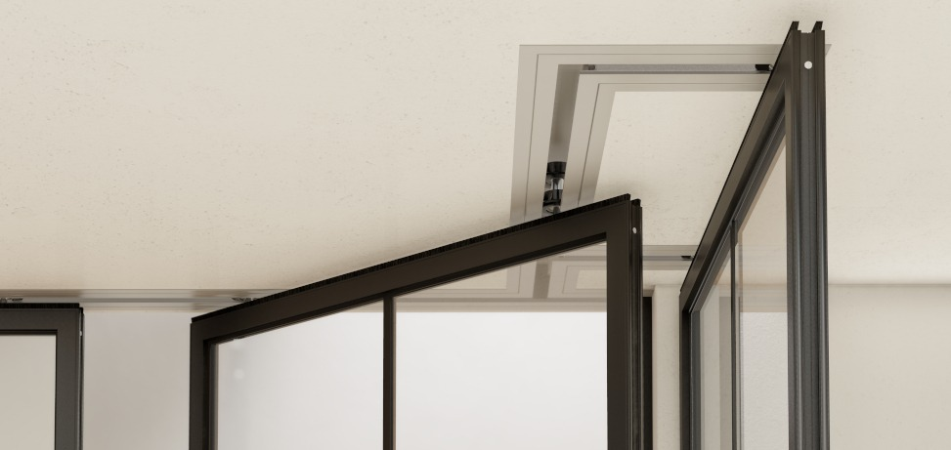
ASTM E 557
Fire Sprinklers & Lighting
Fire suppression sprinkler heads should not be designed within operating clearances of panels.
48” on track center for hinged pairs.
6” on track center for individual panels (except at intersections, consult with manufacturer).
Located outside pocket door swing clearances.

Slide 39
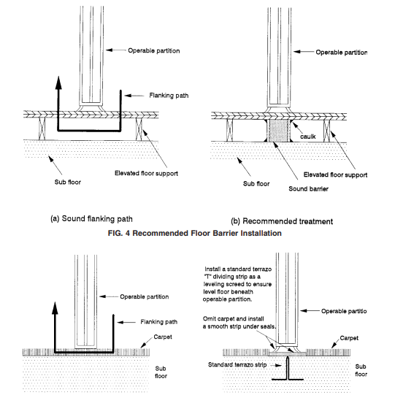
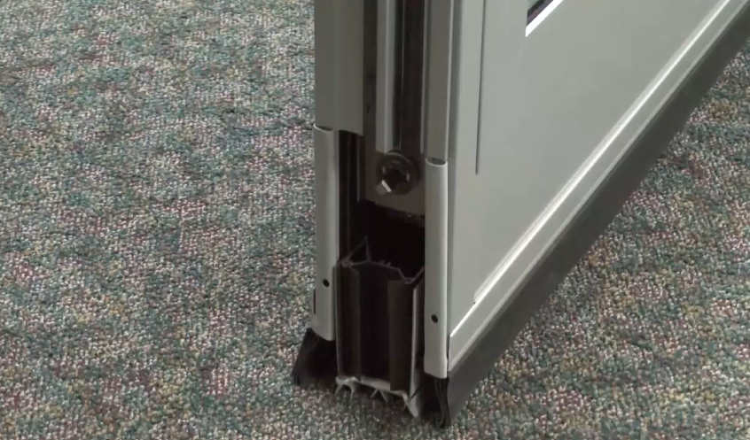
ASTM E 557
Flooring
Floor leveling 1/8” over 12’ non accumulative
Flanking path corrections

Slide 40
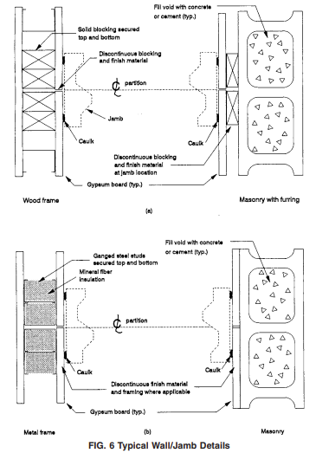
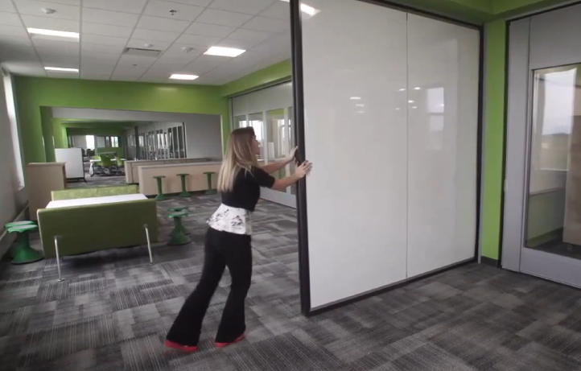
ASTM E 557
Walls
Backing for strength and anchoring
Flanking path corrections

Slide 41
Section 3: Writing Specifications

Slide 42
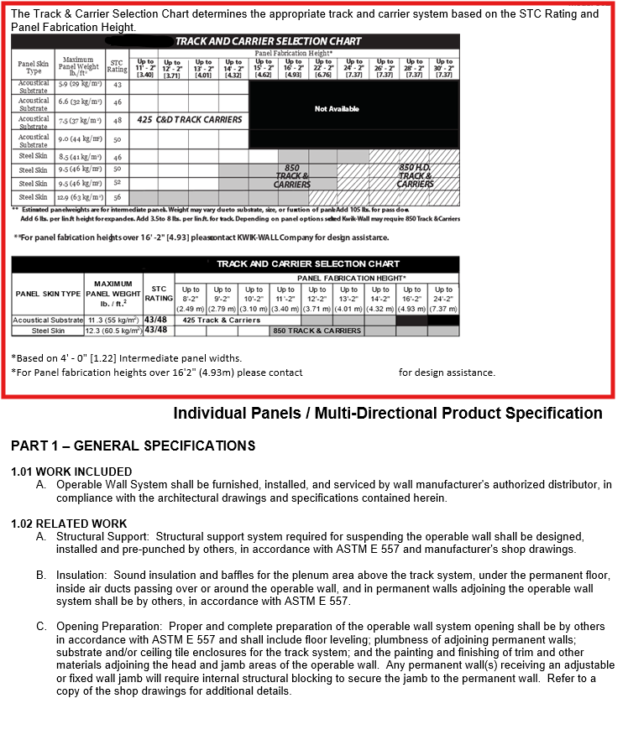
Specification Formatting
CSI 3-part Spec
Look for or request and Introduction or Guide to the specification, so you know how to read and use it.
Bullet Specification
STC rating
Panel thickness & weight
Track type (operation, not material)
Finish options
Options (pocket doors, pass-doors)
Closure method
Warranty duration
Key Elements to Understand
Face construction / Panel Skin: Steel or Gypsum
Seals: Fixed or Operable
Operable: Adjustable, Manual or Automatic
Closure: Final piece that finalizes panel set up
Finishes: Vinyl covered fabric is vinyl. Fabric is fabric
Suspension rollers: Carrier or Trolley
Track Material: Steel or Aluminum

Slide 43
Specification Performance Benchmarks – Operable Partitions
Acoustical Performance
STC 40–44 – Basic meeting rooms
STC 45–49 – Offices, classrooms
STC 50–54 – Hotel ballrooms, high-end corporate spaces
STC 55–56 – Conference centers, training facilities, privacy-sensitive Test Standard: ASTM E90 (Lab), ASTM E413 (STC Calculation), ASTM E336 (Field Testing – optional)
Panel Construction
Aluminum or steel frame, welded or bolted
Steel face with acoustical substrate or no steel
Panel Thickness: Typ, 3”–4.25”
Panel Width: Typ, 24”–48” depending on layout and stacking
Panel weight: correlated with STC rating. High STC = Heavy panels. If panel weight does not correlate, investigate!

Slide 44
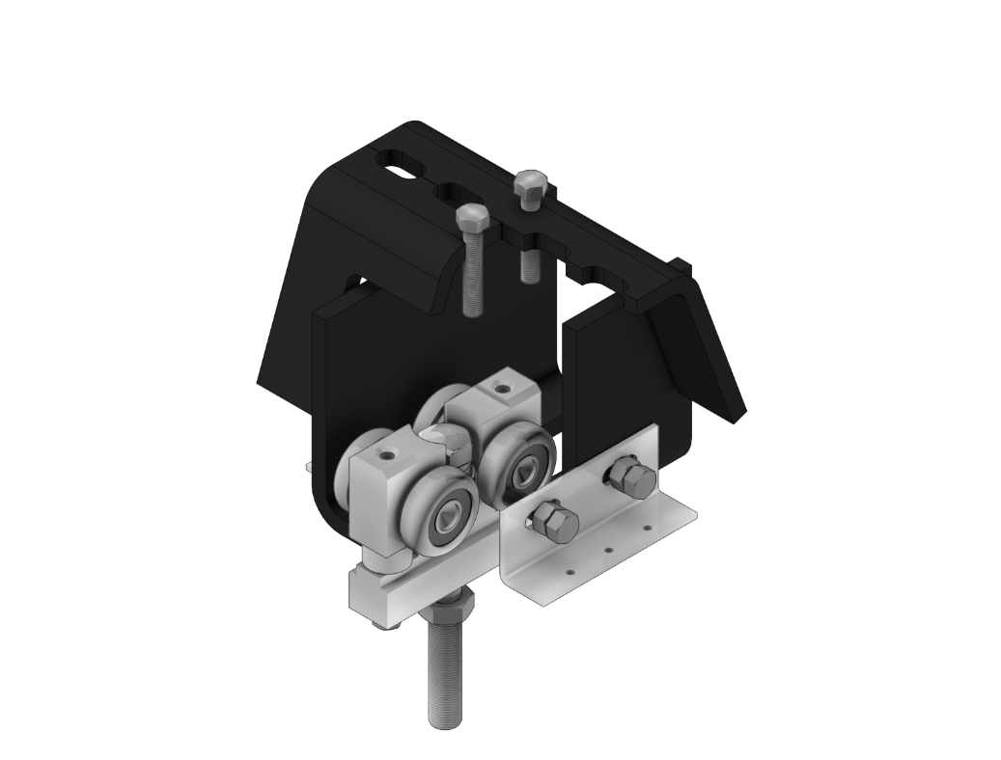
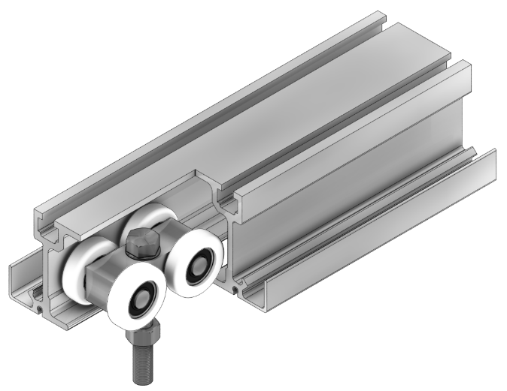
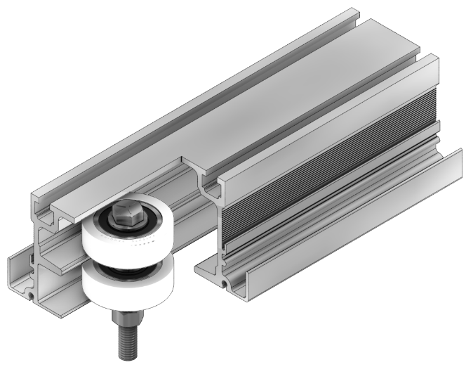
Specification Performance Benchmarks – Operable Partitions
Track Systems
Extruded aluminum
Extruded aluminum with steel raceway
Structural steel tube
Roll-formed steel
Hinged Pairs & Curve/Divert
Standard Duty
+/- 500 lbs
Multi-Directional Individual Panels
Medium Duty
+/- 800 lbs
Hinged Pairs, Individual, & Curve/Divert
Heavy Duty
+/- 3,000 lbs

Slide 45
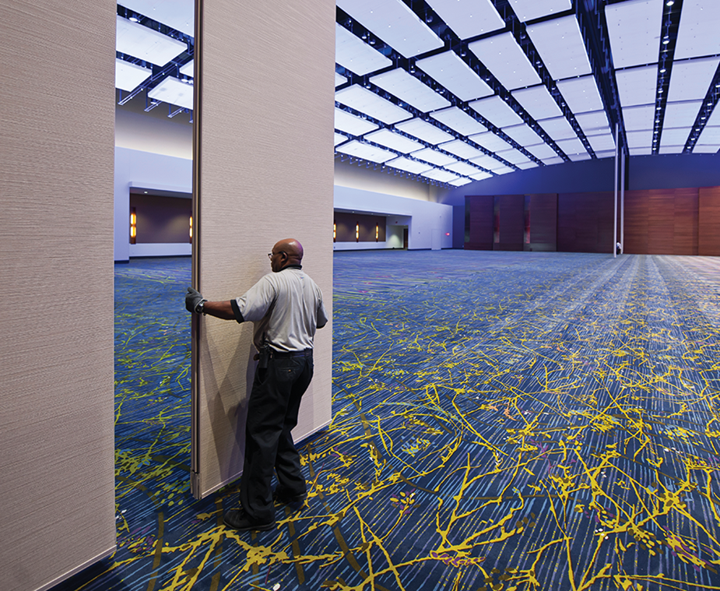
Specification Performance Benchmarks – Operable Partitions
Operation
Manual push/pull
Push button/key electrically operated
Stacking configuration (individual or hinged pairs)
Seals and Closures
Top/Bottom Seals: fixed sweeps/bulbs or retractable
Vertical panel to panel seal, interlocking astragals
Initial closure: wall jamb or bulb seal
Final closure: telescoping expanding panel or hinged panel
Finish Materials
Vinyl, fabric, HPL, carpet, whiteboard, tackboard, wood veneer
Class A per ASTM E84
Warranty
1 year standard, 5-10 year on for premium products

Slide 46

Specification Performance Benchmarks – Operable Partitions
Basis of Design Language
Allow substitutions if they meet or exceed defined performance and design criteria:
STC rating
Panel thickness & weight
Track type (operation, not material)
Finish options
Options (pocket doors, pass-doors)
Closure method
Warranty duration
Avoid the risk of proprietary language by not specifying a manufacture's uniqueness disguised as performance.
Good Example: “Track type should overhead support, multi-directional.
Bad Example: “Track type to be made of roll-formed steel”
To protect performance integrity without locking out fair competition:
Specify tightly (performance, aesthetics, acoustics)
Allow pre-bid vetting
Disqualify vague or incomplete alternatives

Slide 47

Specification Performance Benchmarks – Operable Partitions
Most Common Testing Standards
ASTM E 90: Standard Test Method for Laboratory Measurement of Airborne Sound Transmission Loss of Building Partitions and Elements
Sound Transmission Class (STC)
Most widely accepted and used method for acoustical performance of operable partitions
ASTM E 413: Laboratory Test Result from which ASTM E90 is performed
ASTM E 336: Standard Test Method for Measurement of Airborne Sound Attenuation Between Rooms in Buildings.
Noise Isolation Class (NIC)
Field test which typically performs 8-10 points less than STC lab test.
ASTM E 84: Standard test method used to evaluate surface burning characteristics for flame spread and smoke development.
Class A is standard.
ASTM E 557: Architectural application and installation of operable partitions.
How the surrounding construction should be designed and installed.
American Society for Testing and Materials

Slide 48
Section 4: Best Practices – Submittal Review

Slide 49
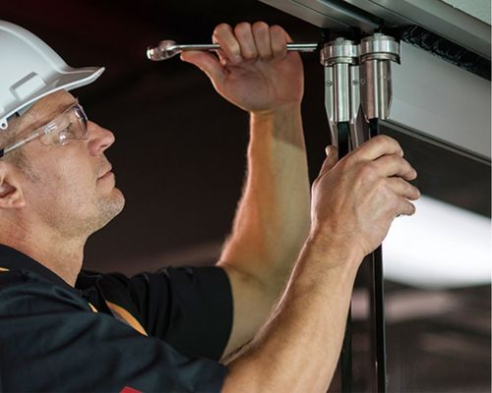
Submittal Checklist & Jobsite Review – Operable Partitions
Checklist and Jobsite Review
Spec Compliance
STC rating
Panel thickness & weight
Track type & installation height
Finish options
Options (pocket doors, pass-doors)
Closure method
Warranty duration
Clearances, stack dimensions, anchoring methods
Coordination with MEP
Face material finish samples

Slide 50
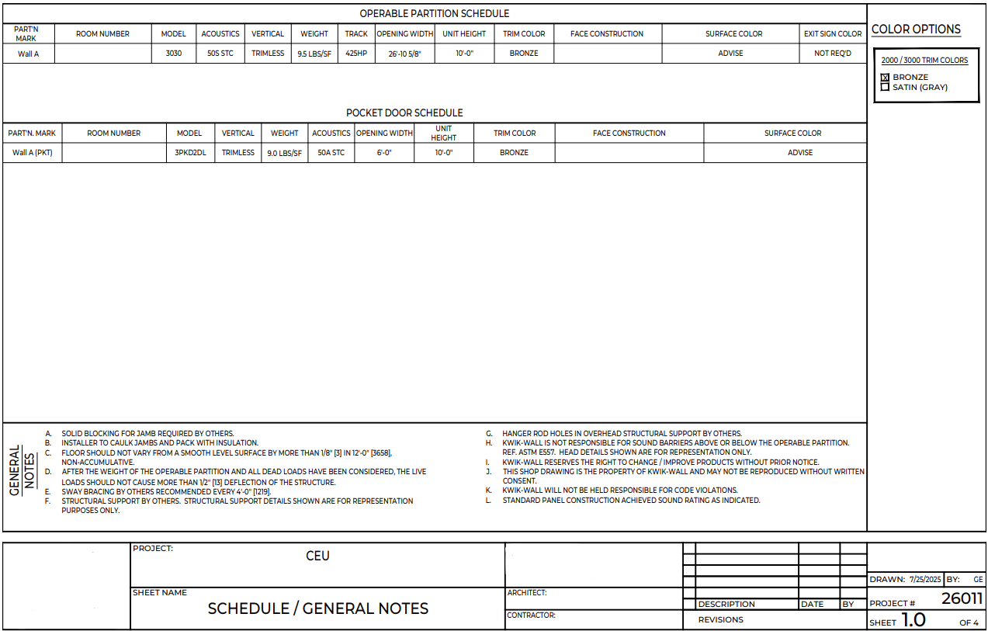
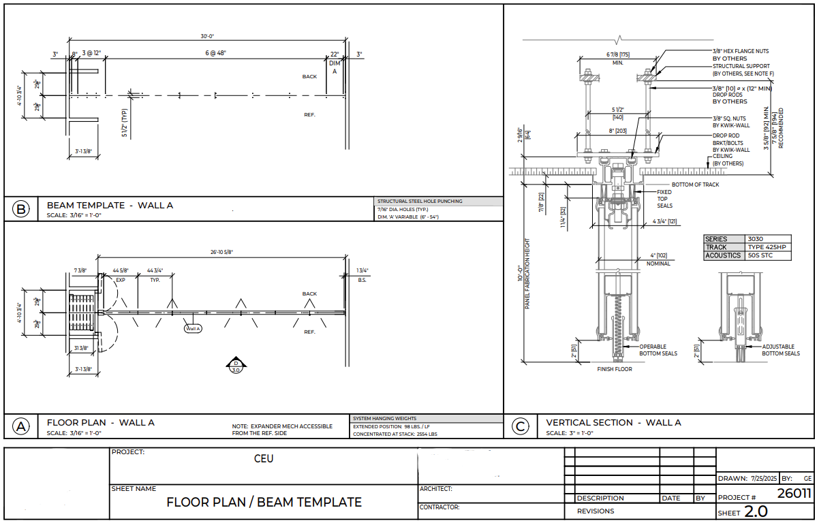
Shop Drawings Review – Operable Partitions
What To Look For
Project Document Compliance
Correct layout & stack configuration
STC
Responsibility of work (structure)
Approximate opening size
Quantity of partitions
Options:
Pass-door location and swing
Exit sign
Marker board location and height
Top and bottom seal types
Room Egress
Exclusionary notes

Slide 51
Section 5: Recap & Resources

Slide 52

Conclusion – Operable Partitions
Key Takeaways
Choose the right partition type based on function and performance
Design coordination is key to operability and code compliance
Specs should be clear but flexible enough for bidding
Thorough submittal review prevents costly field changes
Tools & Resources
Editable CSI Specs
STC guides, track and stacking diagrams
Local distributors

Slide 53
Thank You

Slide 54

Transforming Space Into
POSSIBILITIES
MOVABLE WALL SYSTEMS
Mastering Operable Partition Design & Specifications
Program 4650B
Credit: 1 LU/HSW
Kwik-Wall Provider # J426

Slide 55
Transforming Space Into
POSSIBILITIES
MOVABLE WALL SYSTEMS
Local Kwik-Wall Distribution Partner
Design | Bid | Installation | Service

Slide 56

Transforming Space Into
POSSIBILITIES
MOVABLE WALL SYSTEMS

Slide 57
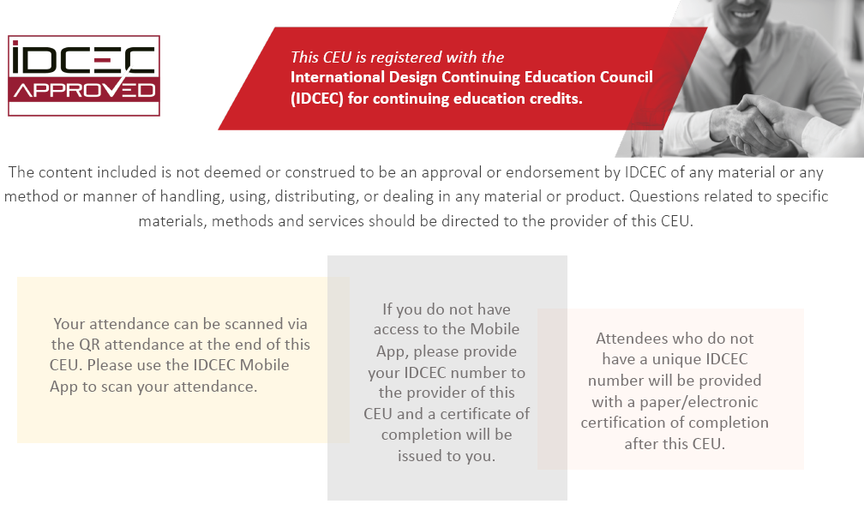
Transforming Space Into
POSSIBILITIES
MOVABLE WALL SYSTEMS

Slide 58
Transforming Space Into
POSSIBILITIES
MOVABLE WALL SYSTEMS
Mastering Operable Partition Design & Specifications
IDCEC Program: CEU-124353
Enter QR Code Here for IDCEC Credit

Slide 59
Transforming Space Into
POSSIBILITIES
MOVABLE WALL SYSTEMS
Local Kwik-Wall Distribution Partner
Design | Bid | Installation | Service

